Slide 1
Create a Groundwater Model
Hallsdale-Powell Utility District

Slide 2
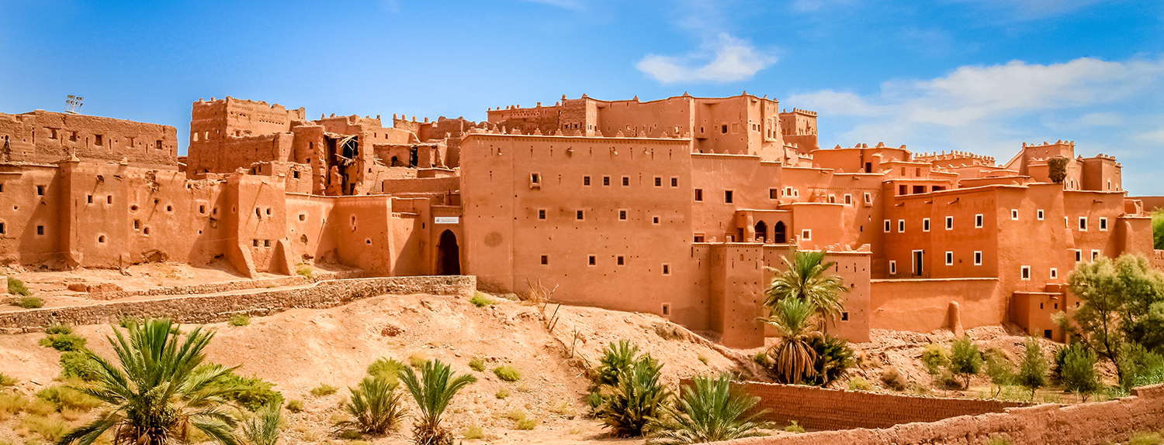
Think About it
Where do you think your water comes from?
Where do people living in the desert get their water?
Image: https://elevatedestinations.com/itineraries/morocco-ancient-landscapes-desert-cities/

Slide 3
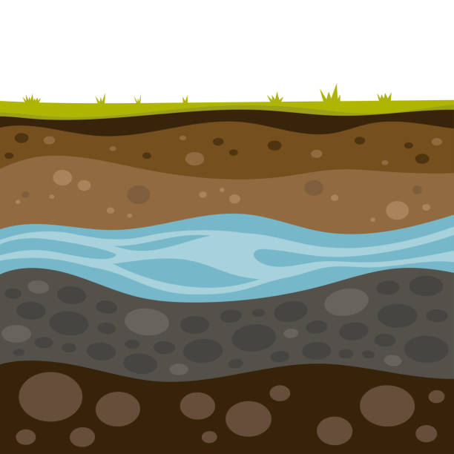
What is Groundwater?
Many communities use groundwater as a drinking water supply. That means the water comes from the ground beneath your feet!
About half the people in the United States use groundwater as their primary water supply.
Image: https://www.istockphoto.com/photos/groundwater

Slide 4
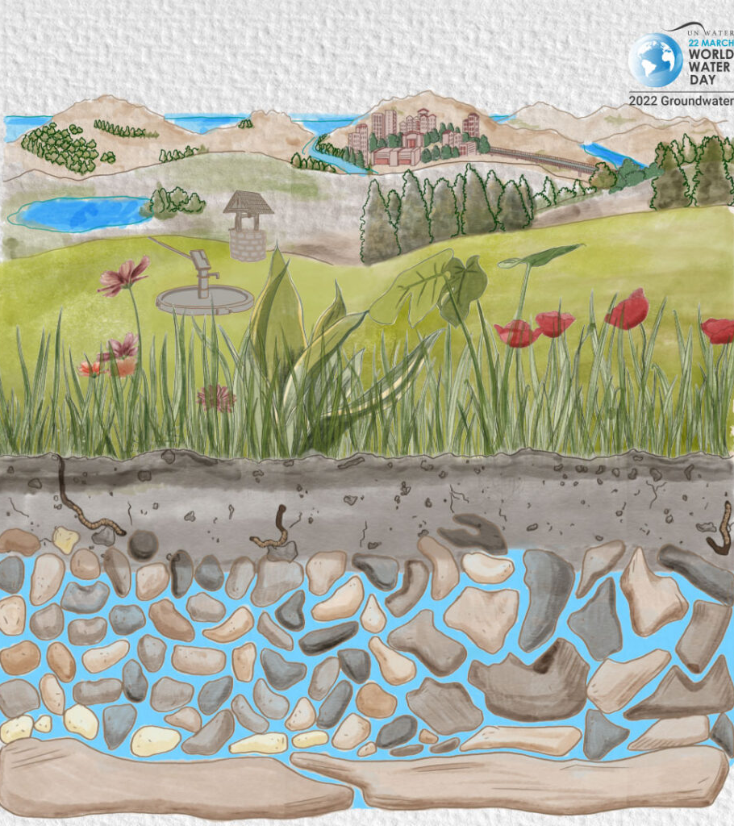
What is Groundwater?
Often the water is stored in the spaces between the sand, silt, and clay underground.
When precipitation seeps into the ground, it sinks due to gravity and collects in the spaces between the sand, silt, and clay particles, and in cavities and fractures in the bedrock.
Groundwater is also flowing slowly underground where it can seep into streams, rivers, lakes, wetlands, or oceans.
Image: https://aquavitallc.com/world-water-day-2022/

Slide 5
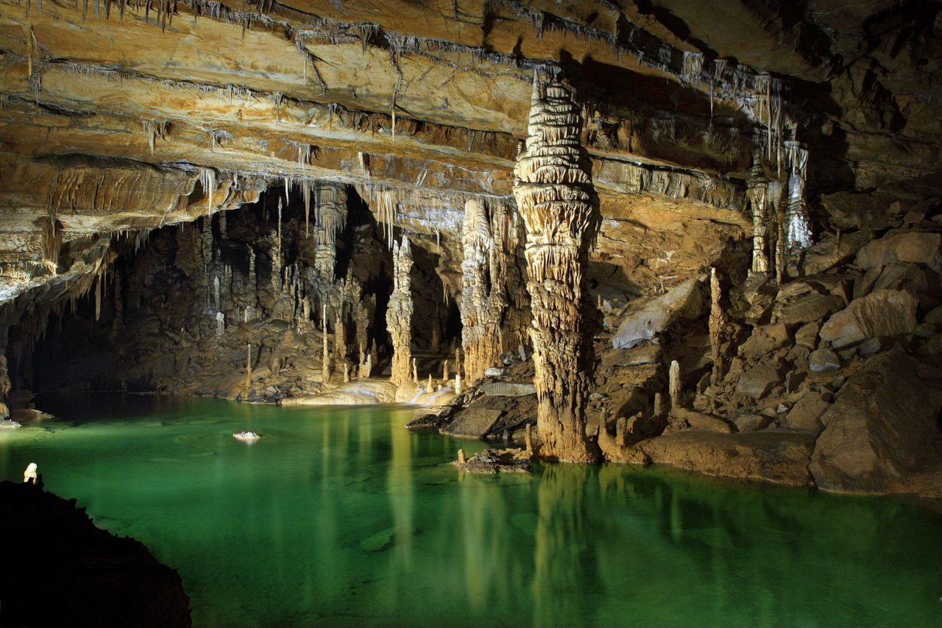
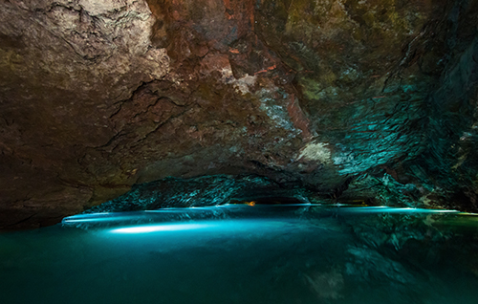
Who has been to either of these places? They exist thanks to groundwater!
Mammoth Cave National Park
Lost Sea Adventure
Image: https://biolime.com/mammoth-cave-its-surprising-kinship-with-biolime/
Image: https://thelostsea.com/daily-tours/

Slide 6
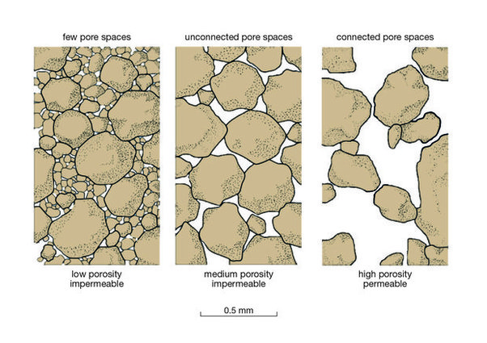
How does water get underground?
There are a few conditions that are needed for groundwater to form: 1 – Porosity: amount of space available to hold water 2 – Permeability: ability of a material to let water pass through
If the soil has large, interconnected pre space, fractures, and/or rock cavities, it creates a perfect spot for water to live underground!
Image: https://www.quora.com/How-do-you-describe-the-porosity-and-permeability-of-clay

Slide 7
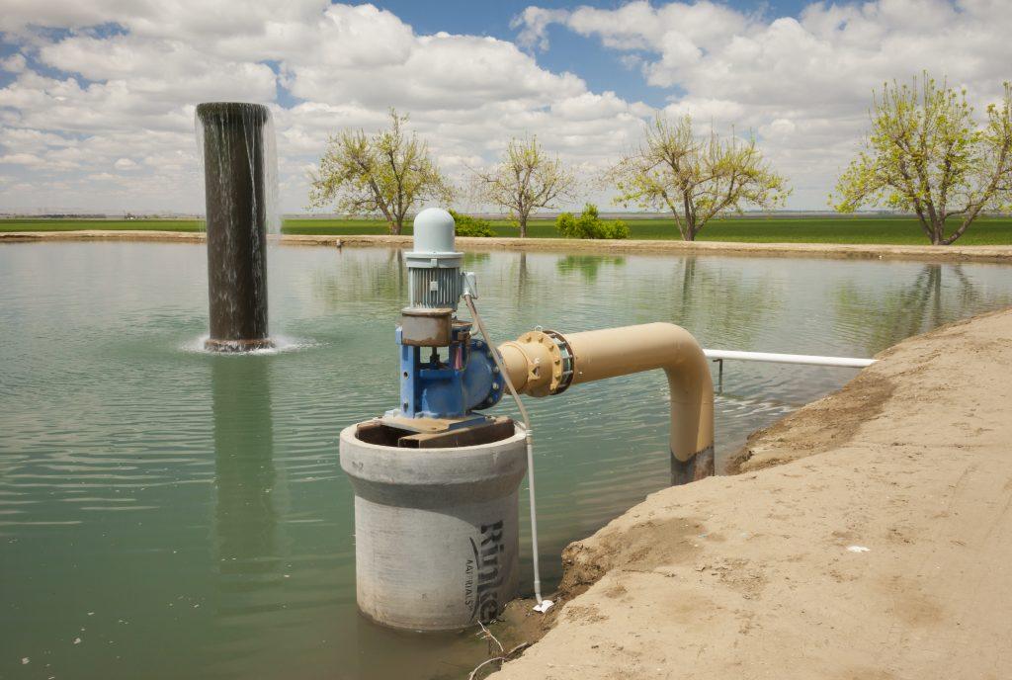
How do we get the water out?
Sometimes groundwater flows naturally to the surface through a well
Most of the time, the water needs to be pumped out.
Image: https://www.pbs.org/newshour/science/global-groundwater-disappears-rice-wheat-international-crops-may-start-vanish

Slide 8
Let’s Build our Model!
First, let’s take a look at the 4 materials you’ll be using.
Look at each of the materials and write your observations down on your worksheet, such as what it looks like, feels like, etc. (#1)

Slide 9
Let’s Build our Model!
With your group, decide on the order you’d like to put the materials in. You can choose any order you’d like! Write down the order of layers on your worksheet (#2).
Once you’ve decided, create your model using the following guidelines: The sand and gravel layers should be 40-60 mL thick The silt and clay layers should be 20-40 mL thick

Slide 10
What Happens with A Light Rain?
Let’s find out!
Pour 20 mL of the blue colored water gently over your model.
Observe very carefully what happens. Play close attention to what happens as the water reaches the different layers.
Draw your observations on the left drawing!

Slide 11
How about a heavy Rain?
Let’s find out!
Pour 20 mL of the blue colored water quickly over your model.
Observe very carefully what happens. Play close attention to what happens as the water reaches the different layers.
Draw your observations on the right drawing!

Slide 12
How do we get the water out of the ground?
Next, we’ll figure out what happens when we try to drill a well into our model to get the water out.
Squeeze the bulb of your pipet and, keeping it squeezed, place the pipet over the center of your model and carefully push the pipet straight down until the tip has “drilled down” into the layers.
Now release the bulb of the pipet and see if you can extract any water!
Gently squeeze the bulb to push out the water into your cup.
Repeat several more times to try to get the most water possible. Who do you think can get the most water out?

Slide 13
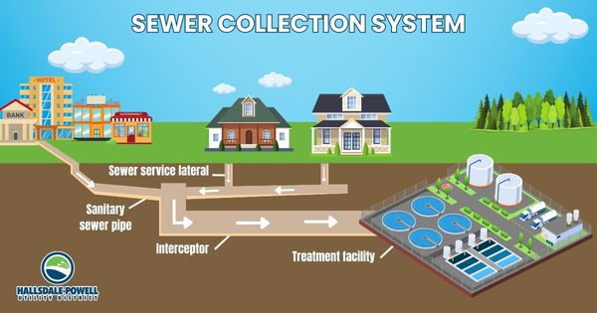
The Important work Of Hallsdale-Powell Utility District
Did you know all water you use at home and at school is sent to a wastewater treatment plant in Powell?
At the plant, we treat wastewater to ensure it’s clean before being put back into Beaver Creek.

Slide 14
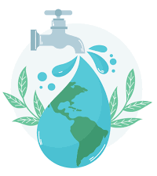
The Important Work of Hallsdale-Powell Utility District
Even though we do not get our water from the ground here, the water we treat is sent back into the environment where it could become groundwater.
It’s essential that we keep the water clean to protect the environment and maintain public health.
Image: https://www.komodowater.org/page/2/

