Slide 1
Game of Pipes
Hallsdale Powell Utility District

Slide 2
What are some ways that you used water today?

Slide 3
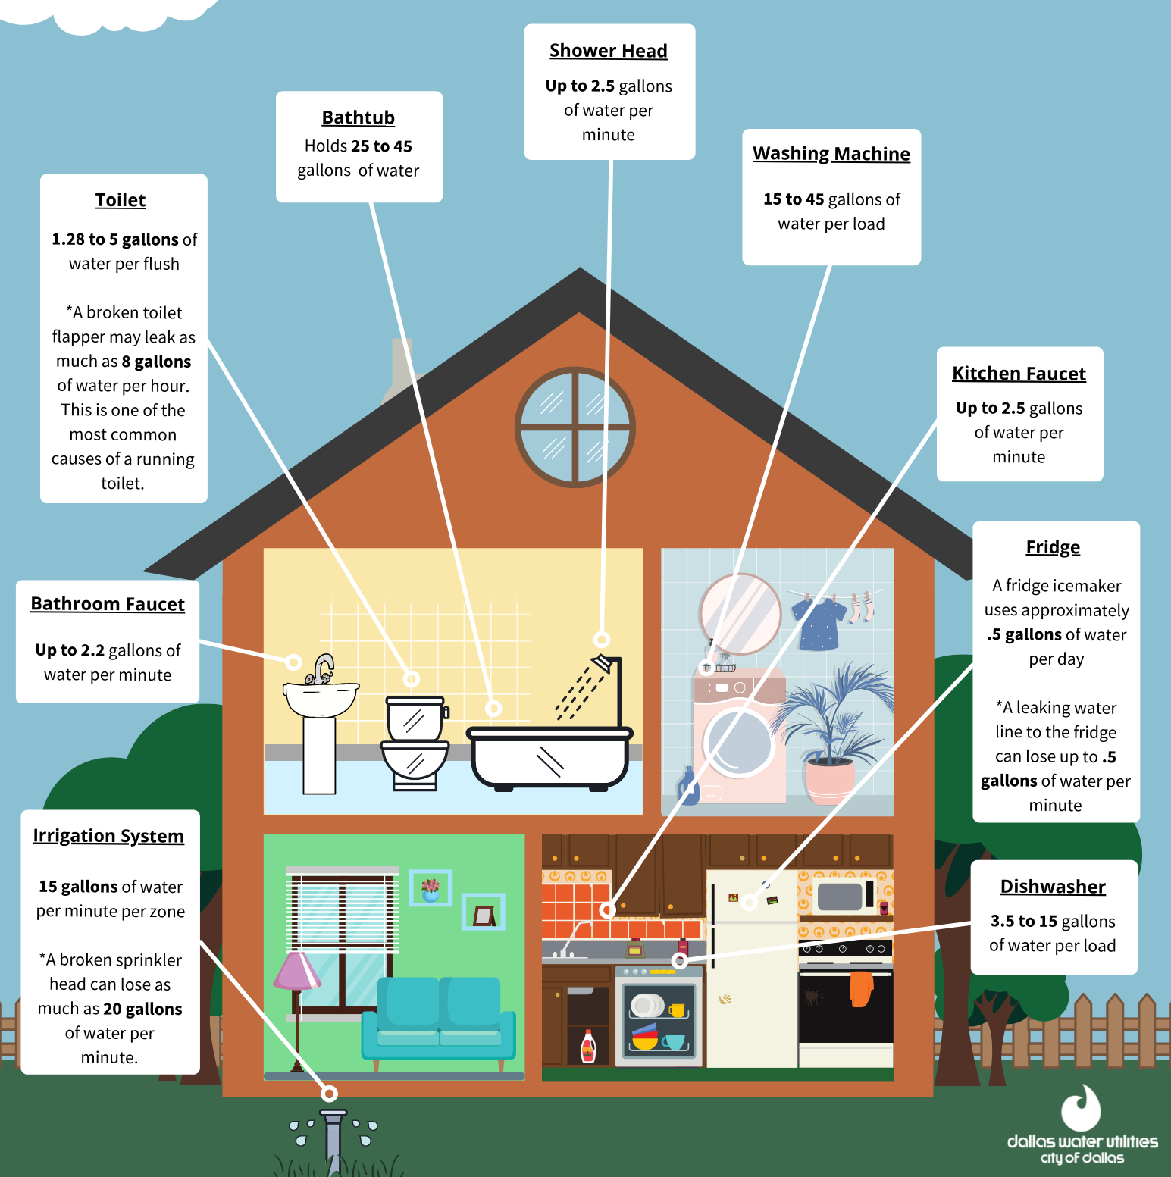
Image: https://dallascityhall.com/departments/waterutilities/Pages/Typical-Residential-Water-Use-Tool.aspx

Slide 4
What would life be like without water?

Slide 5
Today, you’ll play a game!
The goal? Use as little water as possible!
Select a game piece and begin at “Start.”
Each player starts with 500 gallons of water. (Your teacher may adjust this.)
Roll the die and move the designated number of spaces.
Using the number in the space, refer to your action list to determine how many of gallons of water to add or subtract and which move to make next
Pass the die to the next player.
How to Win: Be the first to make it to Blue Plains Advanced Wastewater treatment Plant. - Or -- Have the most gallons of water left at the end of the game.

Slide 6
Follow Up Question
What can you do to reduce the amount of water you use daily?

Slide 7
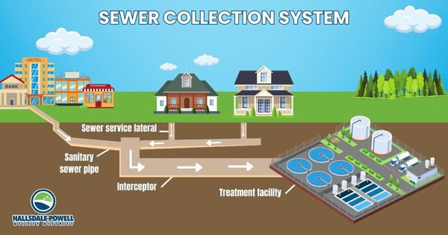
The Important Work of Hallsdale-Powell Utility District
Did you know that all the water you use in your homes and at school goes to the wastewater treatment plant in Powell?

Slide 8
The Important Work of Hallsdale-Powell Utility District
Every day, millions of gallons of used water flow into the wastewater treatment plant. It is crucial that the water is treated before being released back into the nearby Beaver Creek. Water is treated before it enters your home and after it leaves. This ensures that we have safe, clean water and that we protect the environment.
Image: https://www.komodowater.org/page/2/

Slide 9
Link: https://www.youtube.com/watch?v=zNdbj3PbX6o
Notes:
https://www.youtube.com/watch?v=zNdbj3PbX6o

