Slide 1
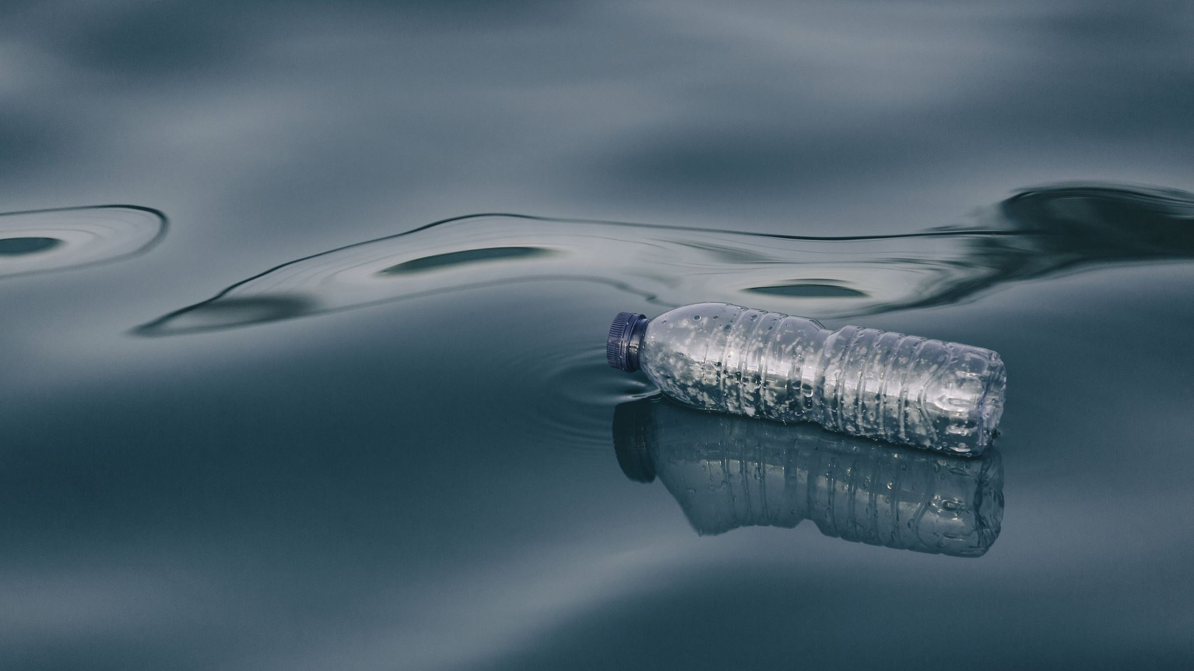
How Much Water Do You Use?
Hallsdale-Powell Utility District

Slide 2
What are some ways you used water today?

Slide 3
Image: https://www.geeksforgeeks.org/uses-of-water-in-daily-life/

Slide 4
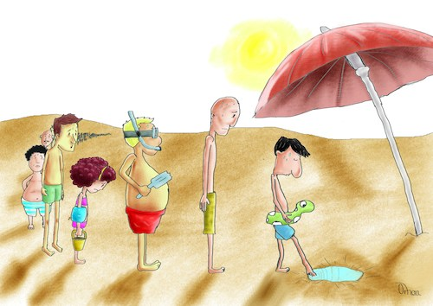
What would life be like without water?
Image: https://www.toonpool.com/cartoons/Life%20Without%20Water%202_342152

Slide 5
Today, you’re going to estimate how much water you think you use in a day!
According to the US Geological Survey, the average American uses 80-100 gallons of water per day!
Assuming the water drop on your worksheet represents 100 gallons of water, divide the drop according to the number of gallons you think you use in the following categories: brushing teeth, taking a shower, washing dishes, hand washing, drinking, laundry, flushing the toilet.

Slide 6
Answer Key
1 gallon drinking
2 gallons tooth brushing
15 gallons handwashing/faucet use
15 gallons washing dishes
20 gallons laundry
20 gallons flushing toilet
25 gallons taking shower

Slide 7
Follow Up Questions
How close were your estimates to the actual data?
What can you do to reduce the amount of water you use daily?

Slide 8
Link: https://www.youtube.com/watch?v=6yCAPAqXodc

Slide 9
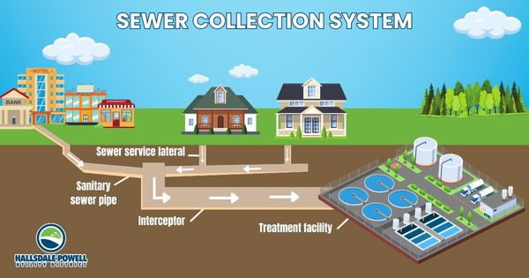
The Important Work Of Hallsdale-Powell Utility District
Did you know that all the water you use in your homes and at school goes to the wastewater treatment plant in Powell?

Slide 10
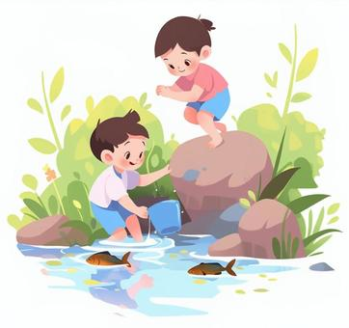
The Important Work Of Hallsdale-Powell Utility District
We use a lot of water every day, and we must clean it before releasing it into the environment.
After the water is cleaned, it is put into Beaver Creek, where you can play and enjoy the beautiful outdoors!
Image: https://en.ac-illust.com/clip-art/24103409/children-playing-in-the-river-during-summer-vacation

