Slide 1
Cholera Outbreak!
Hallsdale-Powell Utility District

Slide 2
What mysteries have you read or seen on TV?
How do detectives solve the crime?
Image: https://www.reddit.com/r/pokemon/comments/1719spk/detective_pikachu_is_back/

Slide 3
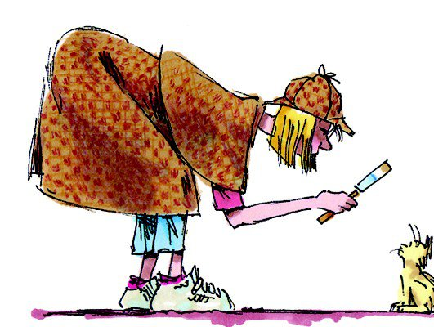
Let’s discuss serial crimes
Serial crimes, such as a series of burglaries, are crimes that are of a repetitive nature.
How would investigators track the culprit?
Image: https://fwtx.com/news/fort-worth/tracking-culprit/

Slide 4
Epidemiologists are just like detectives
Like detective work, epidemiologists, scientists who study disease, study clues to determine where an illness comes from and how and why it’s spreading.
Image: https://www.news-medical.net/health/Statistics-and-Epidemiology.aspx

Slide 5
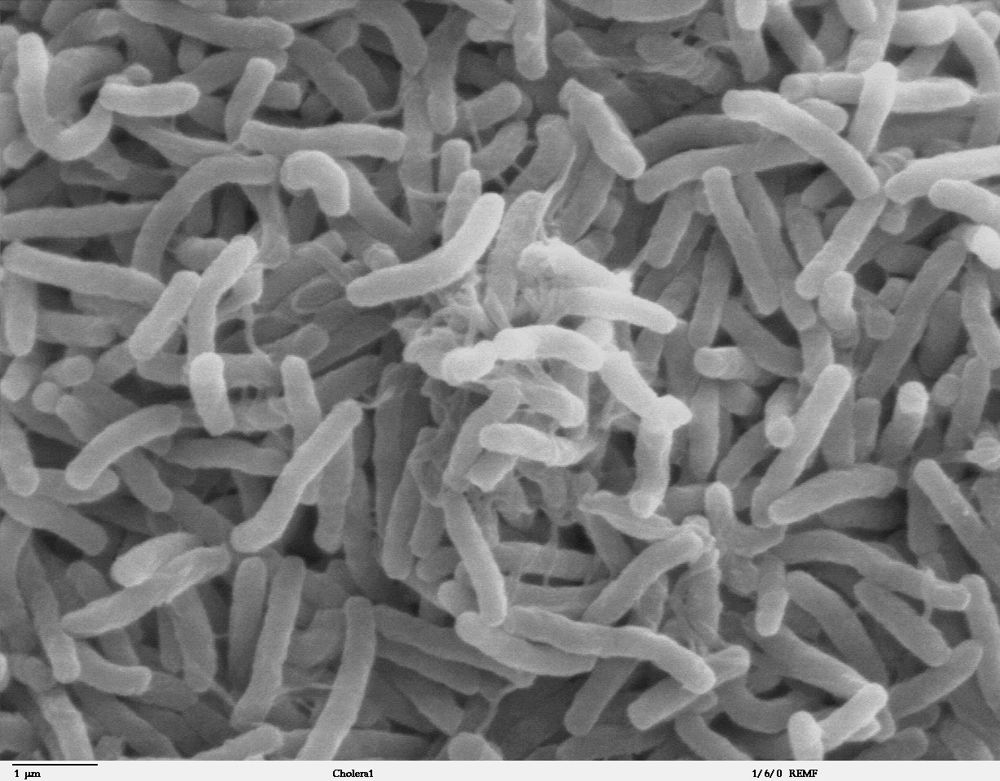
In 1854, a cholera epidemic broke out in the slums of London.
Cholera is a bacteria that causes vomiting, diarrhea, cramps, significant sweating, dehydration, and death in extreme cases
Image: https://en.wikipedia.org/wiki/Vibrio_cholerae

Slide 6
Dr. John Snow discovered the source and stopped the epidemic.
Today, you will be given the same information that Snow had in the 1850s.
Solve what’s causing the cholera epidemic!

Slide 7
Instructions
Working in your group, you will be handed the Broad Street Area Map and a set of the Victim Cards.
Mark where each of the victim cards took place on your map and highlight any similarities between them.
Determine the source of cholera on your map.

Slide 8
Instructions
Read each of the clue cards. Use them to confirm or revise your conclusion.

Slide 9
Clue Cards
The people living around Broad Street are poor. Large families are crowded into one- and two-room apartments. None has indoor plumbing; residents use outdoor toilets and haul their water from the nearest public pump.
Thomas Sutterfield fell ill two hours after visiting his great-aunt, Matilda. He had tea, biscuits, and sausages with his great-aunt. It was a hot day, and he drank cool water before leaving.

Slide 10
Clue Cards
Following his fight with another boy, Tolly Martin washed the blood off his mouth at the Broad Street pump and ran off with a sausage stolen from the butcher shop.
Matilda Wright refused to drink water from the faucets in her home. She would only drink the sweet-tasting water that her gardener hauled from the Broad Street pump.
Ausley and Marthy Brown and their two children are the only people on Ely Street who haven’t gotten cholera. Marthy’s family lives in Soho. The Browns haul their water from the Soho pump, which allows them to visit their relatives.

Slide 11
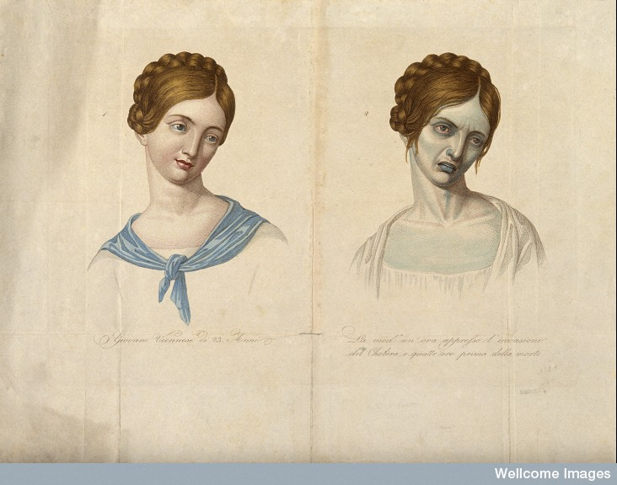
So, what is to blame?
It was the Broad Street water pump!
This activity is based on a real-life cholera outbreak that took place in London in 1854.
Cholera travels through untreated water contaminated by human or animal feces. It’s spread by sharing contaminated food or by eating contaminated food.
Cholera causes rapid dehydration, causing their skin to darken and shrivel!
Image: https://branchcollective.org/?ps_articles=pamela-k-gilbert-on-cholera-in-nineteenth-century-england

Slide 14
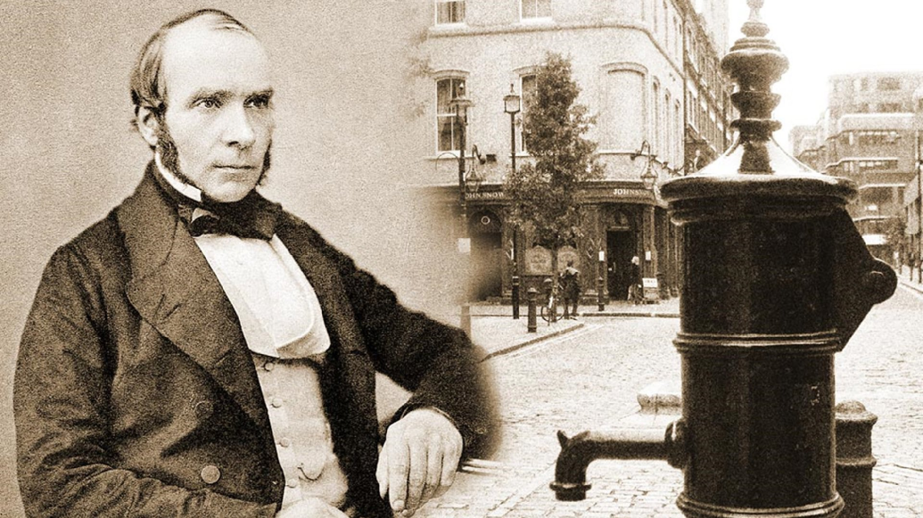
What Caused this Outbreak?
The water company at the time failed to adequately filter the river water to cut costs. Most of the upper-class citizens had indoor plumbing at this time and were not as affected as the lower-class citizens who relied on public water pumps.
Many people doubted Dr. Snow’s suggestion of removing the water pump but listened. Thankfully, it saved many lives!
Image: https://www.micropia.nl/en/discover/microbiology/john-snow/

Slide 15
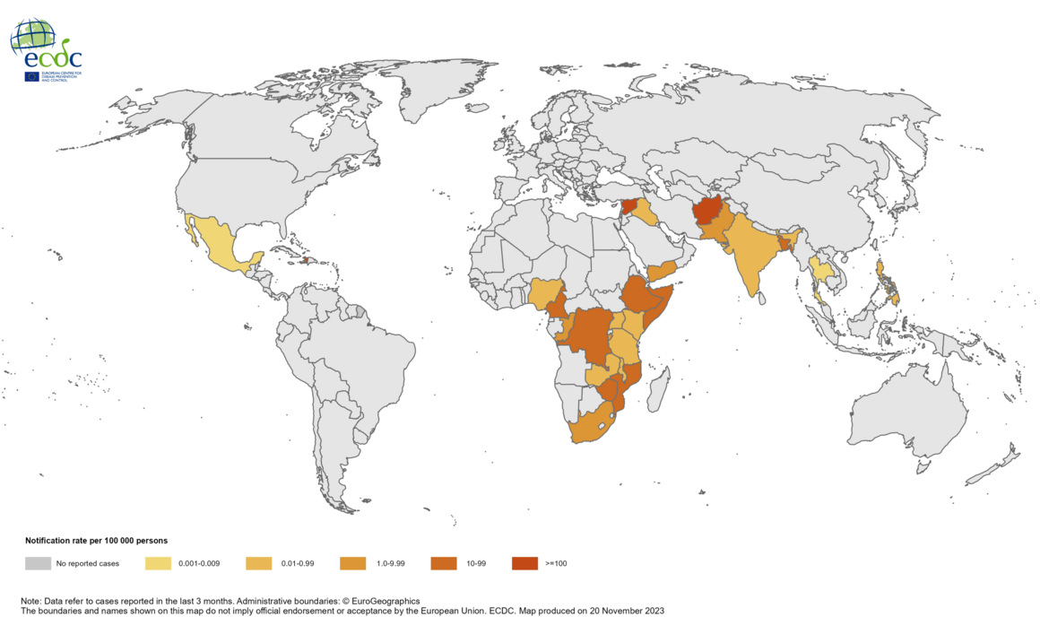
The Future of Cholera
Cholera has been absent from Western society for most of the 1900s but is common in low-income countries.
Today, nearly 1 billion people globally lack access to clean water.
Image: https://www.ecdc.europa.eu/en/all-topics-z/cholera/surveillance-and-disease-data/cholera-monthly

Slide 16
The Important Work of Hallsdale-Powell Utility District
HPUD treats water and wastewater to over 75,000 people in the Knoxville area.
Thanks to their essential work, we don’t have cholera outbreaks or other harmful waterborne diseases.

