Slide 1
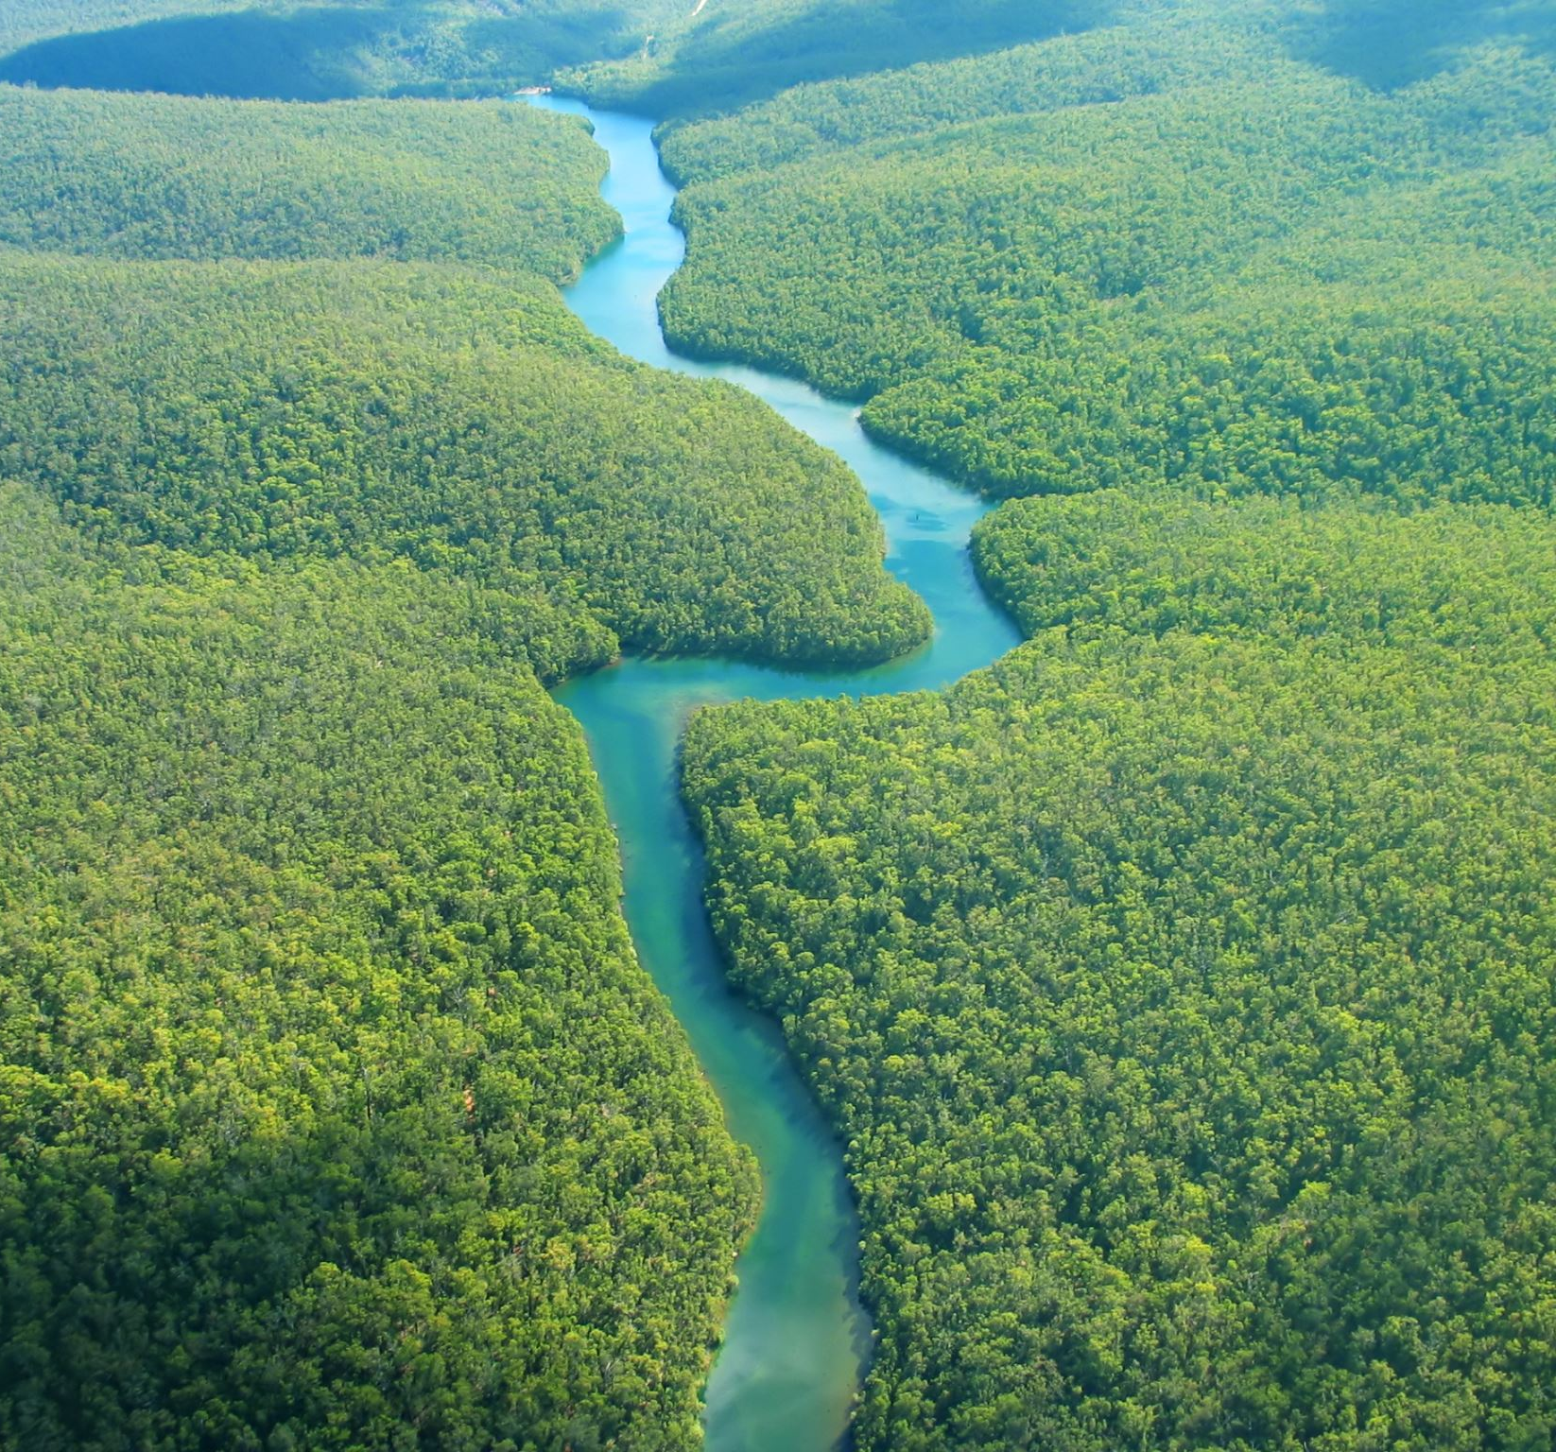
Discover the Waters of our National Parks
Hallsdale Powell Utility District 2024
Adapted from Discover the Waters of Our National Parks Project WET 2011

Slide 2
Which national parks have you visited?
Image: https://onechelofanadventure.com/12-most-beautiful-national-parks-in-the-usa/

Slide 3
Background on National Parks
National parks are designed to preserve the most special places in the United States.
They are available for everyone, not just for those with wealth and privilege.
The first national park was created in 1872. Which park do you think was the first?

Slide 4
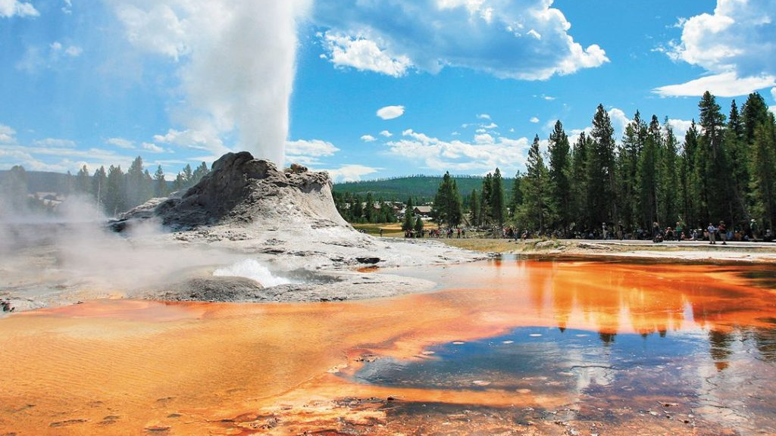
Yellowstone National Park
Yellowstone National Park was the first national park, created in 1872!
Why do you think America wanted to protect Yellowstone?
Image: https://www.moon.com/travel/national-parks/one-day-in-yellowstone-national-park/

Slide 5
Why National Parks?
National park system sites are diverse, with a wide range of plants, animals, landscapes, water features, and recreational opportunities.
Many parks provide habitat for threatened and endangered species.

Slide 6
Notes:
Optional video: 4:33 minutes

Slide 7
Water in National Parks
Water plays a huge role in our national parks.
What are some examples of water in our national parks?
Image: https://www.viator.com/Zion-National-Park/d5610

Slide 8
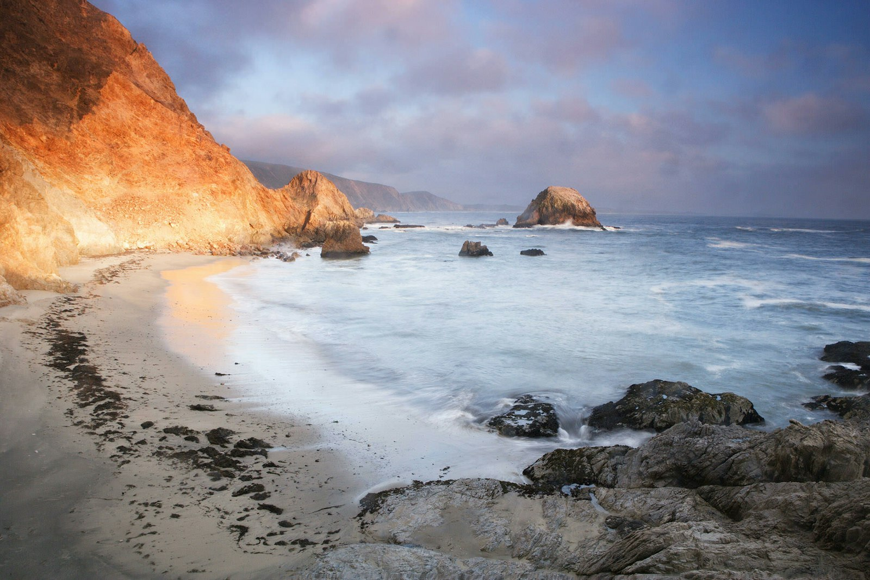
Water in National Parks
Some parks were created to protect and preserve unique water features, such as the tidal aquatic zones at Point Reyes National Seashore.
Image: https://www.nationalparks.org/explore/parks/point-reyes-national-seashore

Slide 9
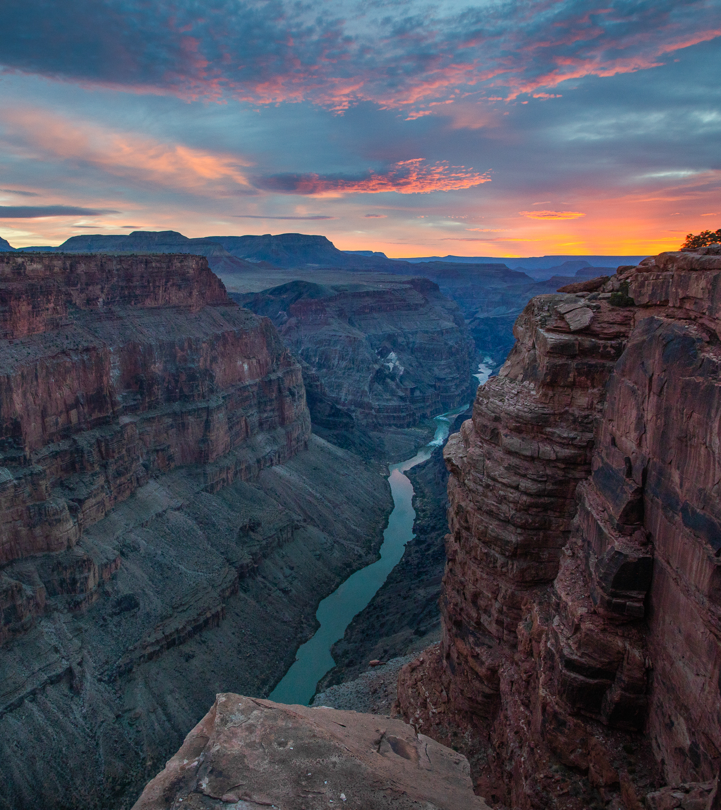
Water in National Parks
Other parks preserve landscapes shaped by water, such as Grand Canyon National Park, carved by the rushing Colorado River.
Image: https://www.americanrivers.org/river/colorado-river-in-the-grand-canyon-2/

Slide 10
Let’s take a Closer look at our national parks!
Image: https://morethanjustparks.com/list-of-national-parks-by-state/

Slide 11
Card #1 Yellowstone National Park
Image: https://www.cntraveler.com/story/yellowstone-national-park-guide

Slide 12
Card #2 Crater Lake National Park
Image: https://www.npca.org/parks/crater-lake-national-park

Slide 13
Card #3 Rocky Mountain National Park
Image: https://www.aarp.org/travel/vacation-ideas/outdoors/info-2020/rocky-mountain-national-park-guide.html

Slide 14
Card #4 Point Reyes National Seashore
Image: https://en.wikipedia.org/wiki/Point_Reyes_National_Seashore

Slide 15
Card #5 Everglades National Park
Image: https://ruggednation.com/blogs/adventure-outpost/destination-everglades-national-park

Slide 16
Card #6 Great Smoky Mountain National Park
Image: https://tennesseerivervalleygeotourism.org/entries/great-smoky-mountains-national-park/59cc164f-dbb8-42ed-9d83-f3e2f65eae61

Slide 17
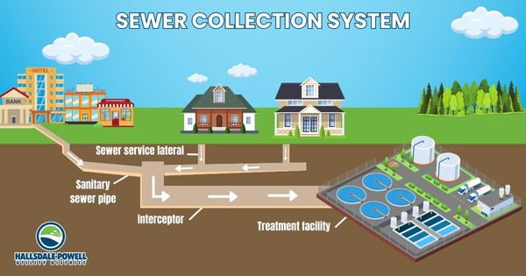
The Important Work of Hallsdale-Powell Utility District
Did you know that all water you use at home and school must be treated at a wastewater treatment plant?

Slide 18
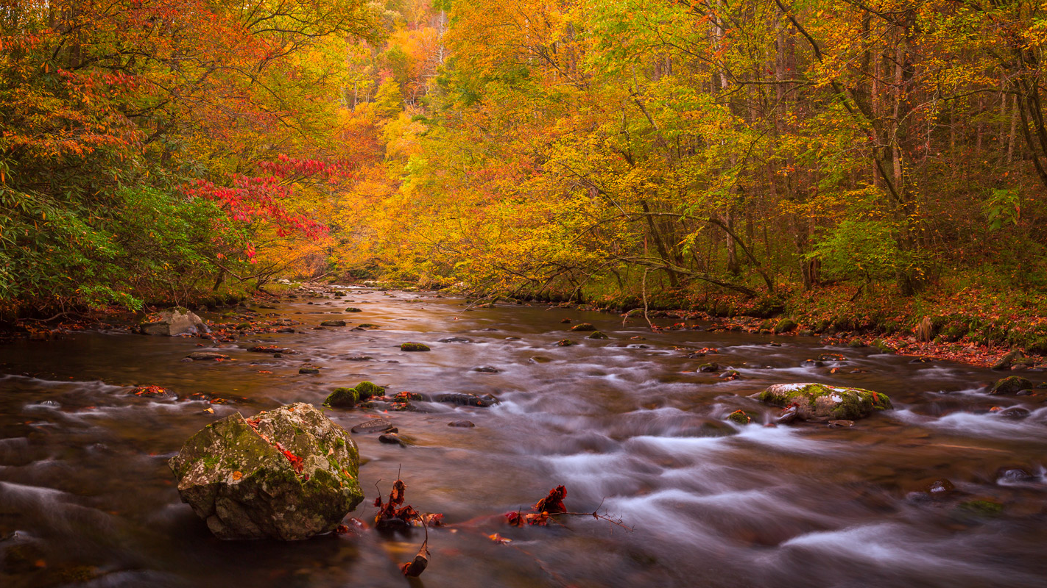
The Important Work of Hallsdale-Powell Utility District
Without wastewater treatment, our local waterways would be unhealthy and stinky. Thanks to the vital work done at wastewater plants to clean used water, water running through and shaping these beautiful national parks remains clean and protects the environment!
Image: https://www.josephfiler.com/gallery/smoky-mountains/

