Slide 1
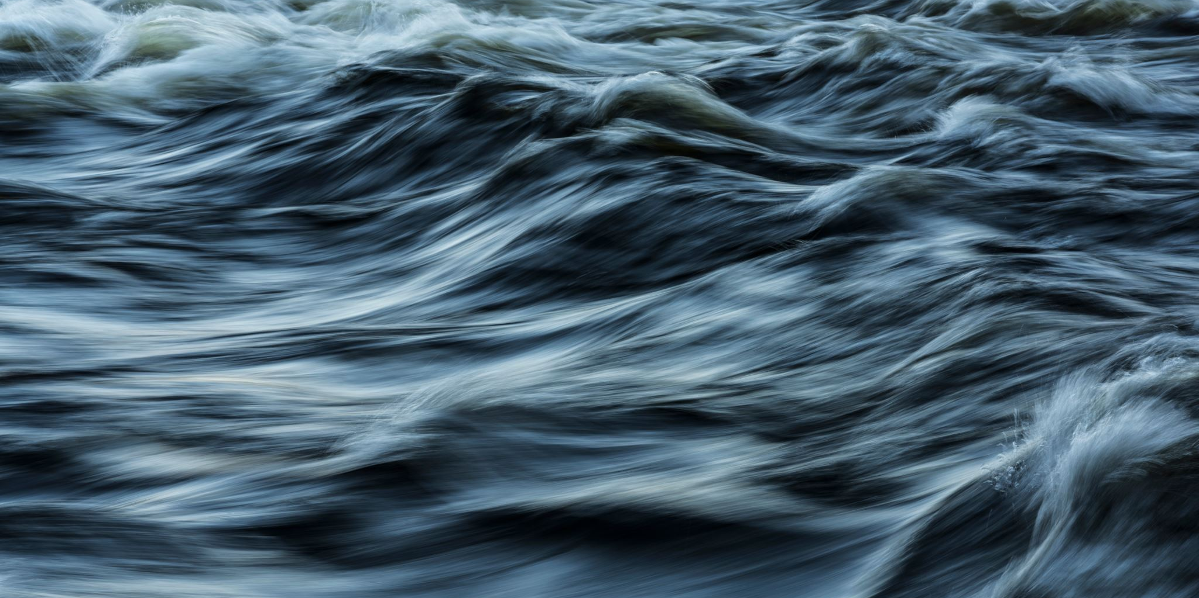
Water Power
Hallsdale-Powell Utility District

Slide 2
What ways can we use water as energy?
Image: https://investorplace.com/2024/06/3-renewable-energy-stocks-with-unstoppable-momentum/

Slide 3
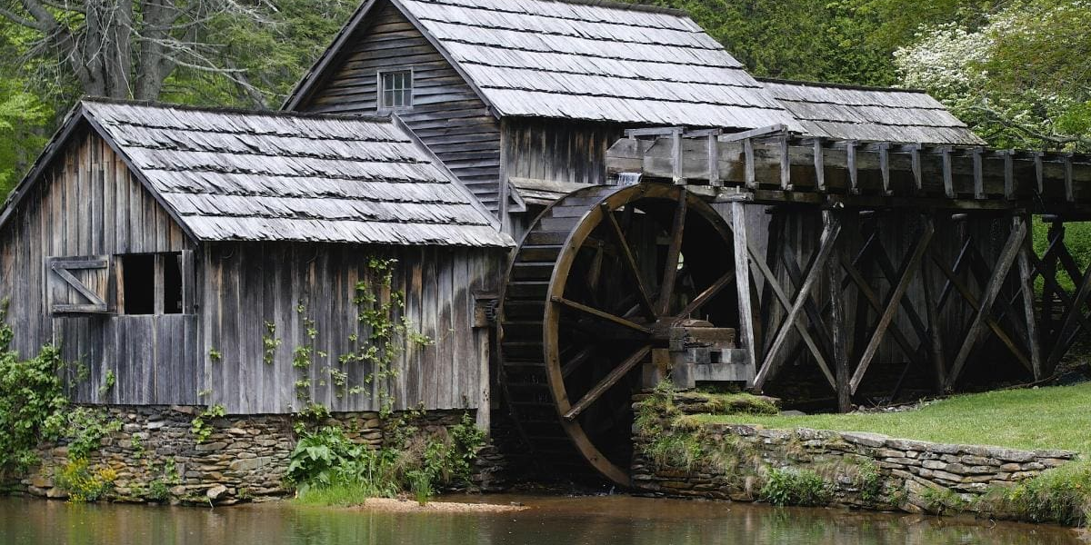
Water has been used as an energy source for 2,000 years! It was first used by early farmers to grind wheat into flour.
Image https://www.perkins.org/resource/building-water-wheel/

Slide 4
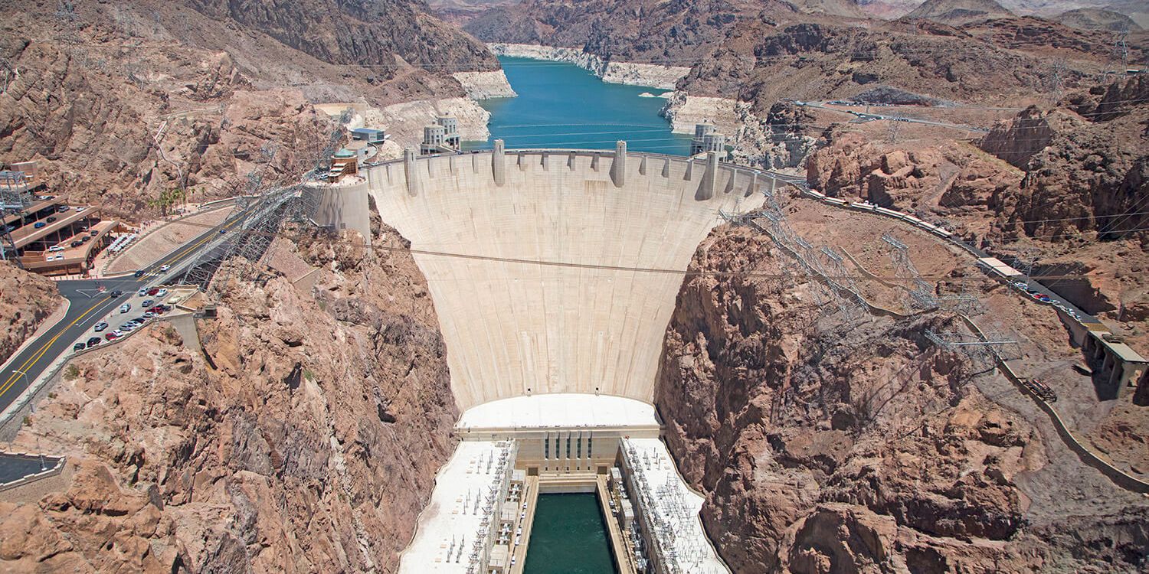
Since nature can produce water over and over again, what type of resource is it?
Image: https://travelnevada.com/hoover-dam/

Slide 5
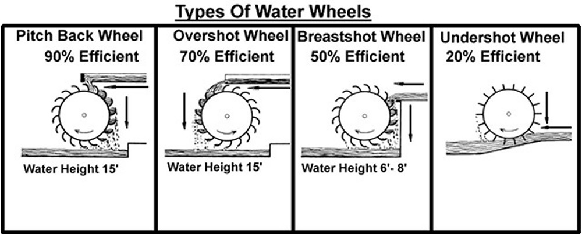
There are several different types of water wheels
Image https://richmondconspiracy.blogspot.com/2013/03/water-wheel-and-mill-basics.html

Slide 6
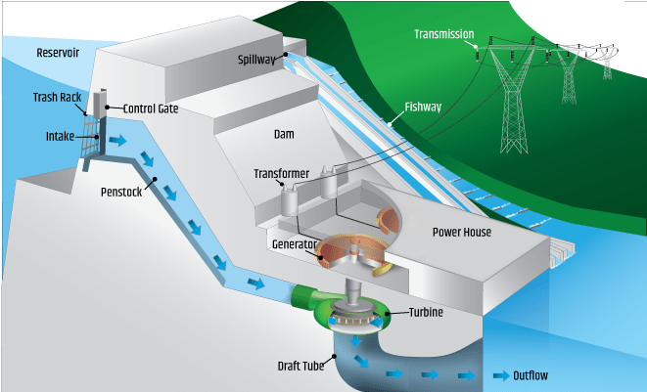
Dams use a similar technology on a much larger scale
Image: https://www.energy.gov/eere/water/types-hydropower-plants

Slide 7
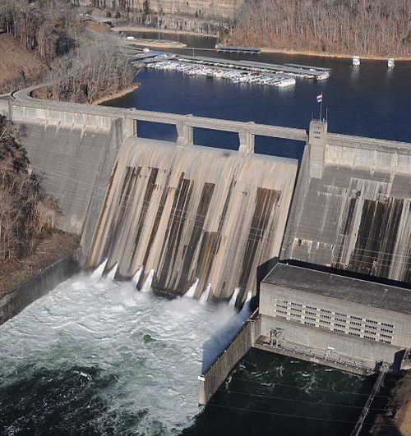
Did you know we have many dams in Tennessee?
Norris Dam was the first dam built by the TVA in 1936. It controls flood water and provides electric power to nearby towns.
It is 1860 feet long and 265 feet tall!
Image: https://livingnewdeal.org/sites/norris-dam-andersonville-tn/

Slide 8
What are some benefits to capturing energy using a renewable source?
Image: https://www.newsweek.com/navigating-new-frontier-renewable-energy-1872616

Slide 9
Notes:
https://www.youtube.com/watch?v=pEUzot8Zufo

Slide 10
Let’s create our own model!
Notes:
https://www.youtube.com/watch?v=nHGRcXD5SMM

Slide 11
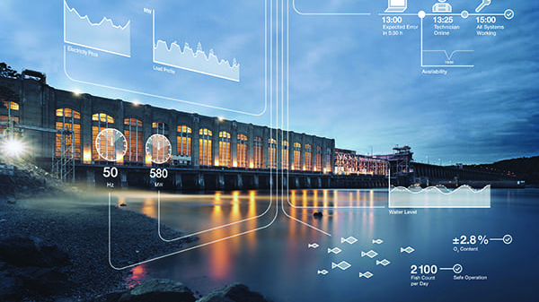
Great work engineers!
How could you have improved your model?
Image: https://www.powermag.com/iiot-and-the-future-of-hydropower/

Slide 12
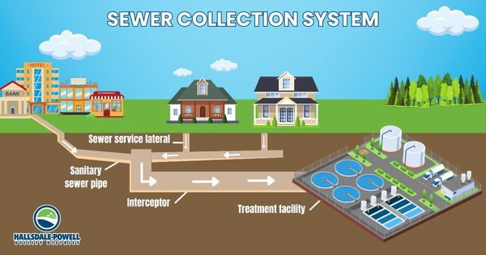
The Important Work of Hallsdale-Powell Utility District
Did you know that all the water you use in your home and at school goes to the wastewater treatment plant in Powell?

Slide 13
The Important Work at Hallsdale-Powell Utility District
Think of all the gunk you see on the side of the road. When it rains, trash and oil from cars on the road travel to the wastewater plant to make sure it doesn’t get into our local waterways!
Thanks to the efforts of local utility districts, the water in Tennessee lakes and rivers stays clean, so you can enjoy them!

