Slide 1

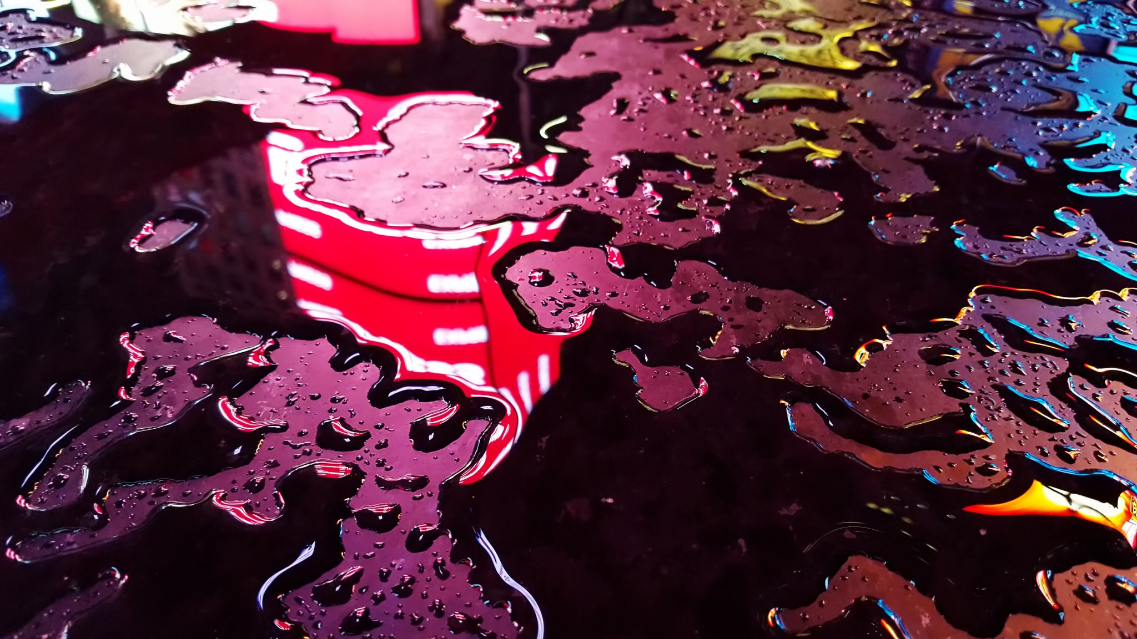
The Effects of Acid Rain
Hallsdale-Powell Utility District

Slide 2

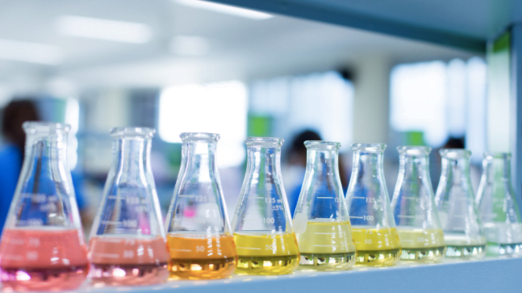
What do you know about acids and bases?
Image: https://chemistrytalk.org/acid-base-chemistry-made-easy/

Slide 3
What are acids and bases?
Did you know that almost every liquid you see is an acid or a base (except for distilled water, which is neutral).
The amount of tiny particles, called ions, in a liquid determines whether something is categorized as an acid or a base.
We refer to the pH scale when we identify if a liquid is acidic or basic.

Slide 4
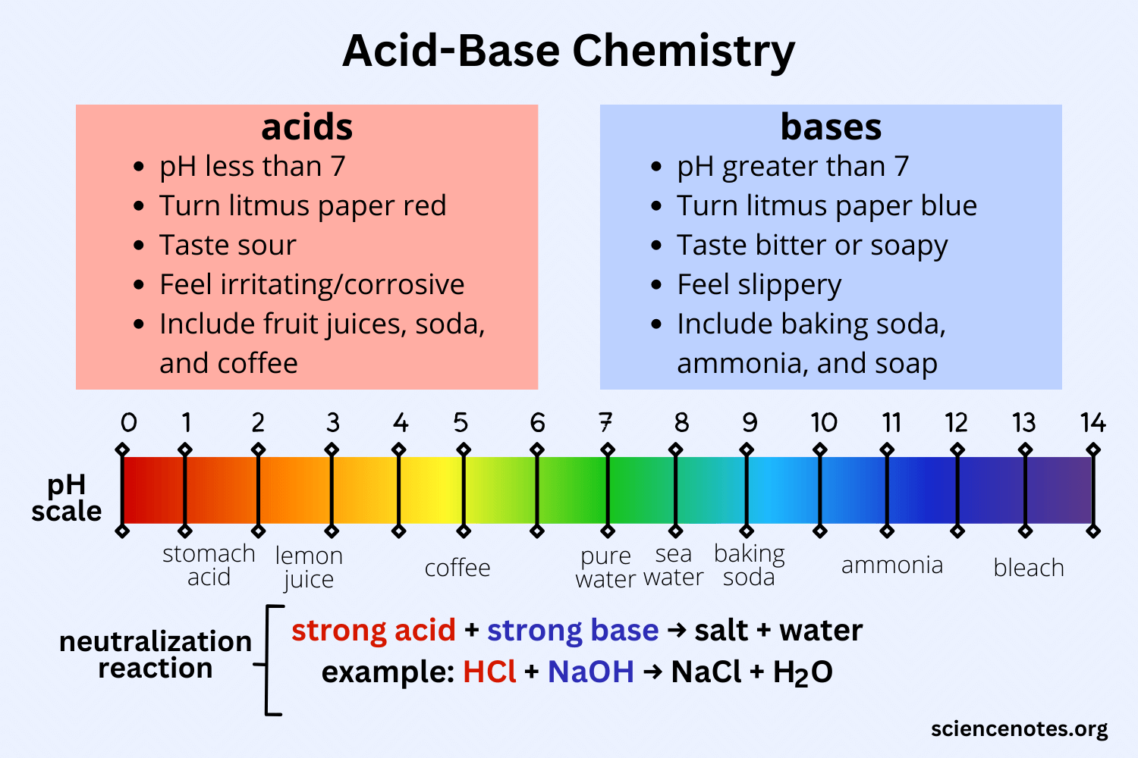

Slide 5


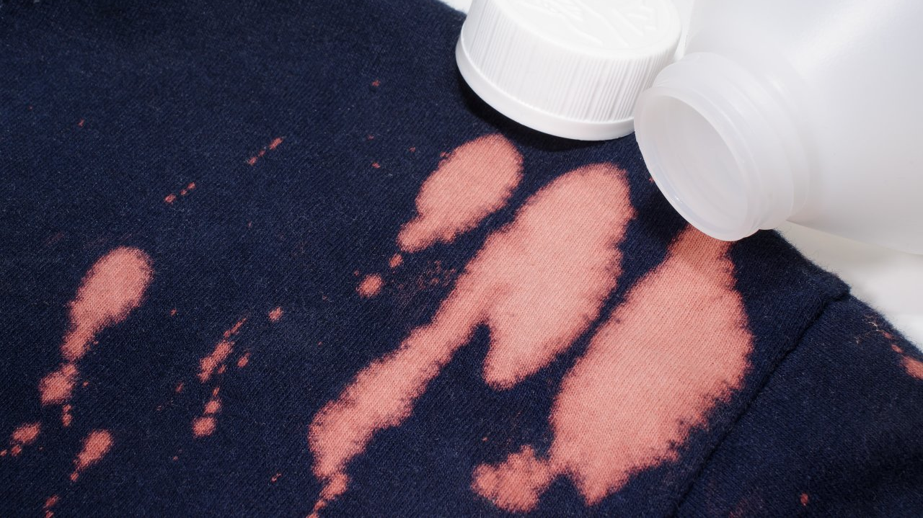
Did you know that a really strong acid or base can break something apart?
If you add straight bleach to a piece of clothing, it takes the color away or even creates a hole in the fabric!
Image: https://www.persil.com/uk/laundry/laundry-tips/stains/how-to-remove-bleach-stains-from-clothes-prevent-future-stains.html

Slide 6
Acid in the Air
Acids can also be found in the air around us – specifically in polluted air.
Acid rain happens when air pollution chemicals from fuel-burning factories and cars react to form acids in the air.
*These acids are not strong enough to harm humans ☺

Slide 7
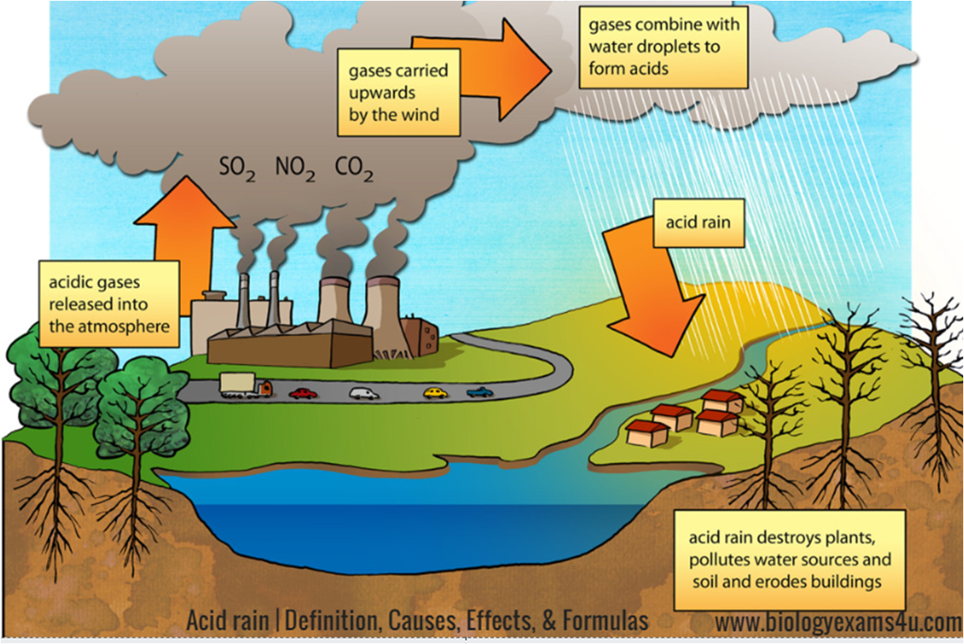

Slide 8

Effects of Acid Rain
The Taj Mahal has yellowed over time because of acid rain.
Acid rain causes chemical erosion, which damages statues and buildings, weakens exposed metals on bridges, damages wildlife, and contaminates drinking water.
Image: https://www.javatpoint.com/effects-of-acid-rain-on-taj-mahal

Slide 9
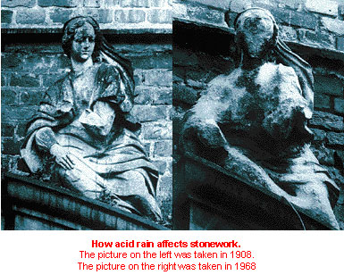
Image: https://lisbonacidrain1.weebly.com/economist.html

Slide 10
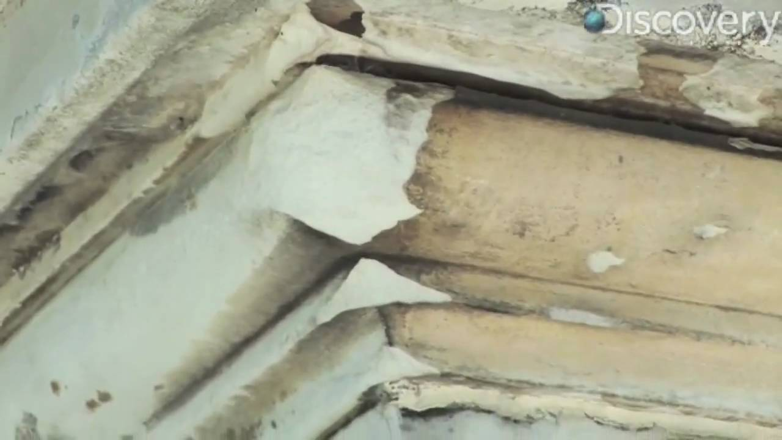
Acid Rain
Limestone and marble, which contain calcium carbonate (CaCO3), are materials often used to construct countertops and floors.
Acid rain breaks down limestone and marble faster than other building materials. Many historical monuments were built with these materials.
Image: https://www.youtube.com/watch?v=MqHw1hMEkAQ

Slide 11
Today, you will model acid rain!
In this activity, lemon juice and vinegar are the acids used to represent acid rain.
Chalk, composed of limestone, represents statues.
You will be working in groups of 3.

Slide 12
Modeling Acid Rain
In front of you are three cups (vinegar, lemon juice, water), chalk, and a nail.
Carefully use the nail to carve a picture, shape, or marking into the piece of chalk. Sketch the chalk on your worksheet.

Slide 13
Modeling Acid Rain
In your group of 3, place one piece of chalk in a cup and set a timer for 10 minutes.
Place your litmus paper into each cup and measure the pH of each liquid. Graph the pH on your worksheet.
Write down your observations on your worksheet.

Slide 14
Modeling Acid Rain
After 10 minutes, remove your chalk from the liquid and draw a new sketch of the changed chalk on your worksheet.
Answer the follow-up questions on your worksheet.

Slide 15
Modeling Acid Rain
Compare your chalk with the chalk of the other members of your group. Which chalk looked the worst?
Which liquid — lemon juice, tap water, or vinegar — is the most acidic (dissolved the chalk the most and lowest pH value)?

Slide 16
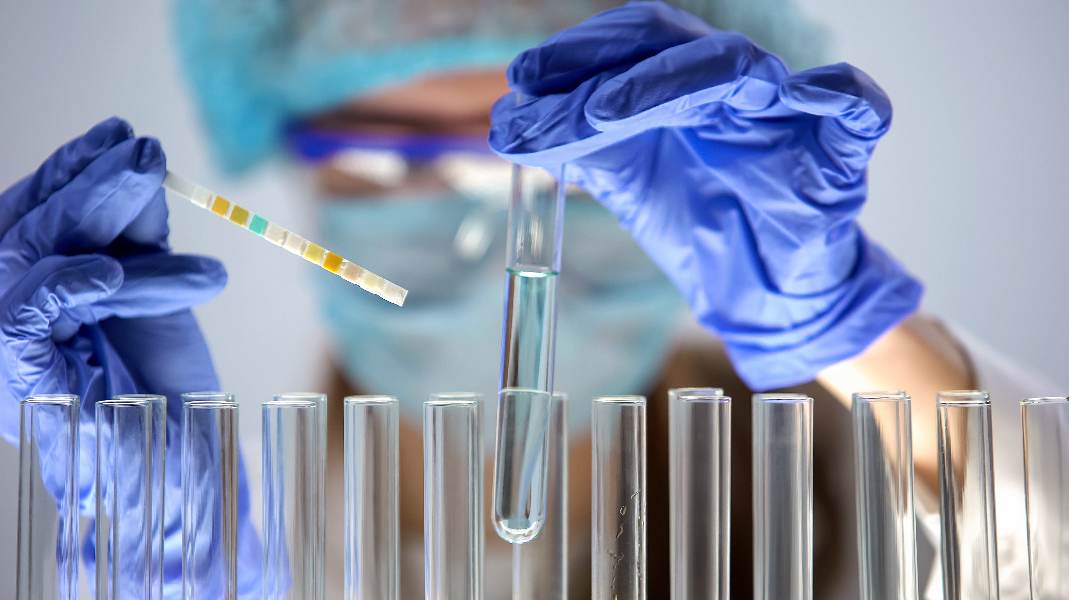
The Important Work of Hallsdale-Powell Utility District
Did you know that all the water you use at home and in school must be treated? Scientists look for bacteria, viruses, and other contaminants. They also check the water’s pH.
Image: https://www.elgalabwater.com/blog/water-purity-and-ph-not-simple-you-think

Slide 17

The Important Work of Hallsdale-Powell Utility District
After the wastewater has been treated, scientists check the pH of the cleaned water. If the pH is too acidic or basic, it can harm the ecosystem of Beaver Creek, where HPUD discharges its treated water.
This ensures that we have safe, clean water and protect the environment.
Image: https://www.komodowater.org/page/2/

