Slide 1
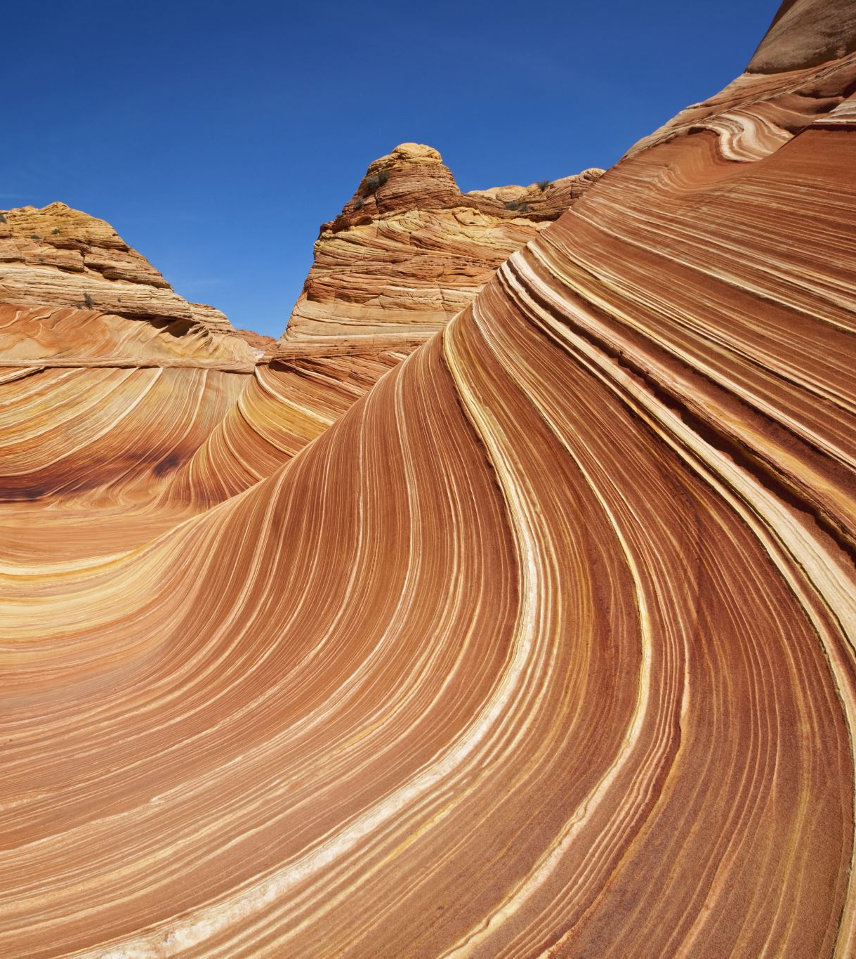
Erosion in a Tub
Hallsdale-Powell Utility District

Slide 2
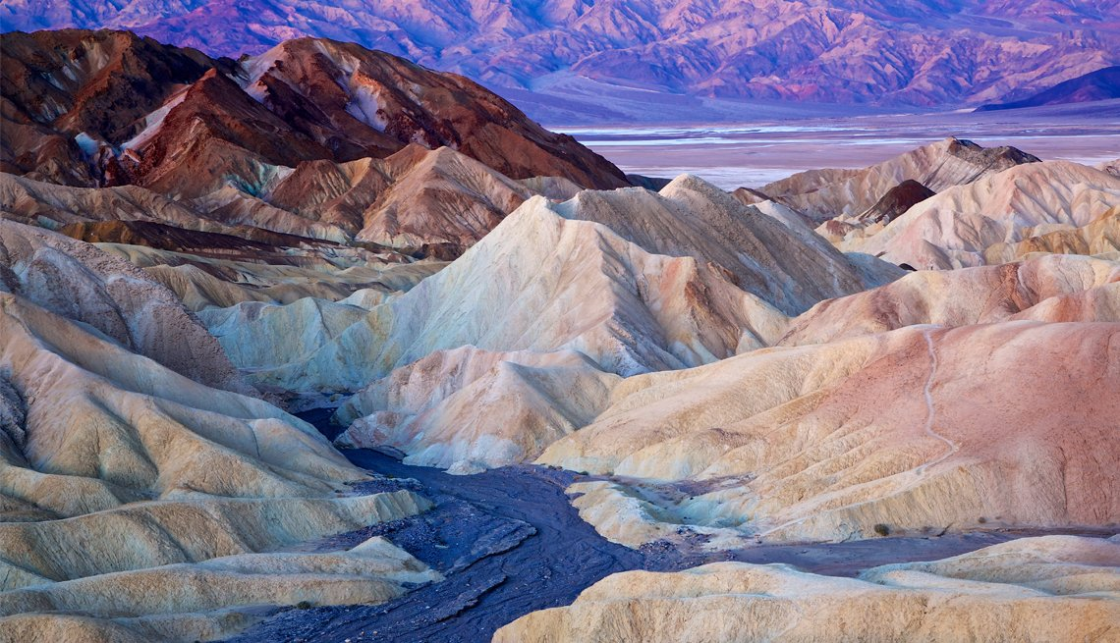
Have you ever wondered how mountains can turn into tiny grains of sand over time?
Image: https://www.aarp.org/travel/vacation-ideas/outdoors/info-2021/death-valley-national-park.html

Slide 3
How Do Things Break Down?
Weathering is nature’s way of slowly breaking things down.
Imagine a big rock sitting outside. Over time, wind, rain, and even plants can cause little cracks or chips in the rock. This happens really slowly, but bit by bit, the rock starts to crumble into smaller pieces.
Weathering is the first step in turning something big, like a mountain, into tiny grains of dirt or sand!

Slide 4
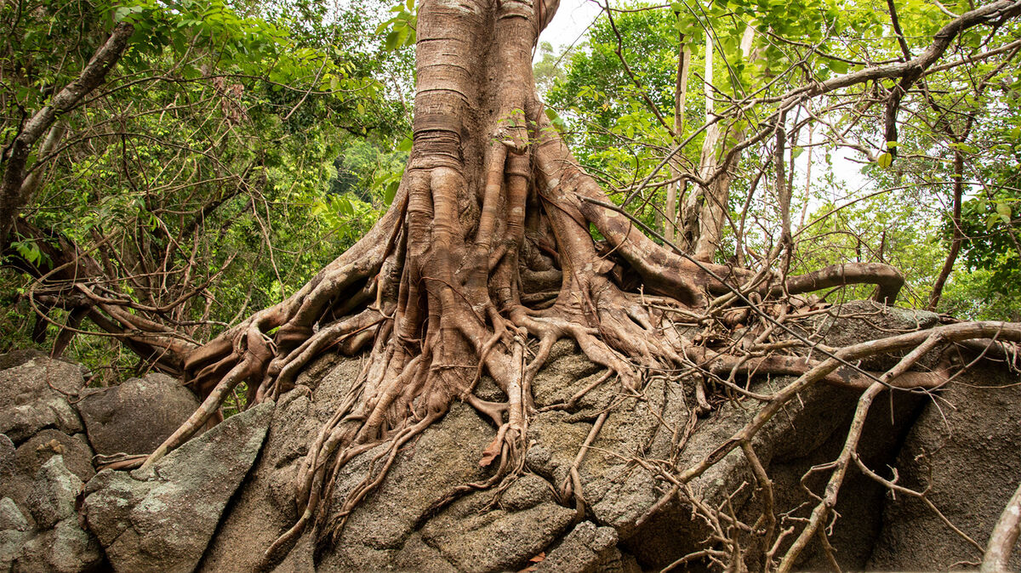
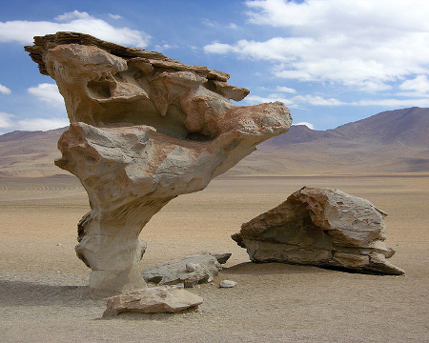
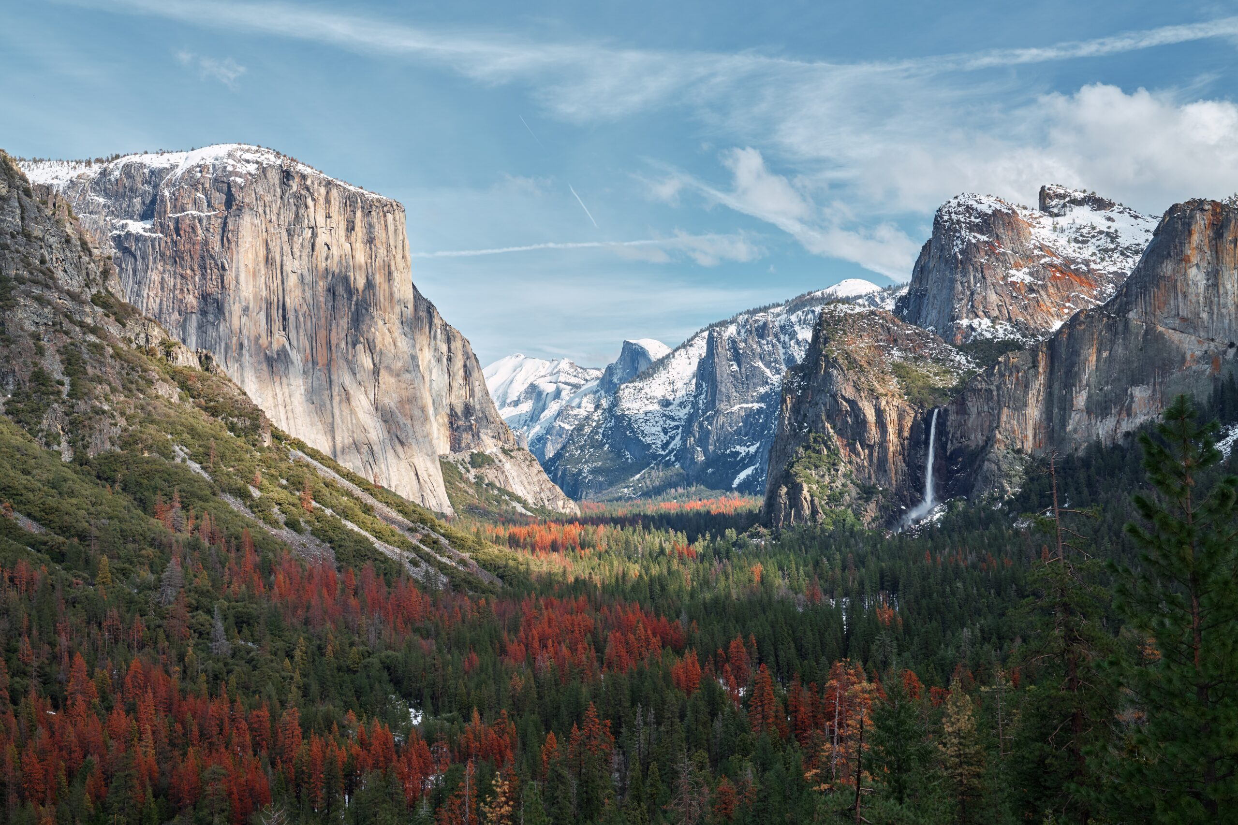
Weathering caused by tree roots!
Weathering caused by wind and water!
Image: https://www.yourdictionary.com/articles/examples-physical-weathering
Image: https://study.com/academy/lesson/mechanical-weathering-definition-process-types-examples.html
Weathering caused by glaciers!
Image: https://usparkpass.com/yosemite-national-park-travel-guide/

Slide 5
How Do Things Break Down?
Erosion is what happens when nature moves things from one place to another.
After weathering breaks rocks into smaller pieces, things like wind, water, and ice can pick up those pieces and carry them away. It's like how rain can wash dirt down a hill or how the wind can blow sand across a beach.
Over time, erosion can change the shape of land and create new landscapes!

Slide 6
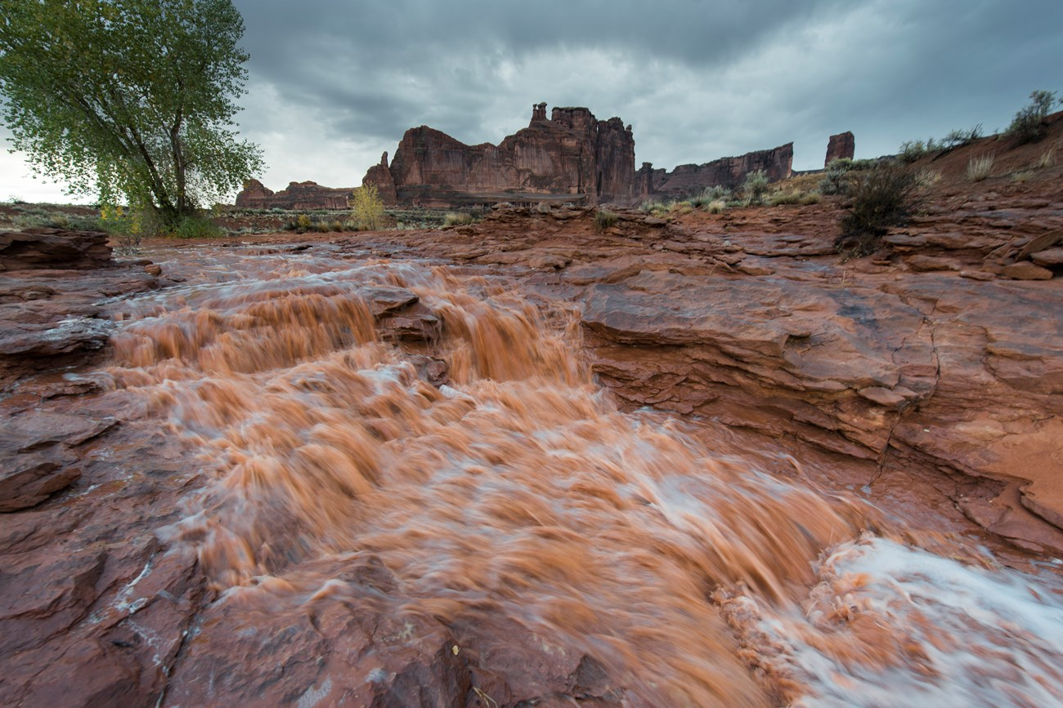
Check out all that sand being eroded (carried by water)!
Image: https://www.nps.gov/subjects/erosion/erosion.htm

Slide 7
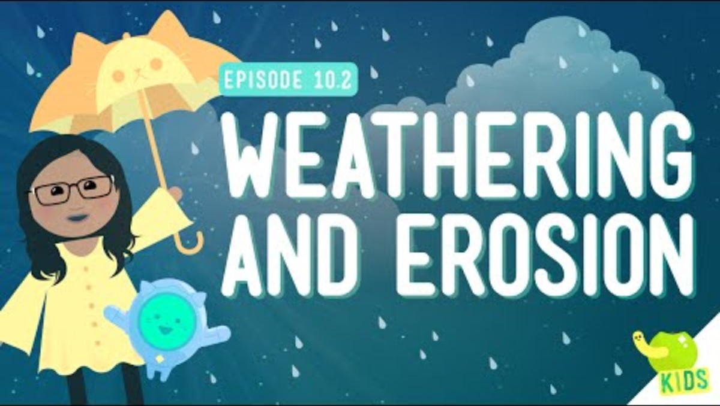

Slide 8
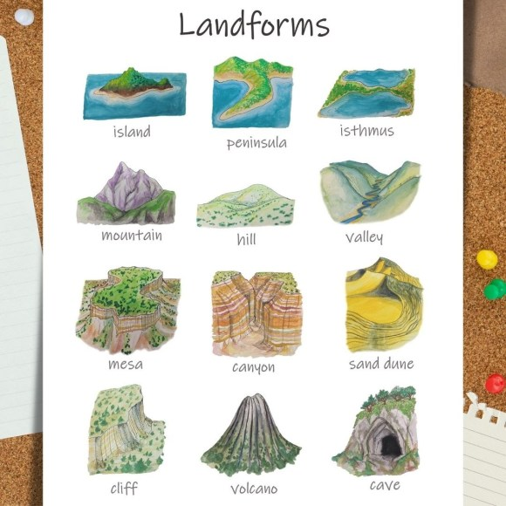
Let’s see erosion in action!
Remember: “Weathering helps make a mess, and erosion helps clean it up!”
Using the sand and dirt in your tub, create your own landform with your group!
Fill out the first page of your worksheet and show your teacher!
Image: https://wildearthlab.com/2021/11/06/common-landforms/

Slide 9
Let’s see erosion in action!
Let’s see wind erosion!
Using your straw, start a timer and carefully blow onto your landform.
Answer the questions under “Wind” in your packet.

Slide 10
Let’s see erosion in action!
Let’s see ice (glacier) erosion!
Place the ice cube on your landform. Record your observations on your worksheet.

Slide 11
Let’s see erosion in action!
Let’s see water erosion!
Start your timer and carefully pour water over your landform.
Answer the questions on your worksheet.

Slide 12
What happened to your landform?
Sketch your landform on your worksheet after weathering and erosion have impacted it.
Now measure the height and width of your landform. How has it changed?

Slide 13
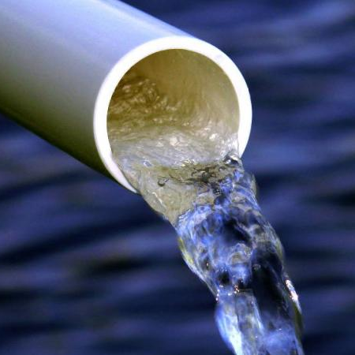
The Important Work of Hallsdale-Powell Utility District
Weathering and erosion can change landscapes, shift soil, and move sediment into rivers and storm drains.
Hallsdale-Powell Utility District (HPUD) engineers and planners think ahead to protect pipes and treatment plants.
Weathering and erosion are a part of nature, but HPUD uses smart planning to keep them from harming our pipes and water quality!

