Slide 1
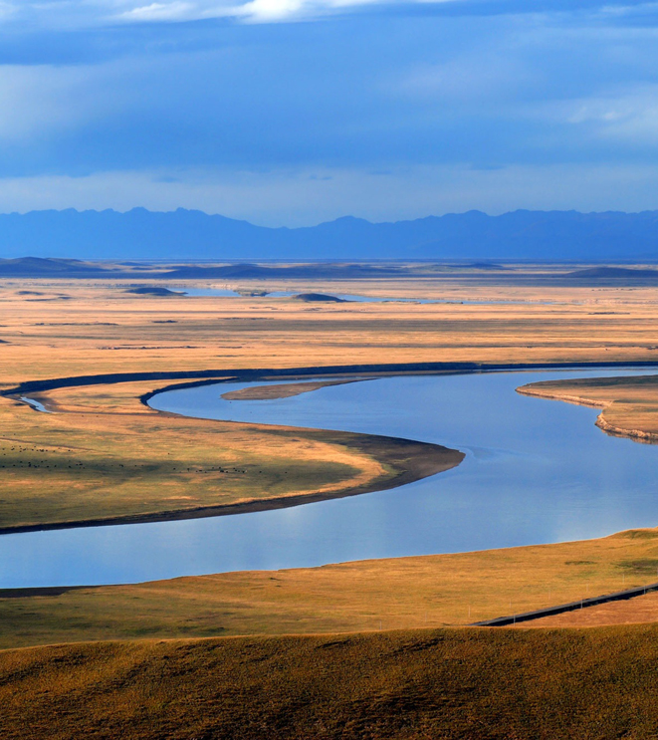
Floodplain Modeling
Hallsdale-Powell Utility District
Image: https://education.nationalgeographic.org/resource/flood-plain/

Slide 2
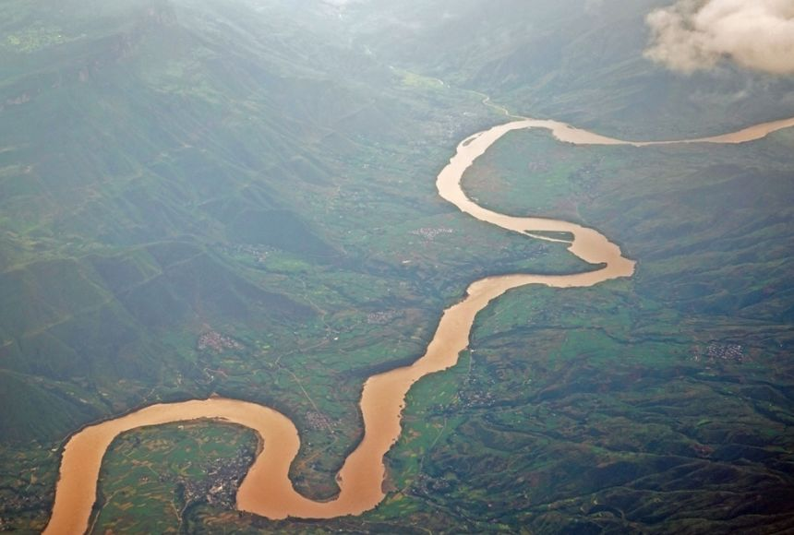
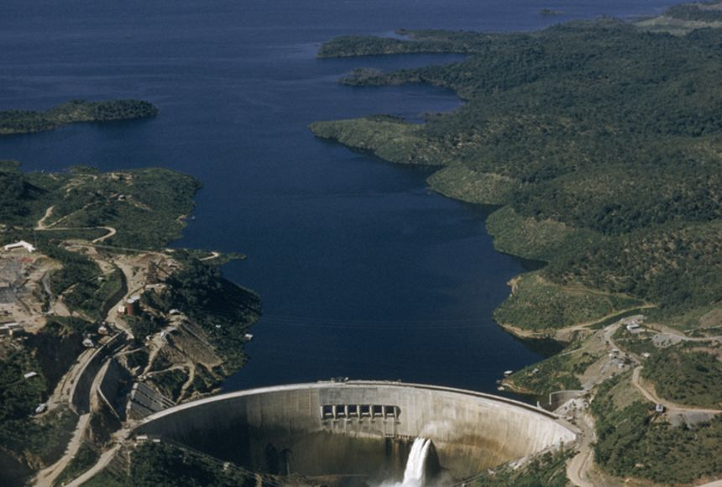
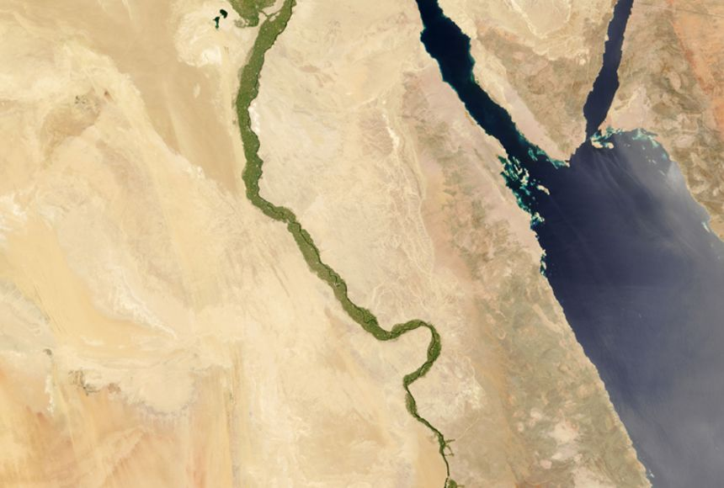
What do all rivers have in common?
Images: https://education.nationalgeographic.org/resource/understanding-rivers/

Slide 3
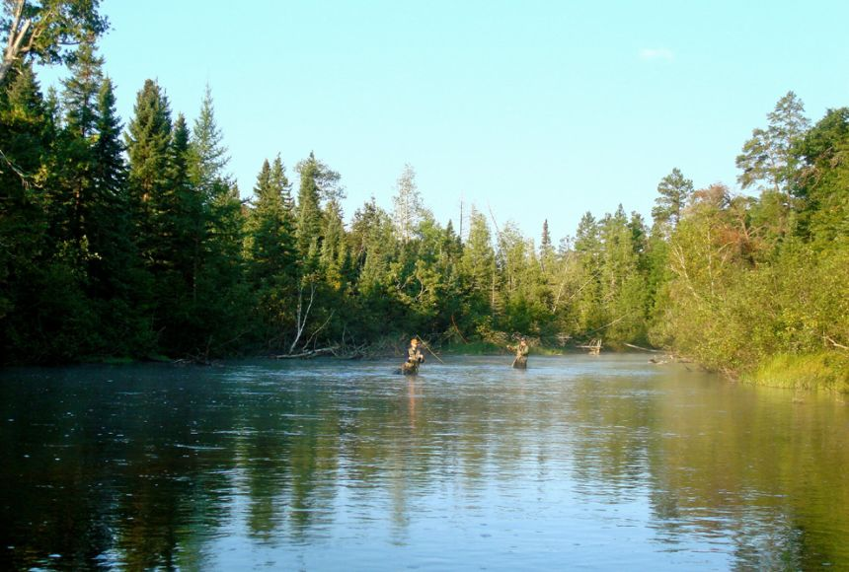
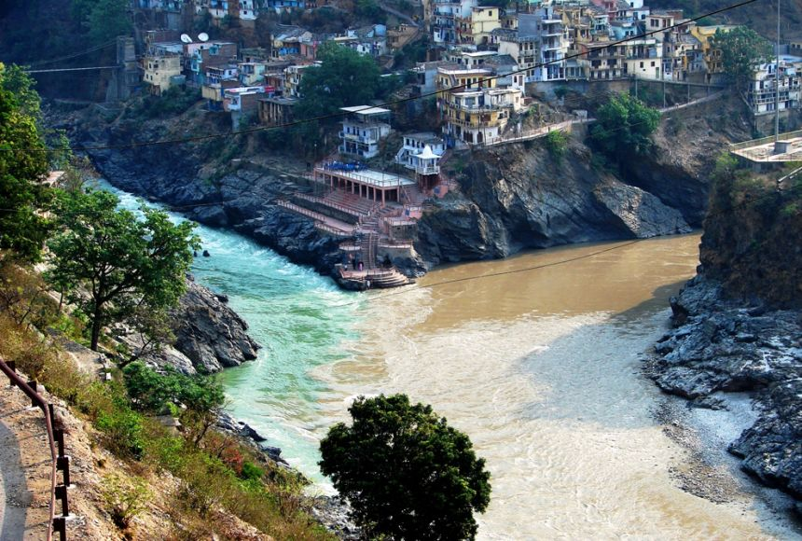
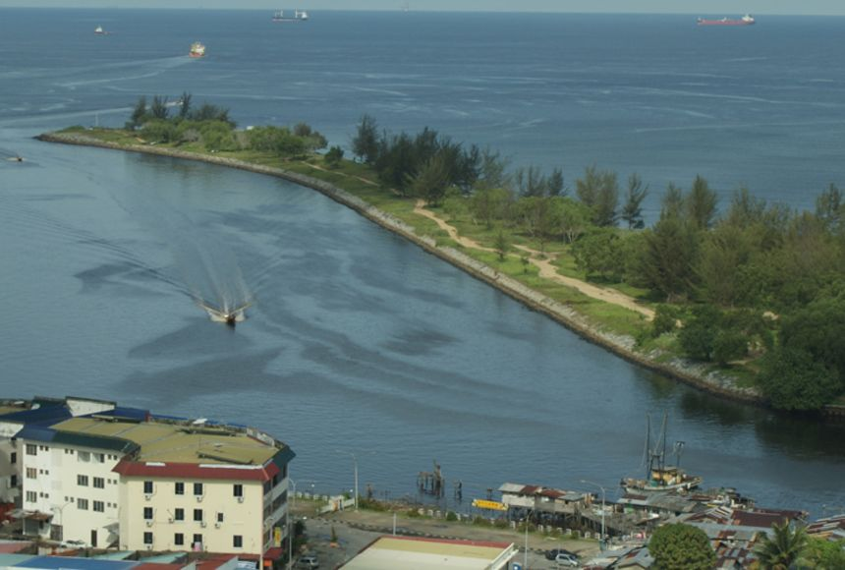
How much water is in a river?
Images: https://education.nationalgeographic.org/resource/understanding-rivers/

Slide 4
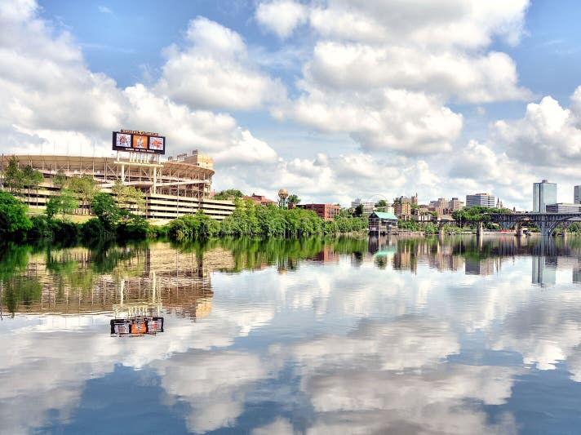
We also have lots of rivers in Tennessee!
Image: https://www.dreamstime.com/photos-images/neyland-stadium-knoxville.html

Slide 5
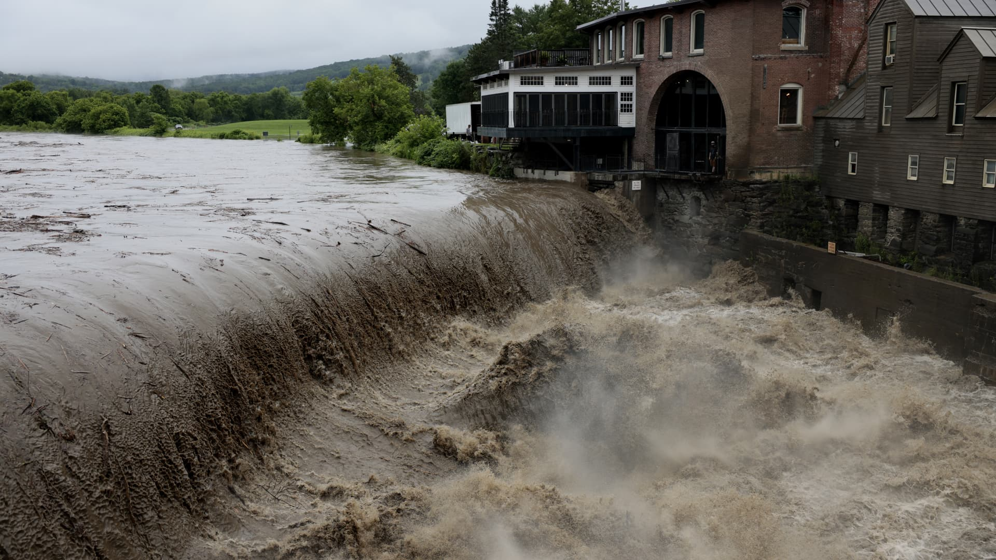
Although rivers are very important, they can also flood when too much water flows through them!
What damage do you think a flood can cause?
Image: https://www.cnbc.com/2023/07/10/see-images-of-the-floods-plaguing-new-york-and-new-england.html

Slide 6
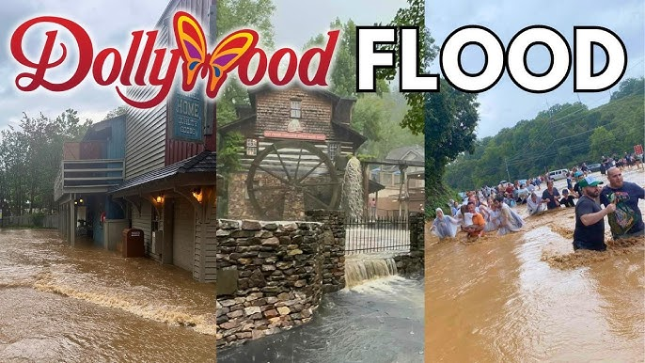
Flooding also happens around here too
Image: https://www.youtube.com/watch?app=desktop&v=WCQv0-AXqdU

Slide 7
Floods can cause a lot of damage!
However, scientists work hard to make sure that our homes and schools stay safe from floods!
Scientists create small-scale models to understand how real-life floods behave.
Today, you’re going to create your own model of a flood and see the damage they can cause!

Slide 8
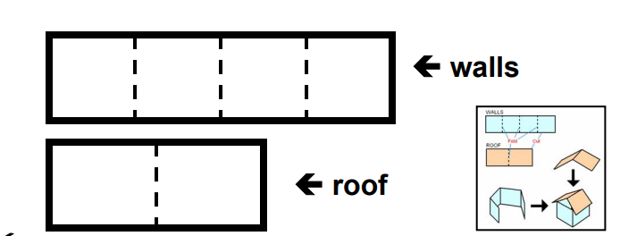
Directions
The first thing you’ll do is create mini houses in your groups. Please use the provided template, scissors, and tape.
Decorate your house when you’re done!

Slide 9
Directions
Now you will create your model using sand and an aluminum pan.
Carefully place the sand on your pan and create a riverbed with your fingers.
Think about: How wide do I want the river? Do I want a straight river or one with curves (meanders)? Do I need to use pebbles anywhere? Where should I place the houses?

Slide 10
Let’s Test it Out!
Your teacher will place your aluminum tray into the plastic bin and pour water down your river.
Watch carefully and think about: Is my river flooding? Are my houses being affected? How can I improve my river to avoid flooding?

Slide 11
Great work scientists! Now consider…
How do you think your model would have been different if the angle of the river was shallower? Steeper?
Why is it important to learn about floods?

Slide 12
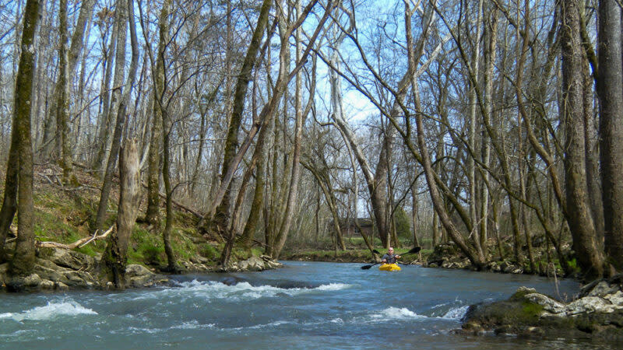
The Important Work of Hallsdale-Powell Utility District
Pipes underground break down overtime, which can create cracks. When big rainfalls and flooding events happen, rainwater can rush through the cracks, mixing with wastewater, causing the treatment plant to become overwhelmed and back up. Sometimes it even backs up enough to come out of manholes!
Hallsdale-Powell Utility District is continuously monitoring and rehabilitating its pipes to help keep everything working properly and to protect the environment!
Image: https://www.visitknoxville.com/listing/beaver-creek-water-trail/3132/

