Slide 1
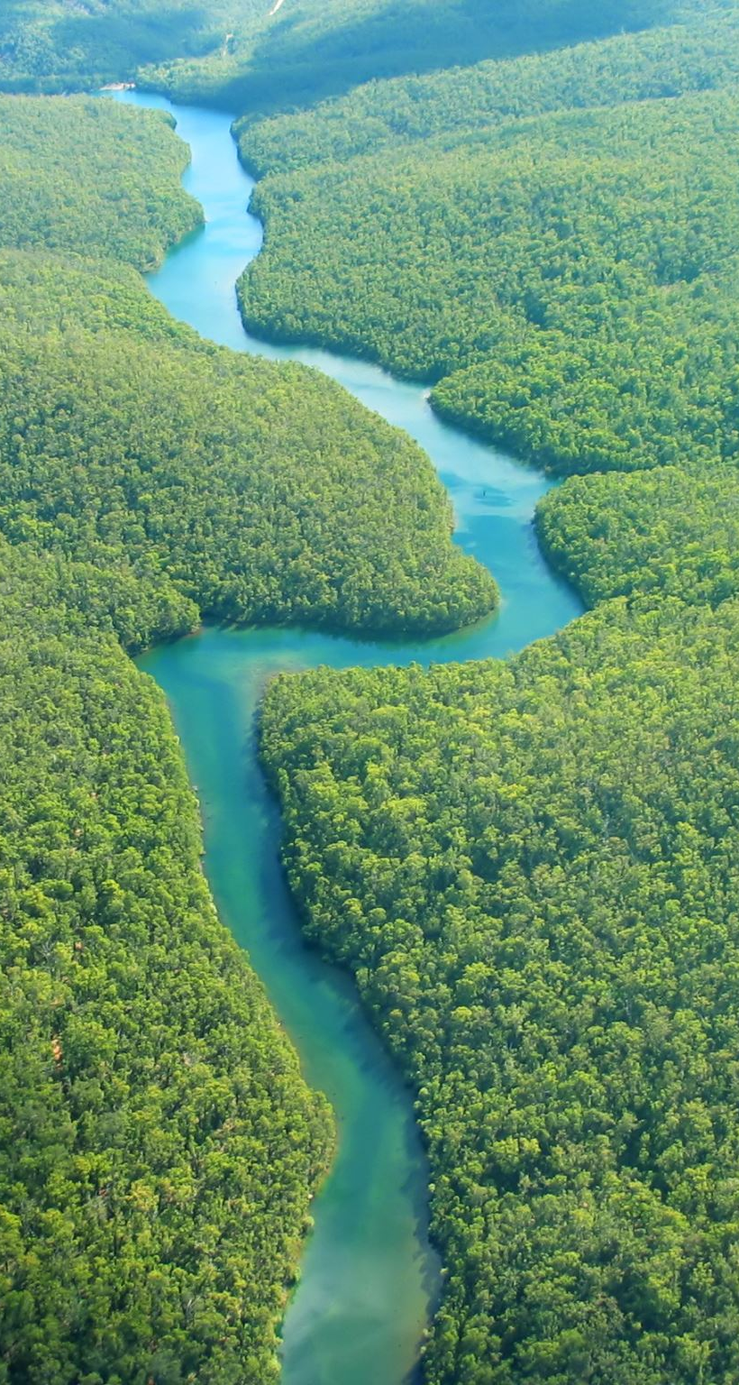
Discover the Waters of our National Parks
Hallsdale Powell Utility District
Adapted from Discover the Waters of Our National Parks Project WET 2011

Slide 2

What does your family like to do for fun?
Image: https://pikbest.com/png-images/family-member-having-fun-together-vector-graphic-element_1551908.html

Slide 3

What is a National Park?
There are special places in the United States called national parks.
Families can visit National Park Service sites, which are located in every U.S. state except for Delaware!
Image: https://www.istockphoto.com/illustrations/family-park

Slide 4
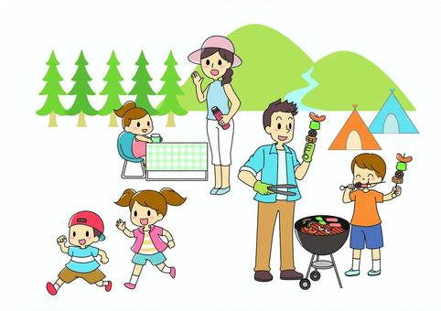
What is a National Park?
National Park Service sites may have mountains, hiking trails, campgrounds, rivers or waterfalls.
Other National Park Service sites may be in a city and have biking trails, squirrels, flowers and picnic areas.
Image: https://en.ac-illust.com/clip-art/799587/outdoor-family

Slide 5
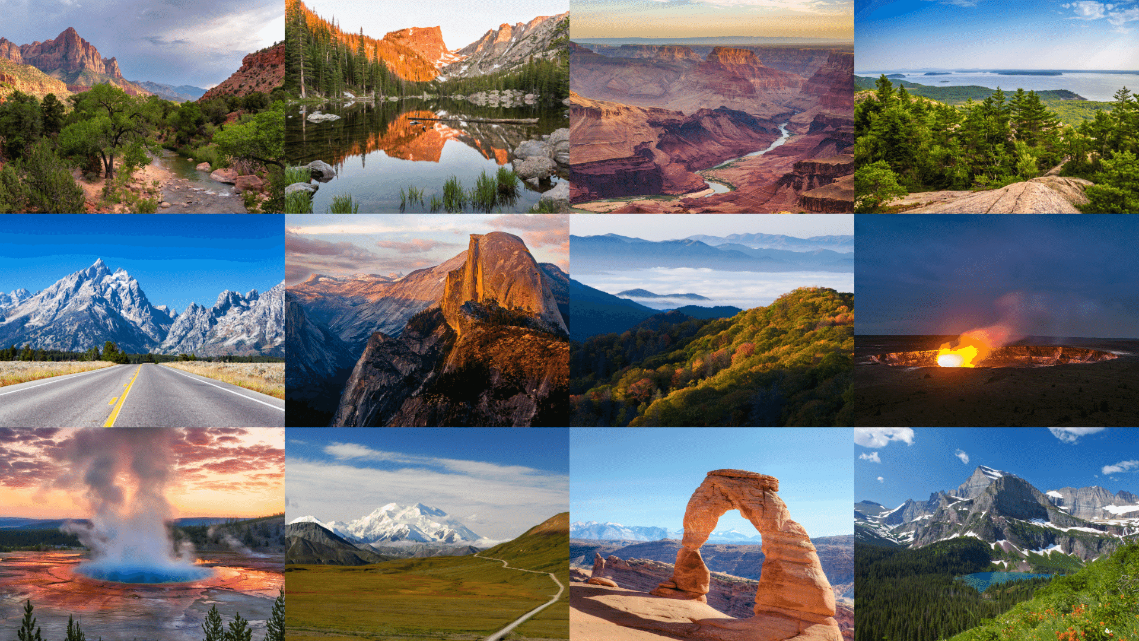
Have you ever been to a national park? What was the best thing you did there?
Image: https://onechelofanadventure.com/12-most-beautiful-national-parks-in-the-usa/

Slide 6
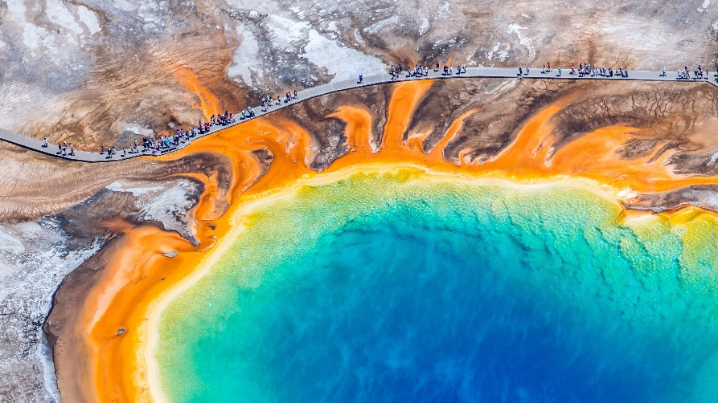
Yellowstone National Park, Wyoming
Image: https://www.cntraveler.com/story/yellowstone-national-park-guide

Slide 7
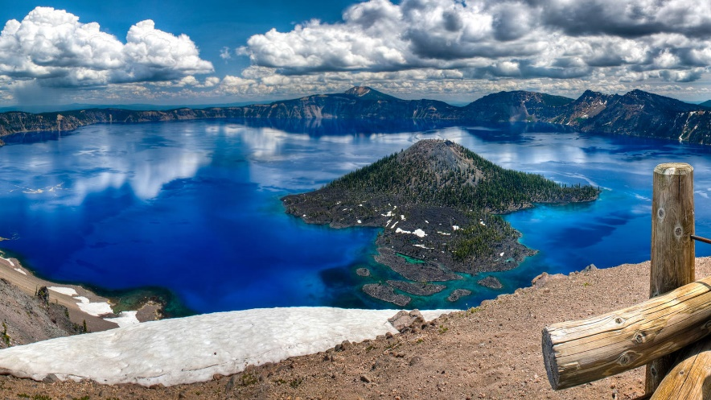
Crater Lake National Park, Oregon
Image: https://www.npca.org/parks/crater-lake-national-park

Slide 8
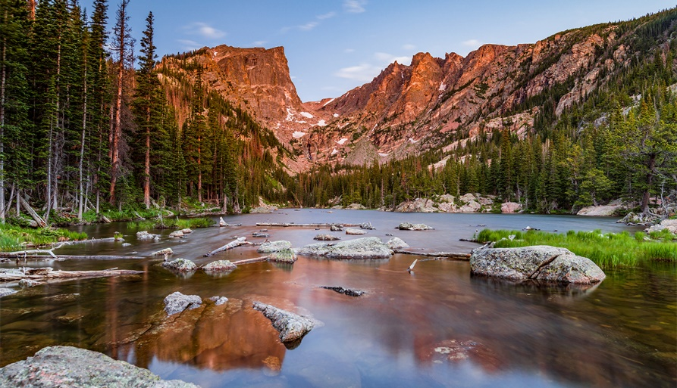
Rocky Mountain National Park, Colorado
Image: https://www.aarp.org/travel/vacation-ideas/outdoors/info-2020/rocky-mountain-national-park-guide.html

Slide 9
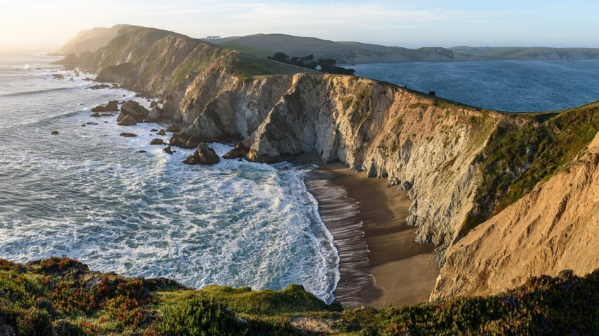
Point Reyes National Seashore, California
Image: https://en.wikipedia.org/wiki/Point_Reyes_National_Seashore

Slide 10
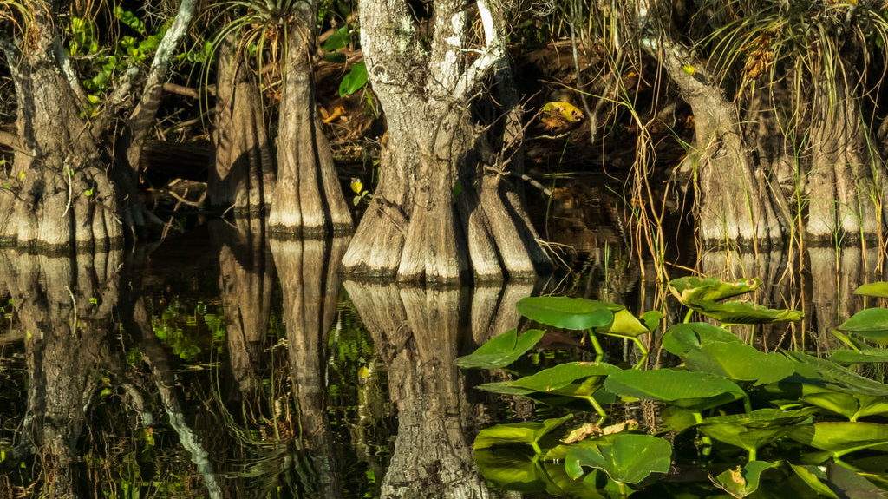
Everglades National Park, Florida
Image: https://ruggednation.com/blogs/adventure-outpost/destination-everglades-national-park

Slide 11
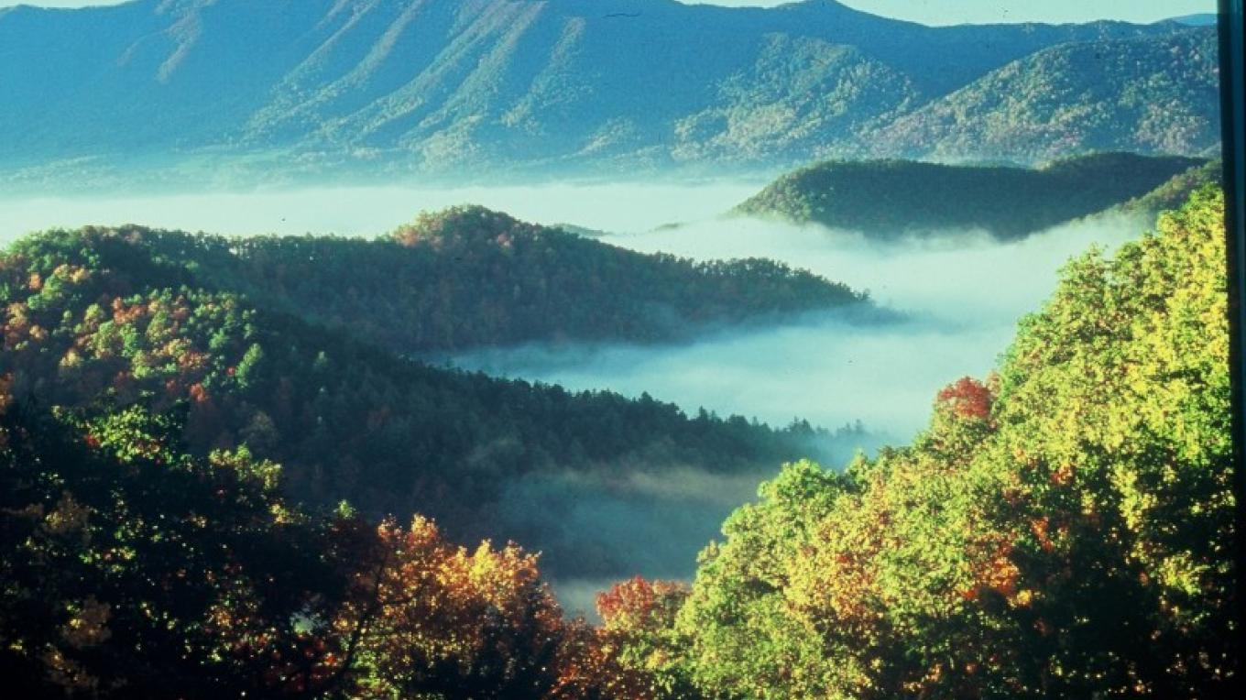
Great Smoky Mountain National Park, Tennessee
Image: https://tennesseerivervalleygeotourism.org/entries/great-smoky-mountains-national-park/59cc164f-dbb8-42ed-9d83-f3e2f65eae61

Slide 12
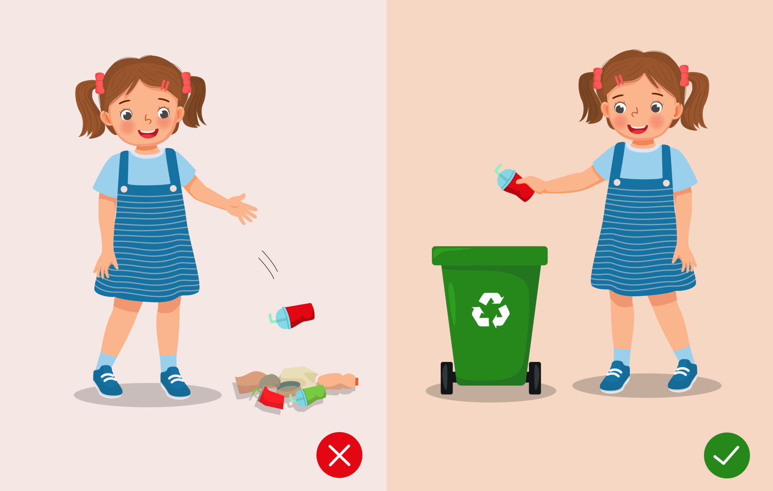
What should we NOT do in a national park?
Image: https://www.vecteezy.com/vector-art/11773370-do-not-littering-illustration-girl-right-and-wrong-behavior-throwing-trash-in-rubbish-bin-and-on-the-ground

Slide 13
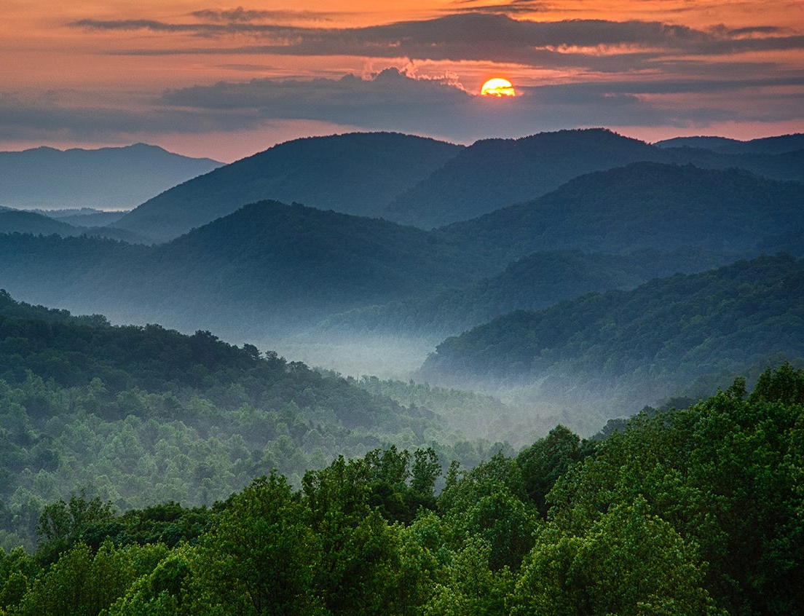
Did you know there’s a national park near you?
It’s the Great Smoky Mountain National Park!
Have any of you ever gone to the Smokies?
What would you like to do there if you went with your family?
What shouldn’t you do while at the national park?
Image: https://www.usatoday.com/story/travel/experience/america/national-parks/2016/08/10/great-smoky-mountains-national-park-tips-visiting/88311594/

Slide 14
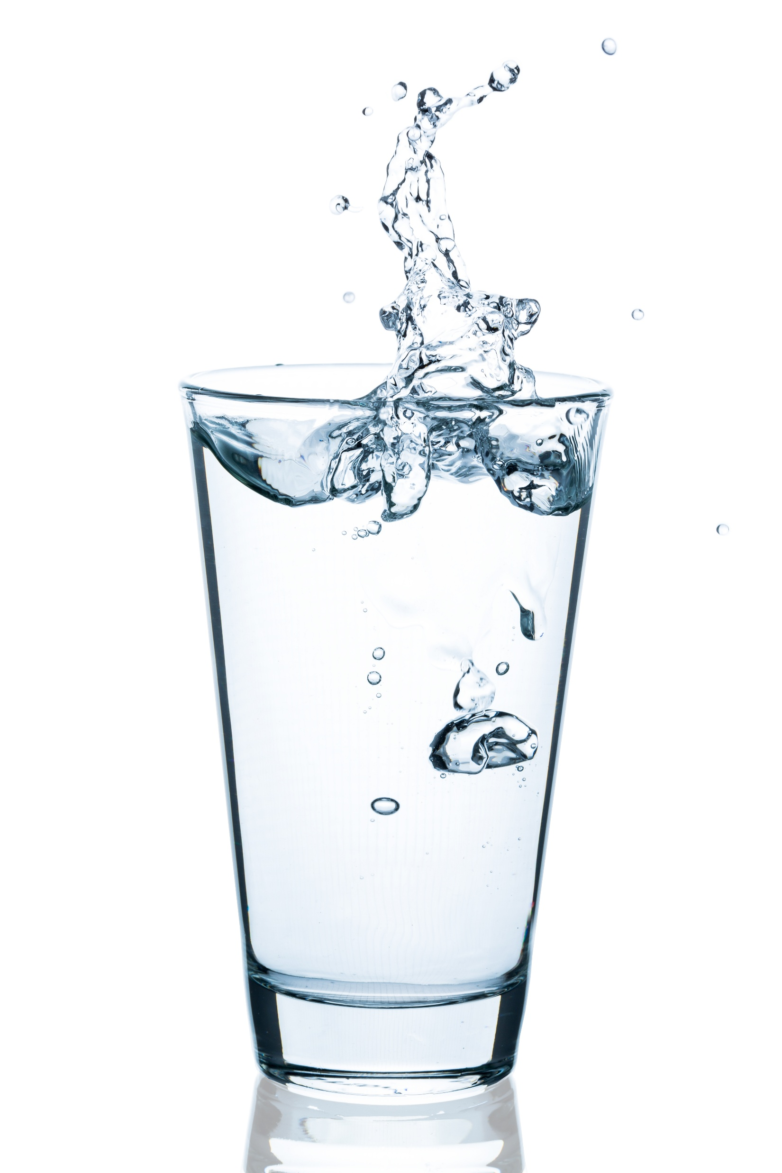
The Important Work of Hallsdale-Powell Utility District
Just like park rangers keep rivers and lakes in our national parks clean, Hallsdale-Powell Utility District works to keep the water we deliver to your home clean and safe to drink!
National parks protect water in the wild. Hallsdale-Powell Utility District protects water at home. It’s up to all of us to take care of it, no matter where it flows!

