Slide 1
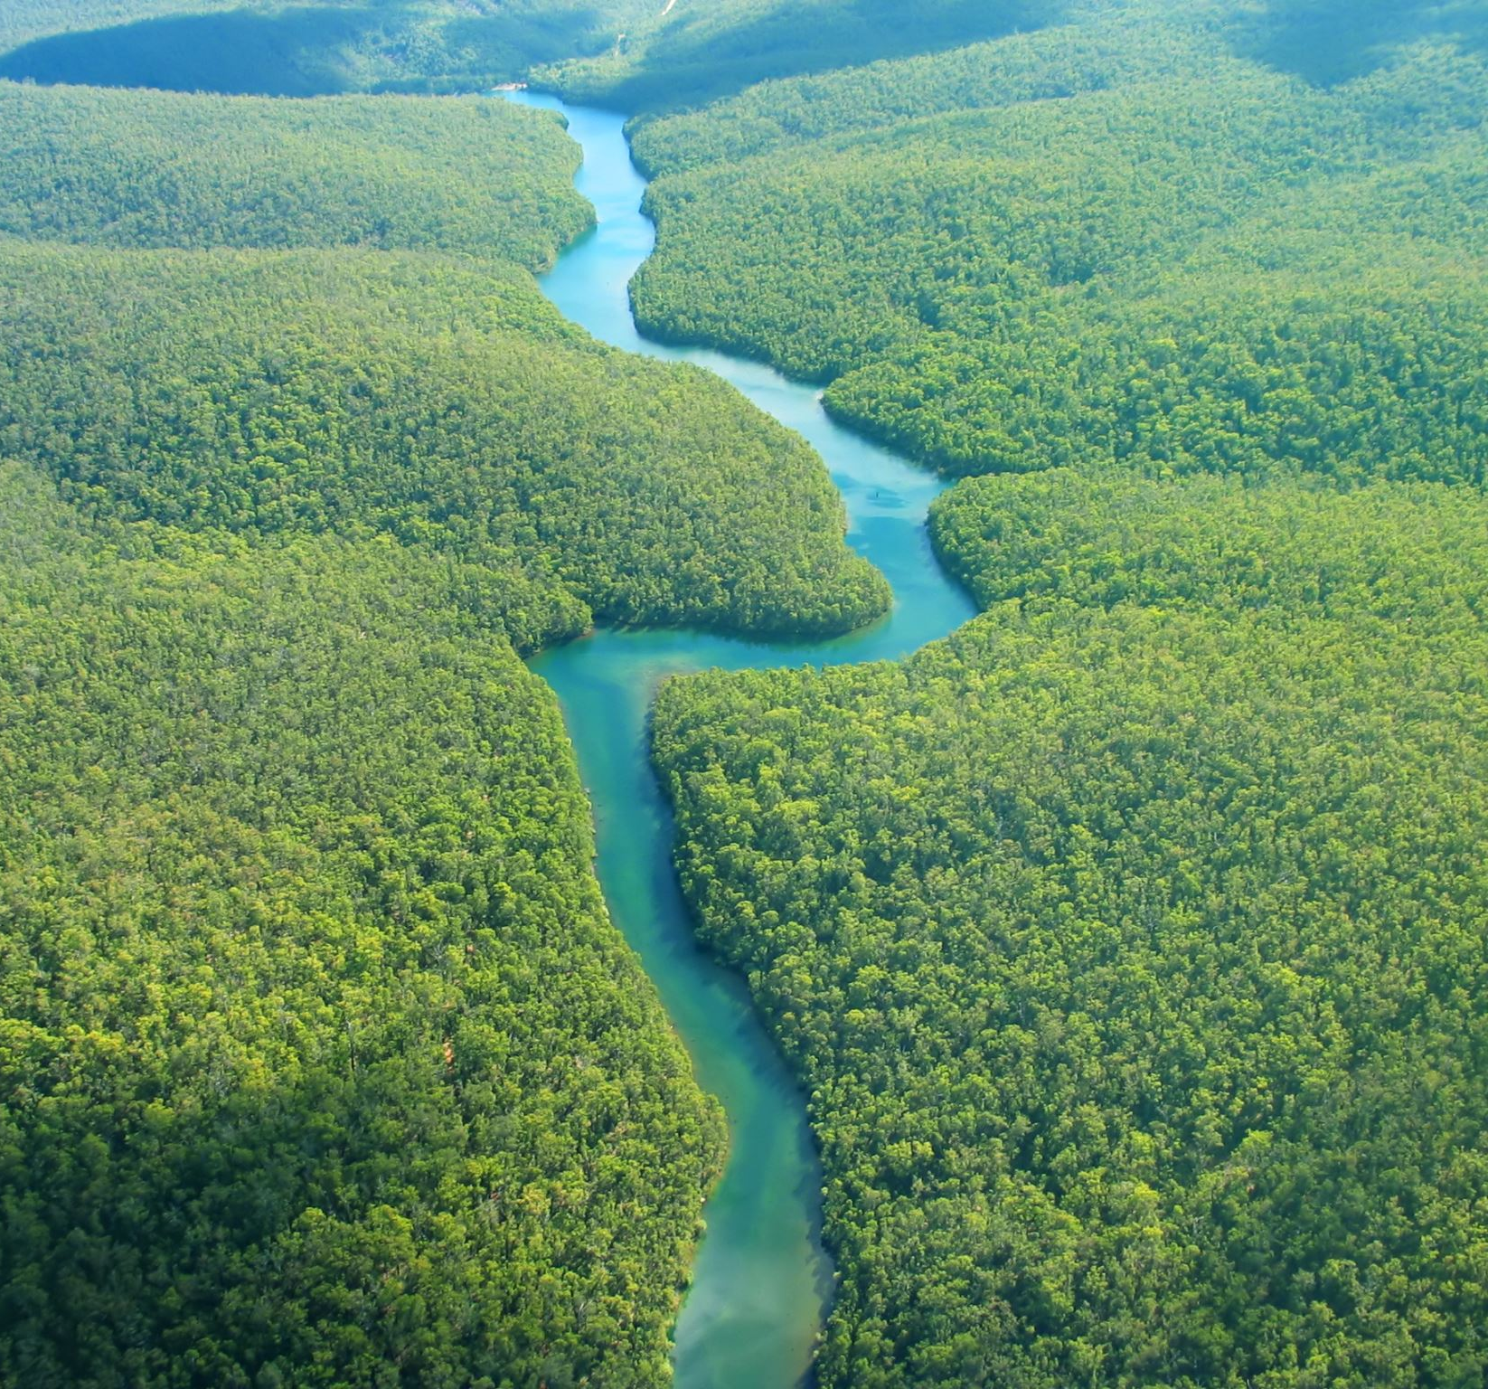
Discover the Waters of our National Parks
Hallsdale Powell Utility District
Adapted from Discover the Waters of Our National Parks Project WET 2011

Slide 2
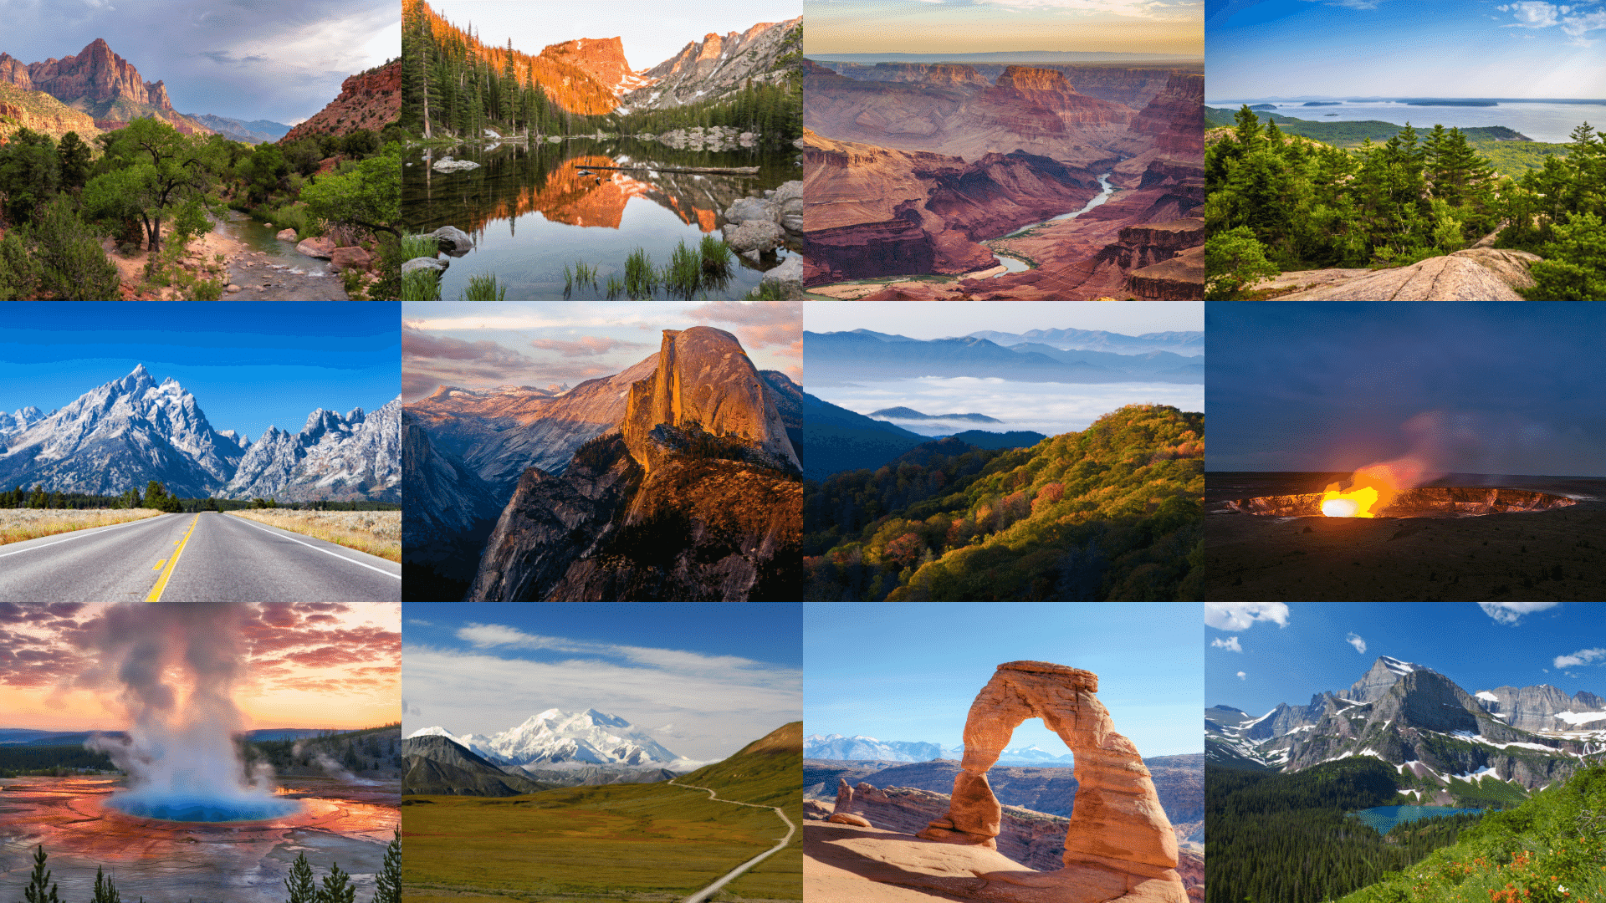
Which national parks have you visited?
Image: https://onechelofanadventure.com/12-most-beautiful-national-parks-in-the-usa/

Slide 3
Background on National Parks
National parks are designed to preserve the most special places in the United States.
They are available for everyone!
The first national park was created in 1872. Which park do you think was the first?

Slide 4
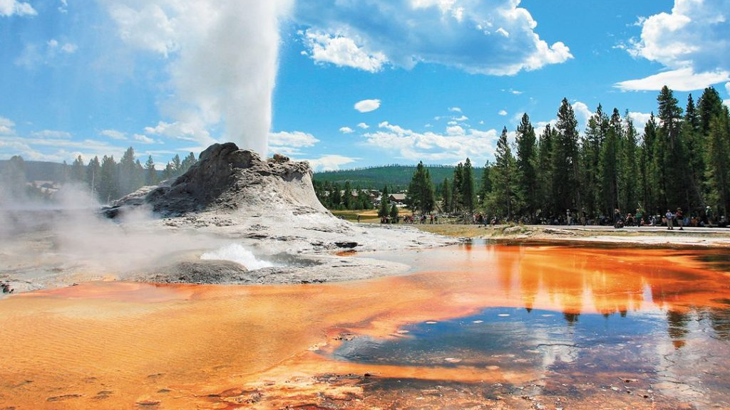
Yellowstone National Park, Wyoming
Yellowstone National Park was the first national park, created in 1872!
Why do you think America wanted to protect Yellowstone?
Image: https://www.moon.com/travel/national-parks/one-day-in-yellowstone-national-park/

Slide 5
Why National Parks?
National park system sites are diverse, with a wide range of plants, animals, landscapes, water features, and recreational opportunities.
Many parks provide habitat for threatened and endangered species.

Slide 6
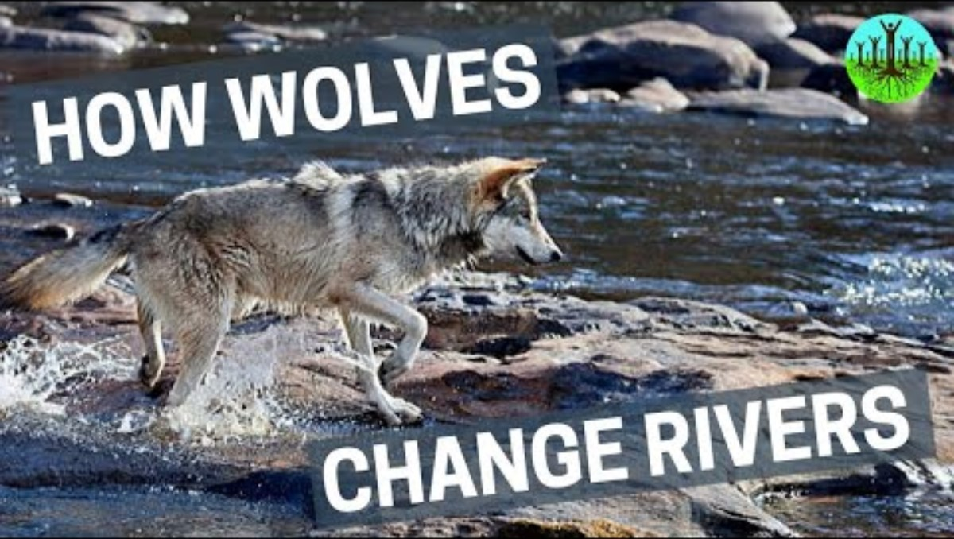
Notes:
Optional video: 4:33 minutes

Slide 7
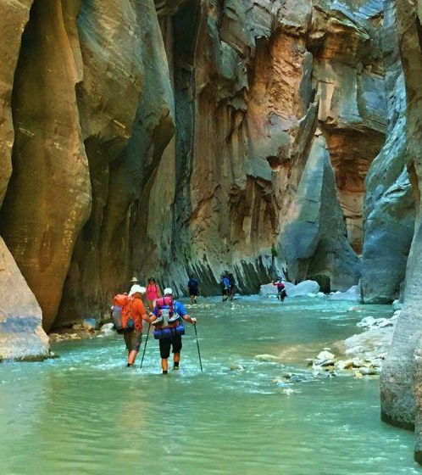
Water in National Parks
Water plays a huge role in our national parks.
What are some examples of water in our national parks?
Image: https://www.viator.com/Zion-National-Park/d5610

Slide 8
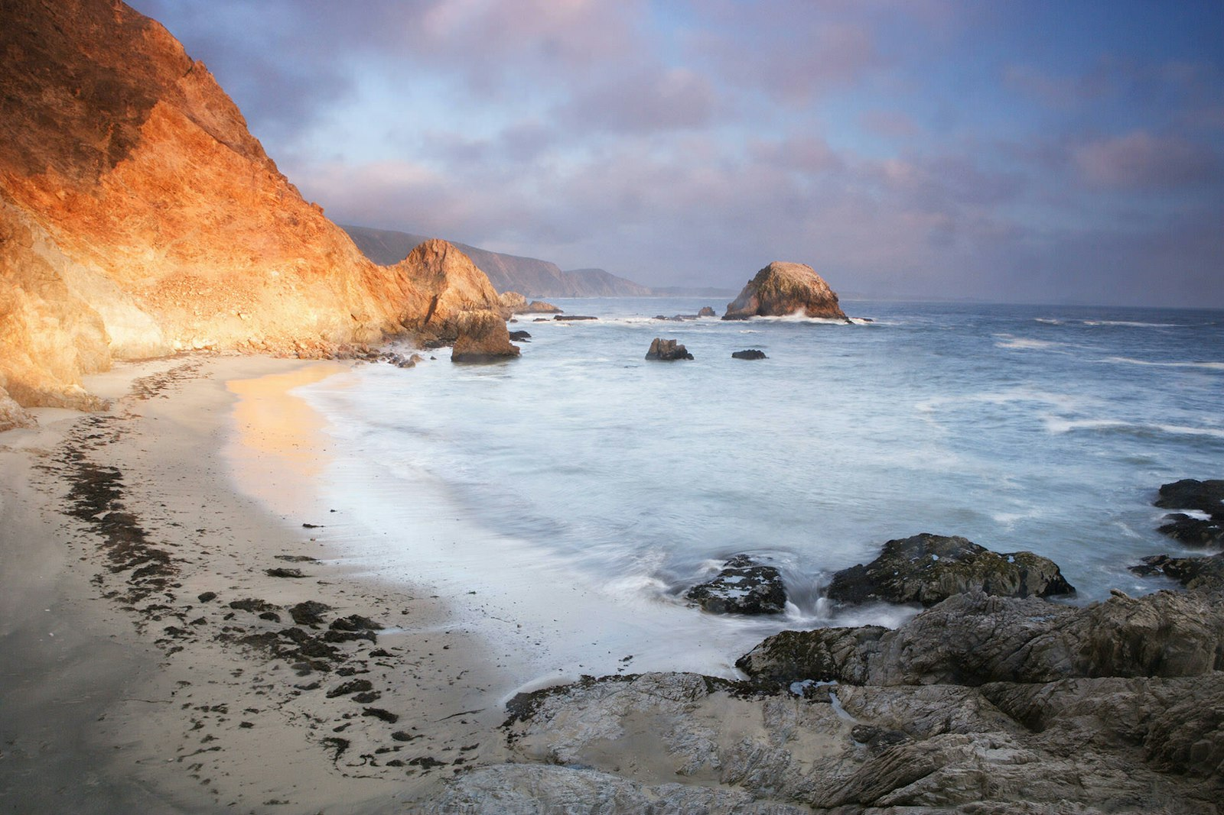
Water in National Parks
Some parks were created to protect and preserve unique water features, such as the tidal aquatic zones at Point Reyes National Seashore, California.
Image: https://www.nationalparks.org/explore/parks/point-reyes-national-seashore

Slide 9
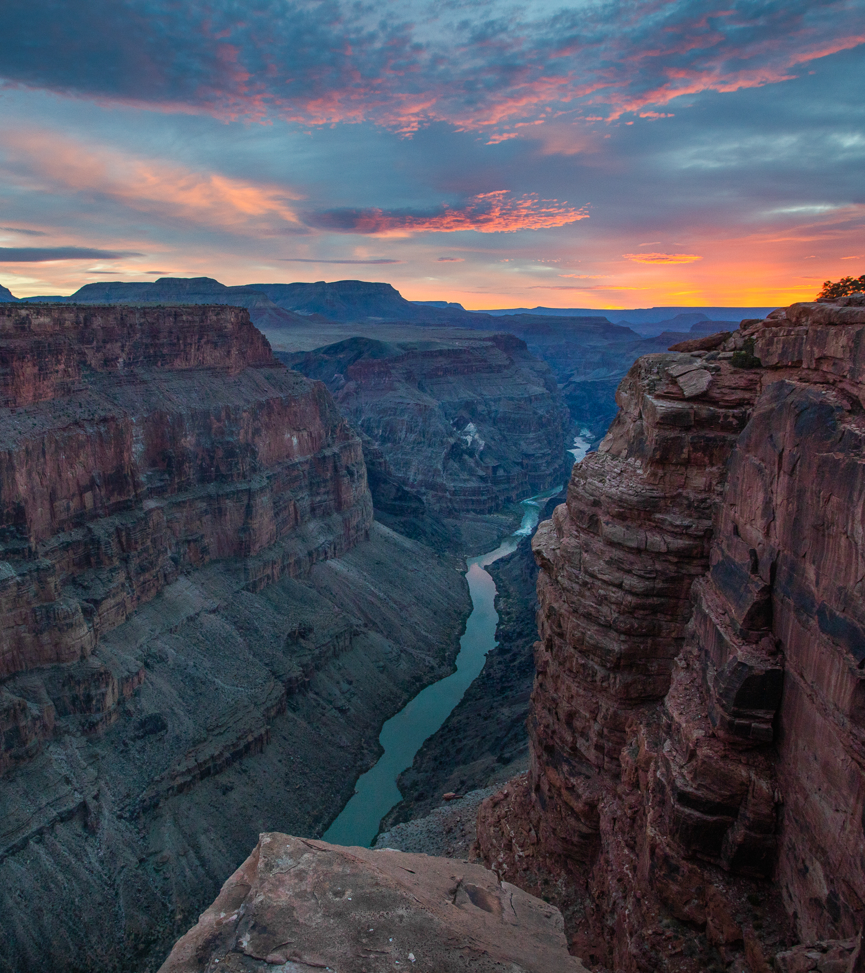
Water in National Parks
Other parks preserve landscapes shaped by water, such as Grand Canyon National Park in Arizona, which is carved by the rushing Colorado River.
Image: https://www.americanrivers.org/river/colorado-river-in-the-grand-canyon-2/

Slide 10
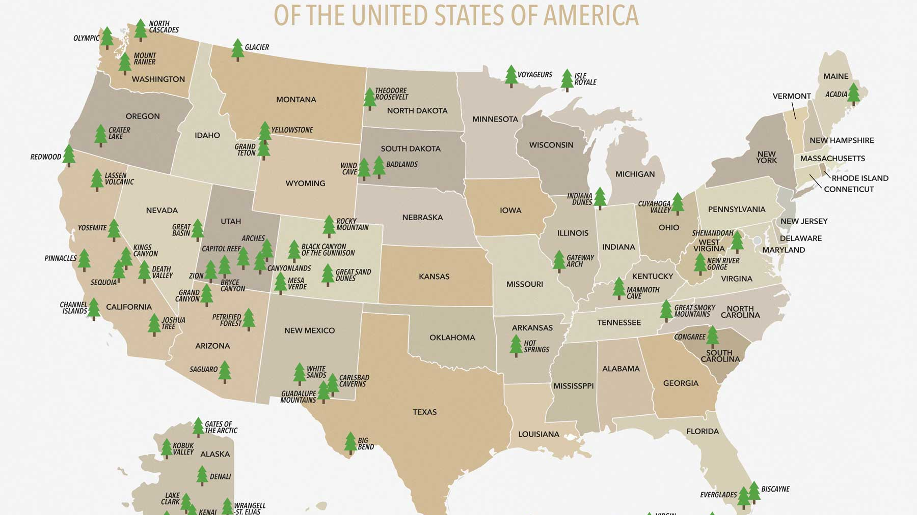
Let’s take a Closer look at our national parks!
Image: https://morethanjustparks.com/list-of-national-parks-by-state/

Slide 11
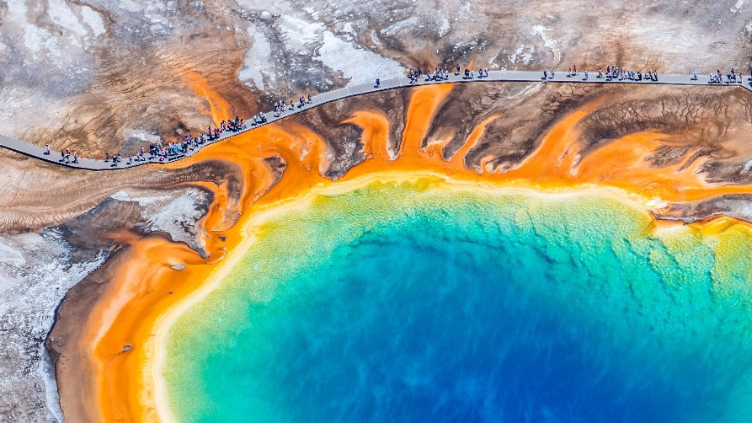
Card #1
Yellowstone National Park, Wyoming
Image: https://www.cntraveler.com/story/yellowstone-national-park-guide

Slide 12
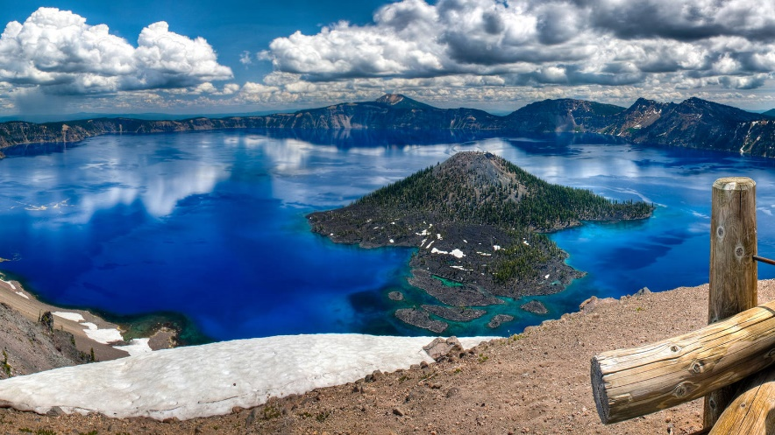
Card #2
Crater Lake National Park, Oregon
Image: https://www.npca.org/parks/crater-lake-national-park

Slide 13
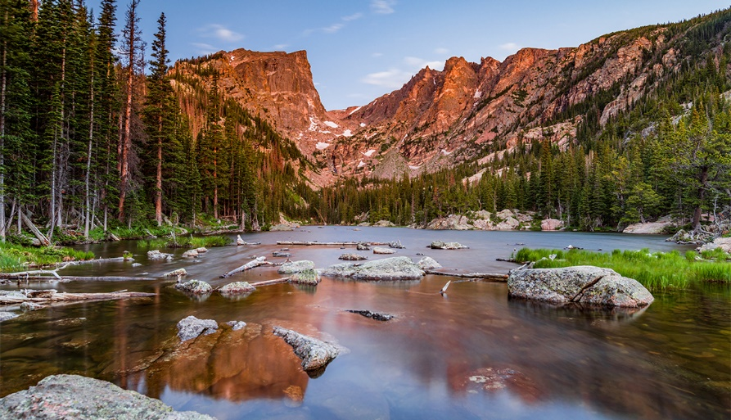
Card #3
Rocky Mountain National Park, Colorado
Image: https://www.aarp.org/travel/vacation-ideas/outdoors/info-2020/rocky-mountain-national-park-guide.html

Slide 14
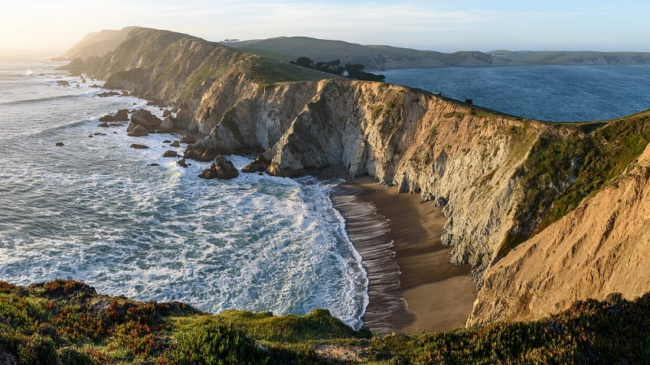
Card #4
Point Reyes National Seashore, California
Image: https://en.wikipedia.org/wiki/Point_Reyes_National_Seashore

Slide 15
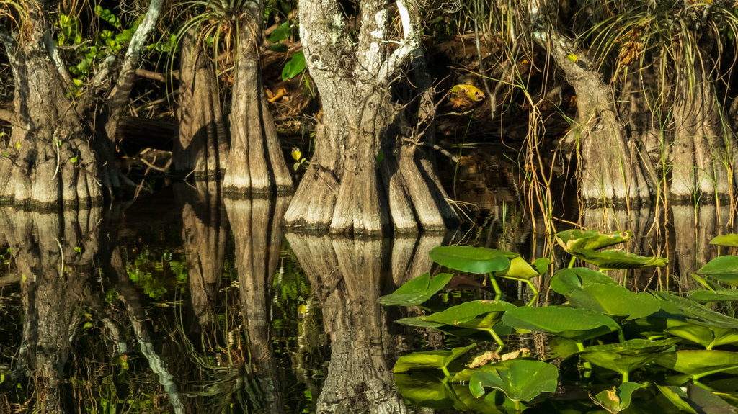
Card #5
Everglades National Park, Florida
Image: https://ruggednation.com/blogs/adventure-outpost/destination-everglades-national-park

Slide 16
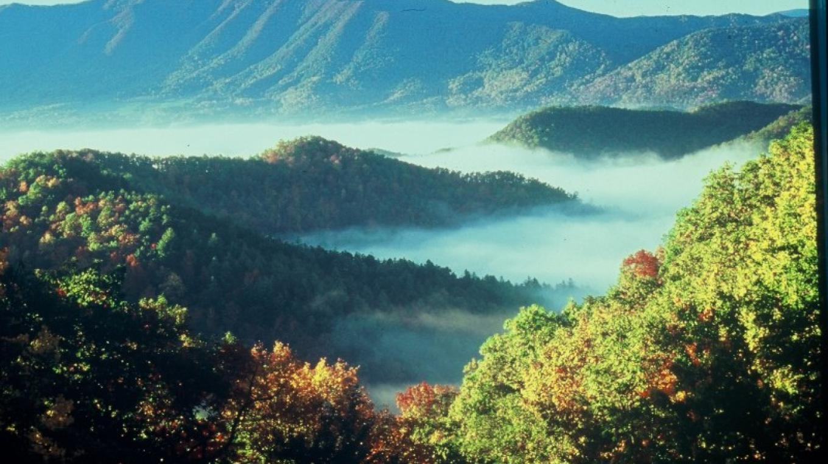
Card #6
Great Smoky Mountain National Park, Tennessee
Image: https://tennesseerivervalleygeotourism.org/entries/great-smoky-mountains-national-park/59cc164f-dbb8-42ed-9d83-f3e2f65eae61

Slide 17

The Important Work of Hallsdale-Powell Utility District
When you turn on the sink, take a shower, or fill your water bottle, the water doesn’t just appear!
The workers at Hallsdale-Powell Utility District clean water from nearby lakes so it’s safe to drink and use. Then they send it through pipes to your home!

Slide 18
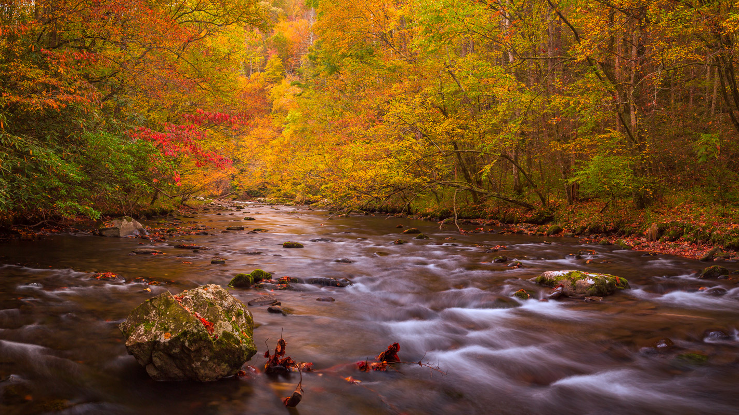
The Important Work of Hallsdale-Powell Utility District
Safe, reliable drinking water is essential to life, health, and the well-being of our communities. Careful planning, dedicated professionals, and vital infrastructure investments make it possible for Hallsdale-Powell Utility District to deliver clean water!
Image: https://www.josephfiler.com/gallery/smoky-mountains/

