Slide 1
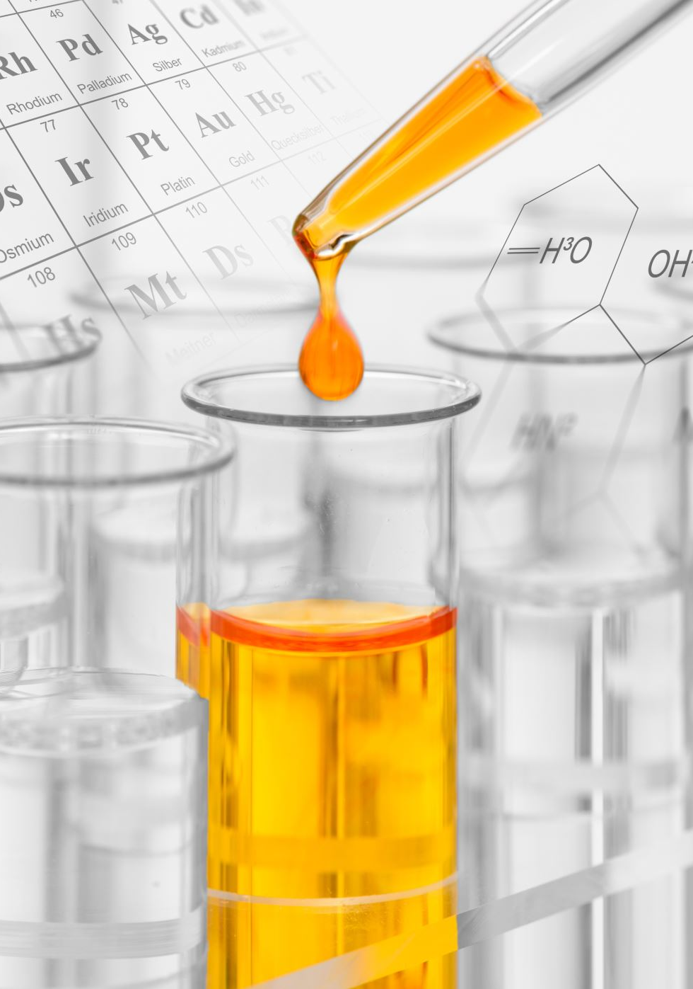
Using Dissolving to Identify Substances
Hallsdale-Powell Utility District

Slide 2
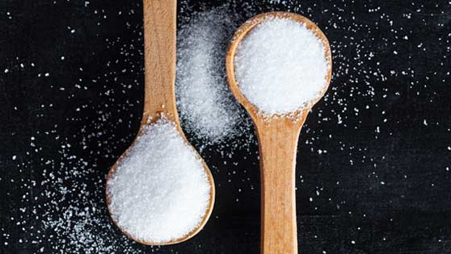
How can you tell the difference between salt and sugar?
Image: https://futureyouhealth.com/knowledge-centre/sugar-vs-salt

Slide 3
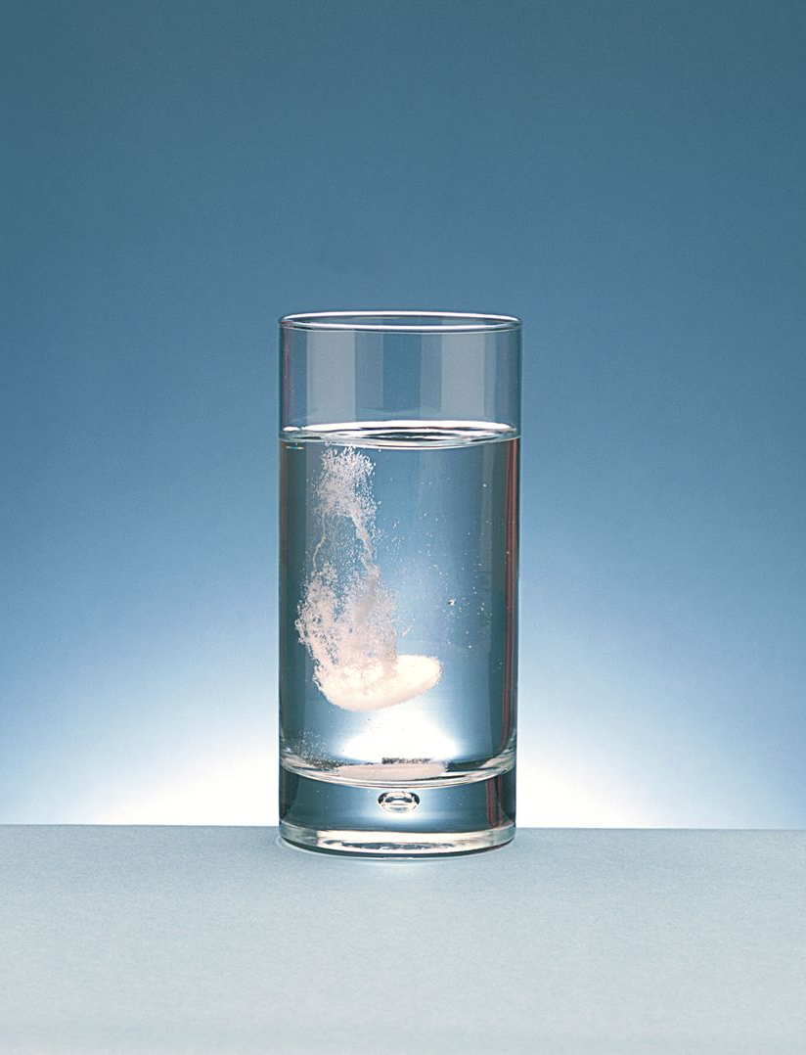
One way to tell one substance from another is to compare dissolving rates
Each substance is different, so water molecules attract and dissolve them differently.
Some substances barely dissolve at all, while others dissolve easily.
Image: https://www.thoughtco.com/why-is-water-the-universal-solvent-609417

Slide 4
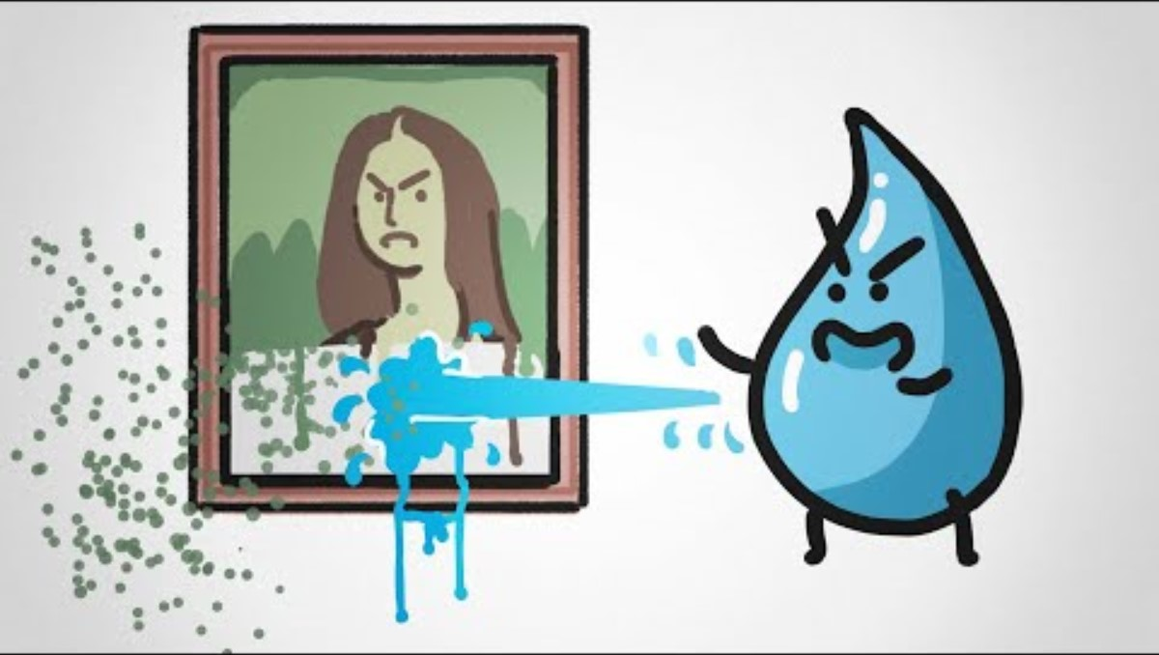

Slide 5
Can you identify substances based on how well they dissolve in water? Let’s find out!
In front of you, you have 5 cups: sugar, salt, cup A, cup B, and cup C. DO NOT TASTE ANY OF THE LAB MATERIAL.
Using your teaspoon, place one level scoop of sugar into one cup and salt into the other cup.
Add 2 teaspoons of water to each cup.
Gently swirl the cups and observe which dissolves the most.
Write down your observations on your worksheet.
Rinse your cups and dry them when you’re finished.

Slide 6
Let’s figure out these unknown substances!
We will now repeat the same procedure with the unknown substances.
Place 1 teaspoon of the unknown substances from cups A, B, and C into your three cups.
Place 2 teaspoons of water into each cup and gently swirl your cups.
Write down your observations.

Slide 7
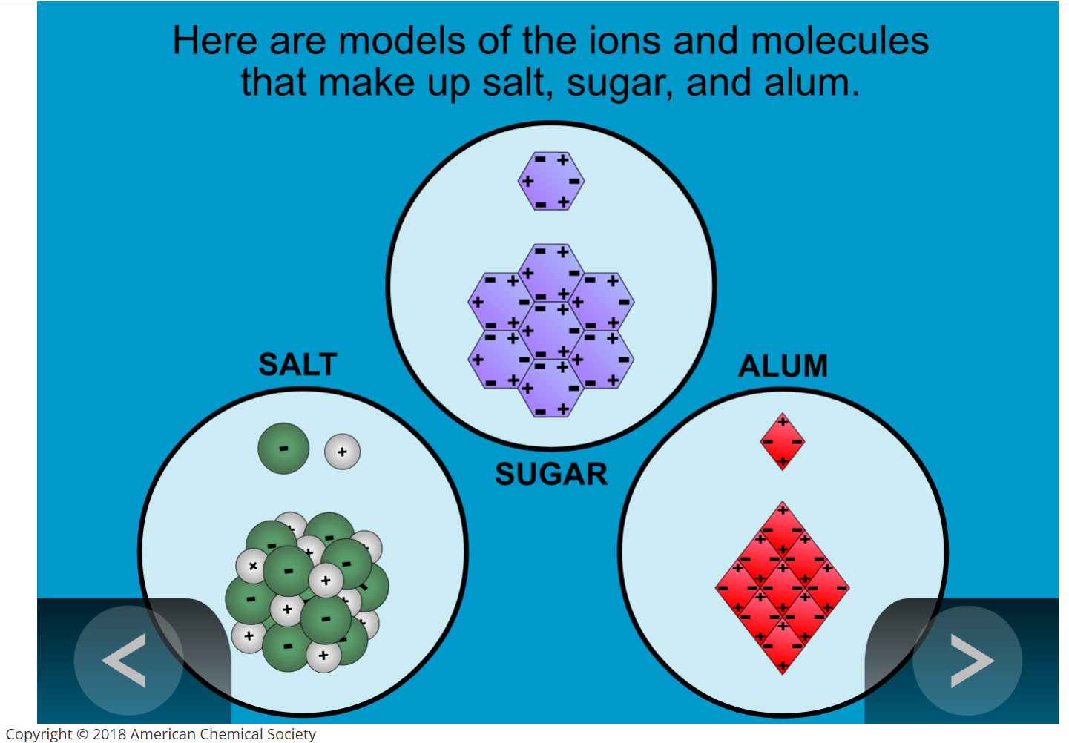

Slide 8
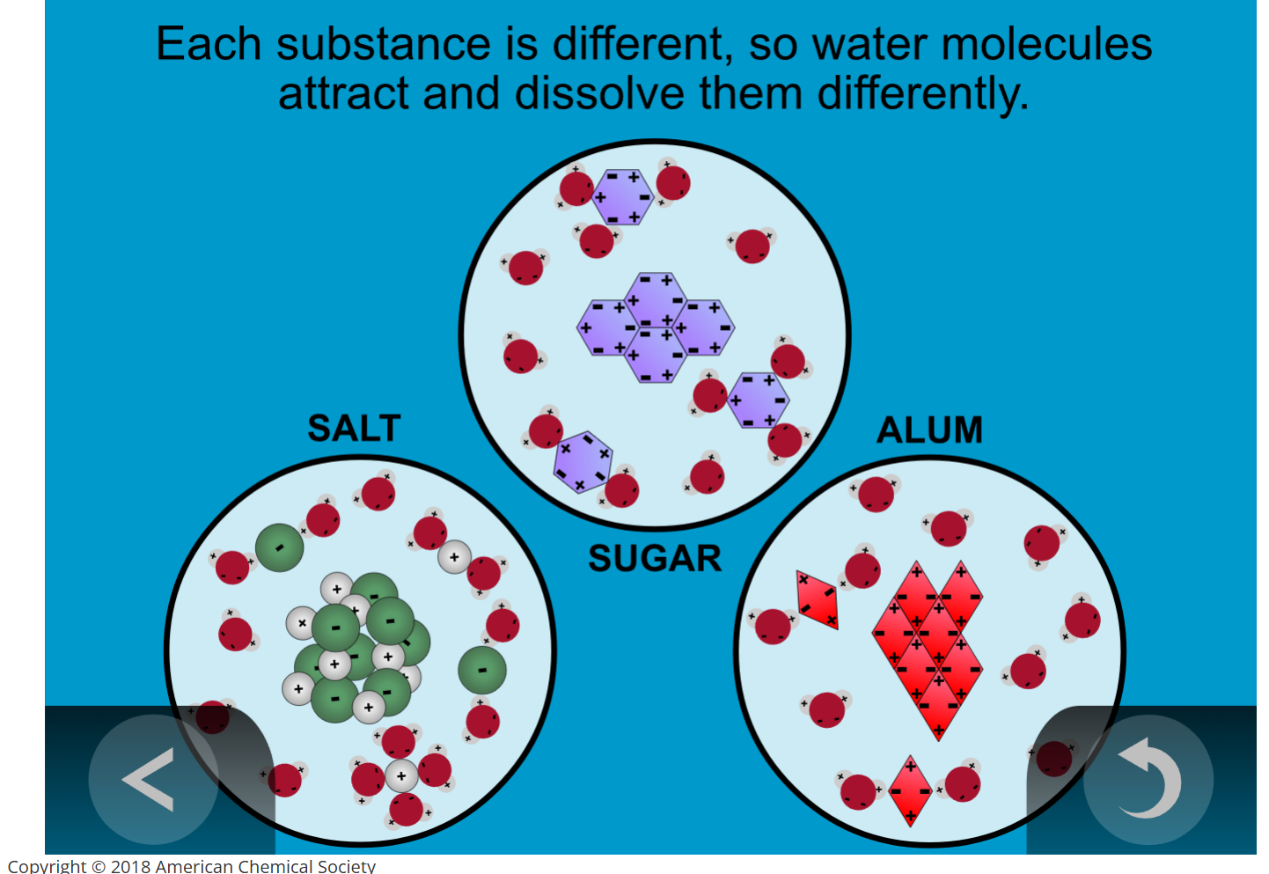

Slide 9
All About Alum!
Alum is a common chemical compound that is used every day!
It’s found in baking powder, toothpaste, cosmetics, and fire extinguishers.
It can also be used to grow crystals and clean water!
Alum neutralizes the negatively charged dirt particles in the water, causing the dirt to clump together and sink to the bottom.

Slide 10
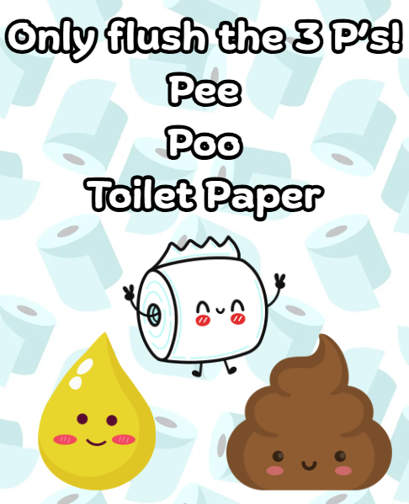
The Important Work of Hallsdale-Powell Utility District
Just because something dissolves in water, doesn’t mean it disappears!
Only flush the 3Ps! Pee, Poo, and Toilet Paper
Flushing other items down the toilet or drain can damage pipes and cause sewage to back up – yuck!

