Slide 1
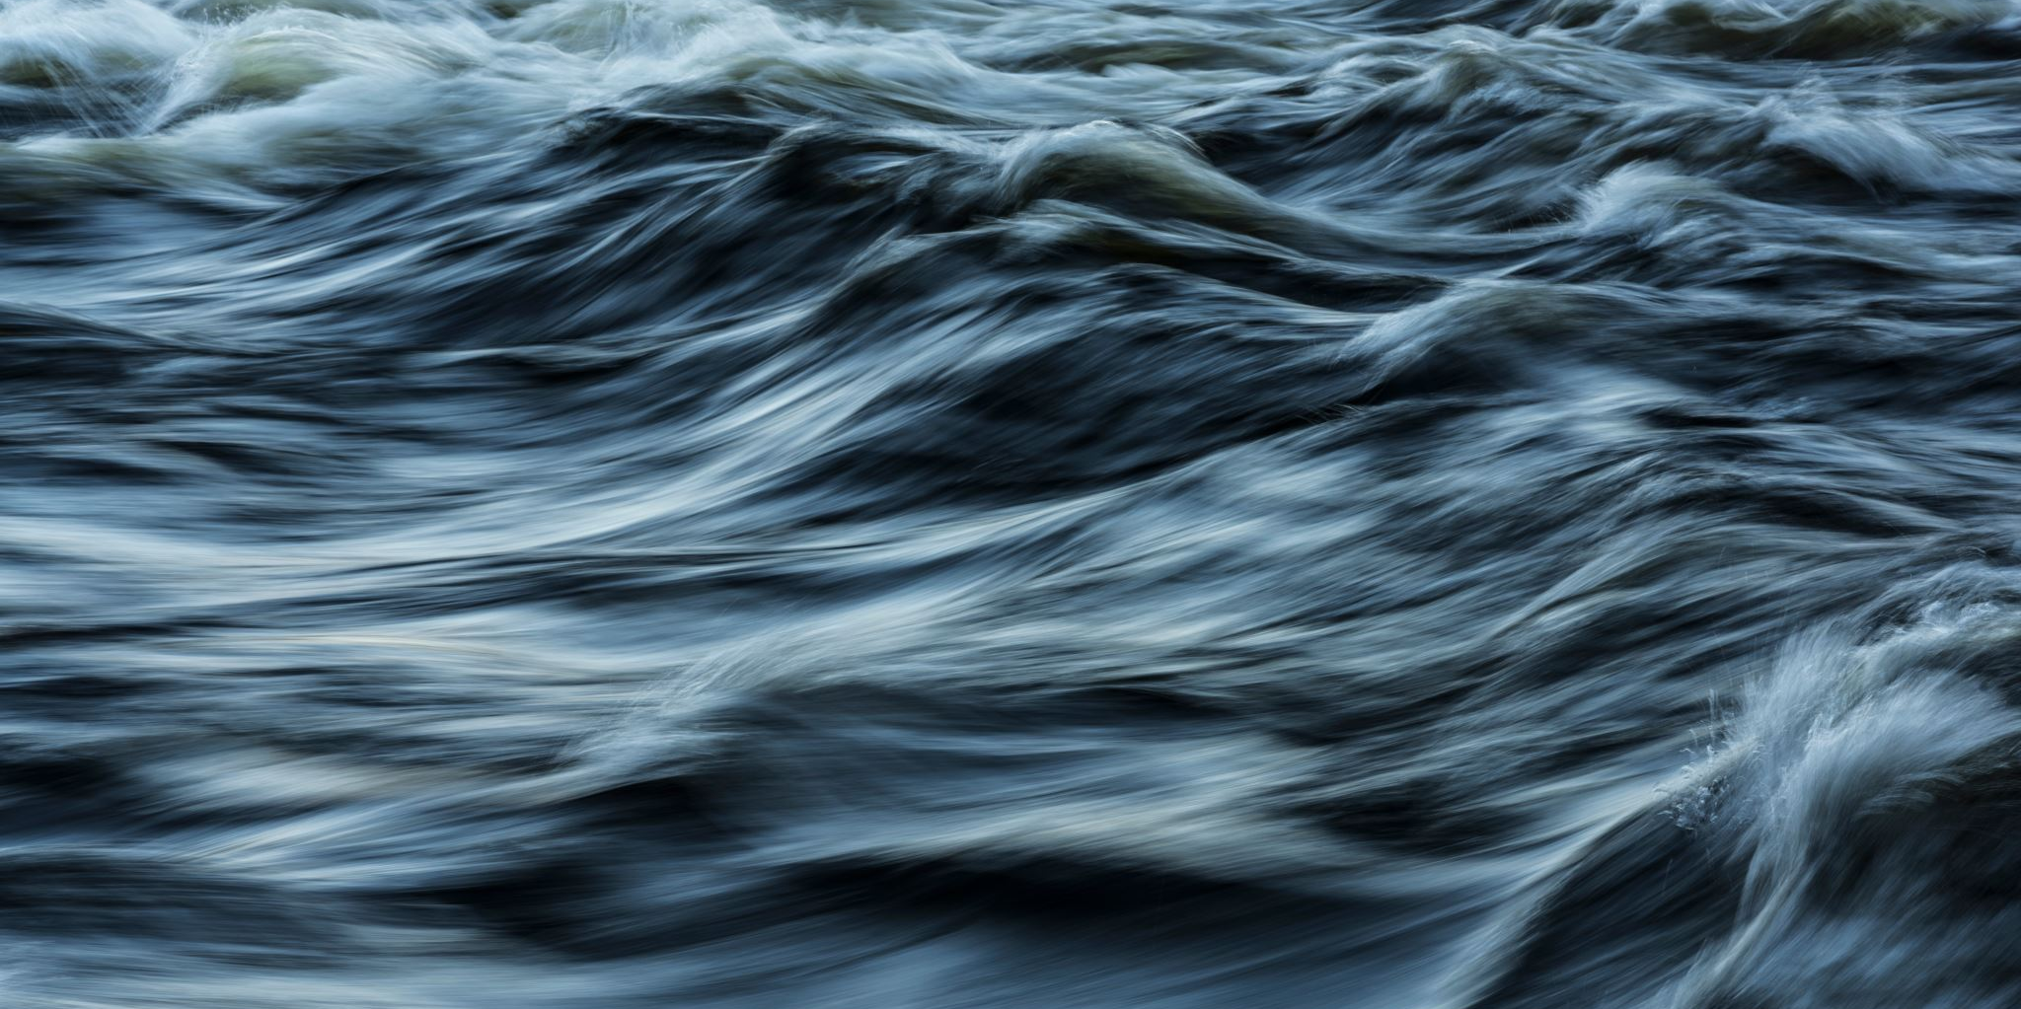

Water Power
Hallsdale-Powell Utility District

Slide 2

What ways can we use water as energy?
Image: https://investorplace.com/2024/06/3-renewable-energy-stocks-with-unstoppable-momentum/

Slide 3
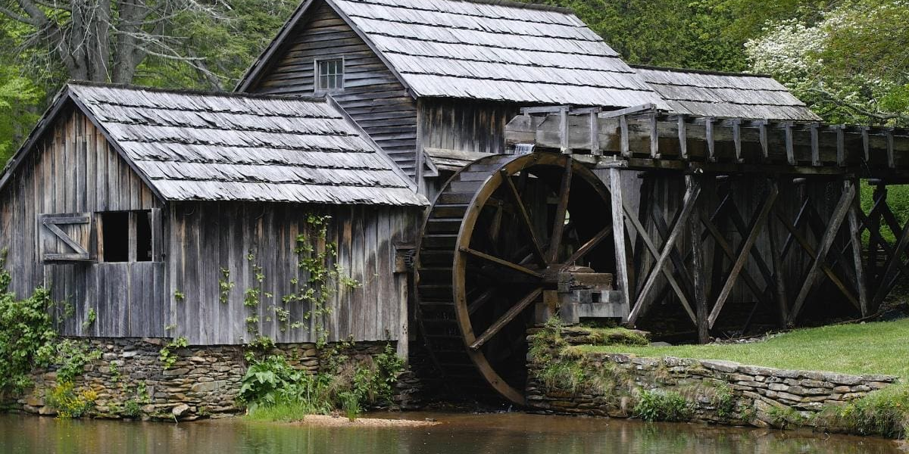
Water has been used as an energy source for 2,000 years! It was first used by early farmers to grind wheat into flour.
Image https://www.perkins.org/resource/building-water-wheel/

Slide 4
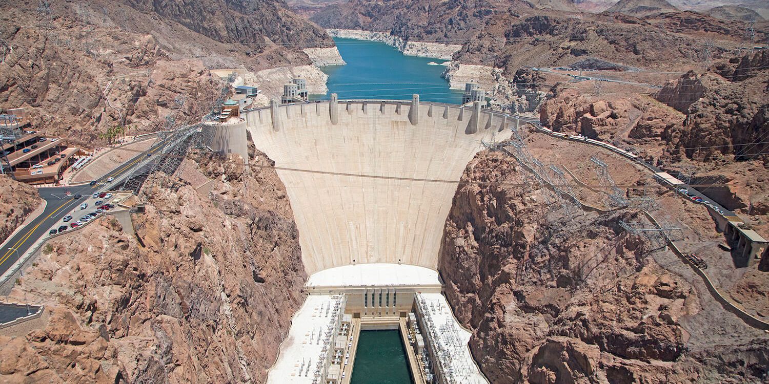
Since nature can produce water over and over again, what type of resource is it?
Image: https://travelnevada.com/hoover-dam/

Slide 5
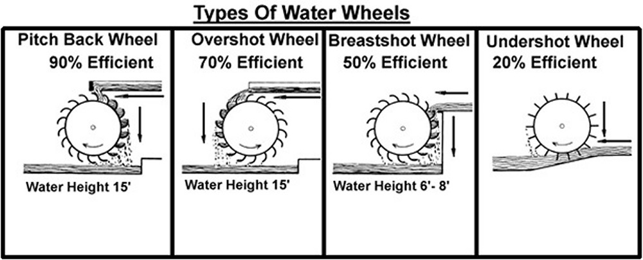
There are several different types of water wheels
Image https://richmondconspiracy.blogspot.com/2013/03/water-wheel-and-mill-basics.html

Slide 6
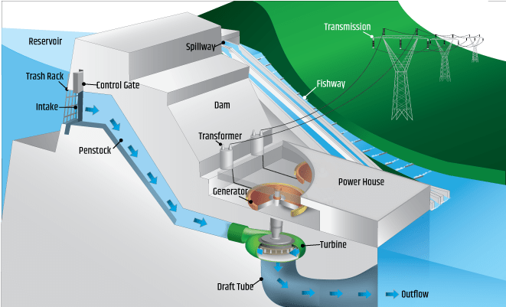
Dams use a similar technology on a much larger scale
Image: https://www.energy.gov/eere/water/types-hydropower-plants

Slide 7
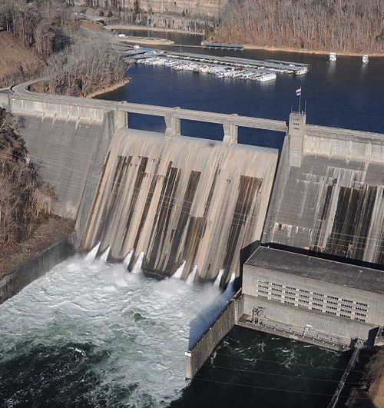
Did you know we have many dams in Tennessee?
Norris Dam was the first dam built by the TVA in 1936. It controls flood water and provides electric power to nearby towns.
It is 1860 feet long and 265 feet tall!
Image: https://livingnewdeal.org/sites/norris-dam-andersonville-tn/

Slide 8

What are some benefits to capturing energy using a renewable source?
Image: https://www.newsweek.com/navigating-new-frontier-renewable-energy-1872616

Slide 9

Notes:
https://www.youtube.com/watch?v=pEUzot8Zufo

Slide 10
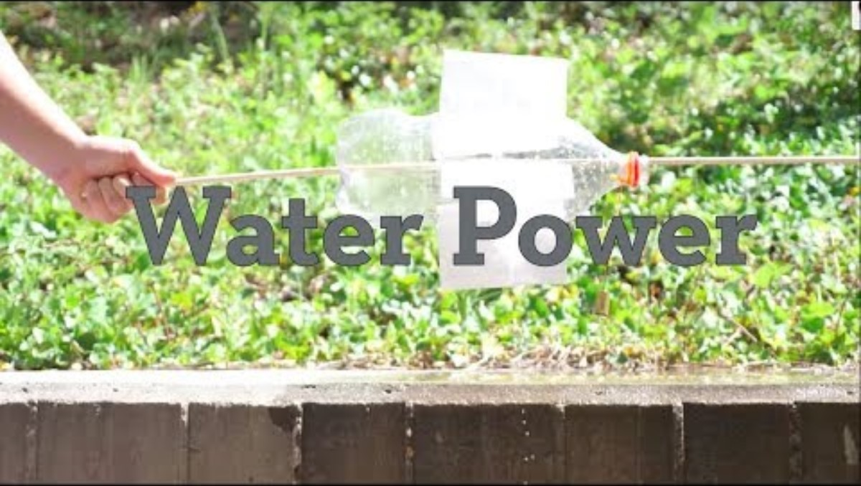
Let’s create our own model!
Notes:
https://www.youtube.com/watch?v=nHGRcXD5SMM

Slide 11
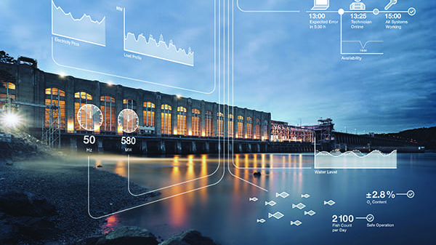
Great work engineers!
How could you have improved your model?
Image: https://www.powermag.com/iiot-and-the-future-of-hydropower/

Slide 12
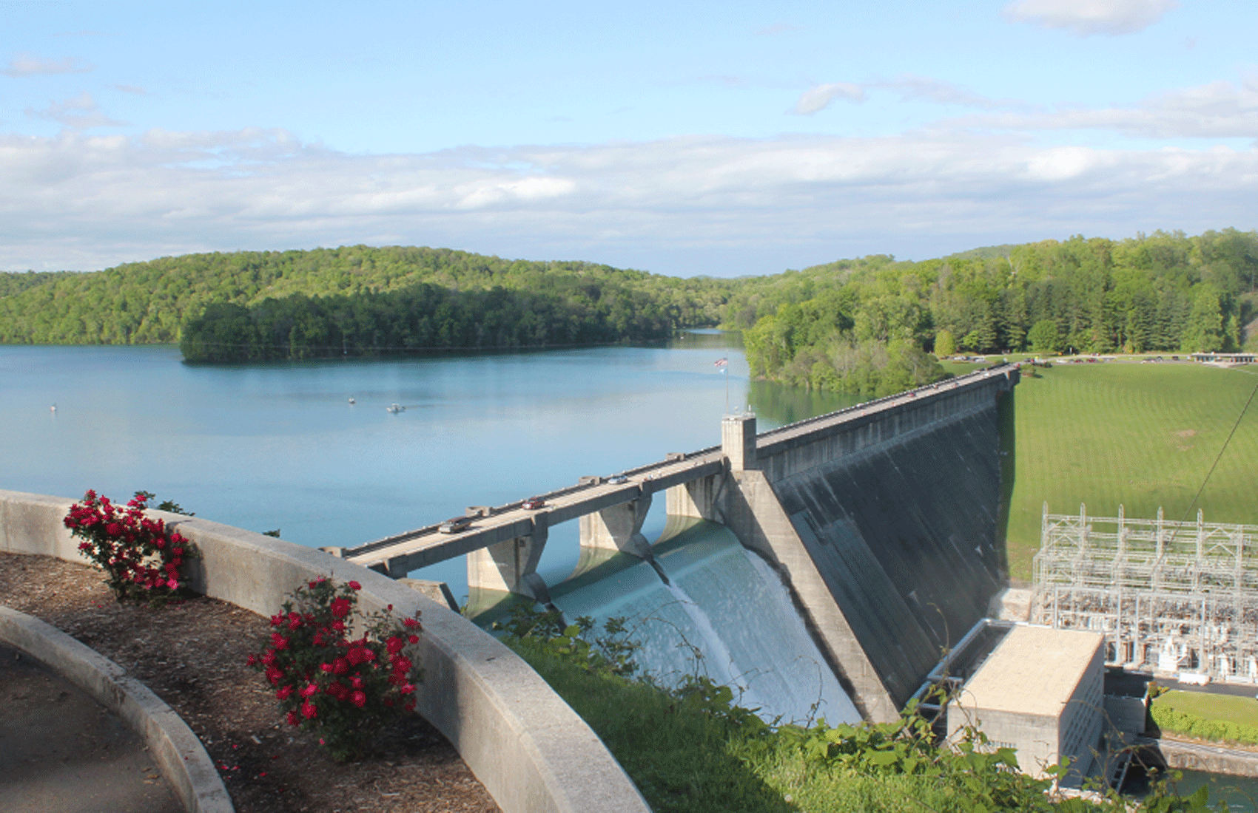
The Important Work at Hallsdale-Powell Utility District
Hallsdale-Powell Utility District gets its water from Norris and Melton Hill Lakes. These lakes formed because of dams!
Dams help store and control water. Hallsdale-Powell Utility District treats the water and delivers it to your home and school!
Image: https://adventureanderson.com/places/norris-dam-state-park/

