Slide 1
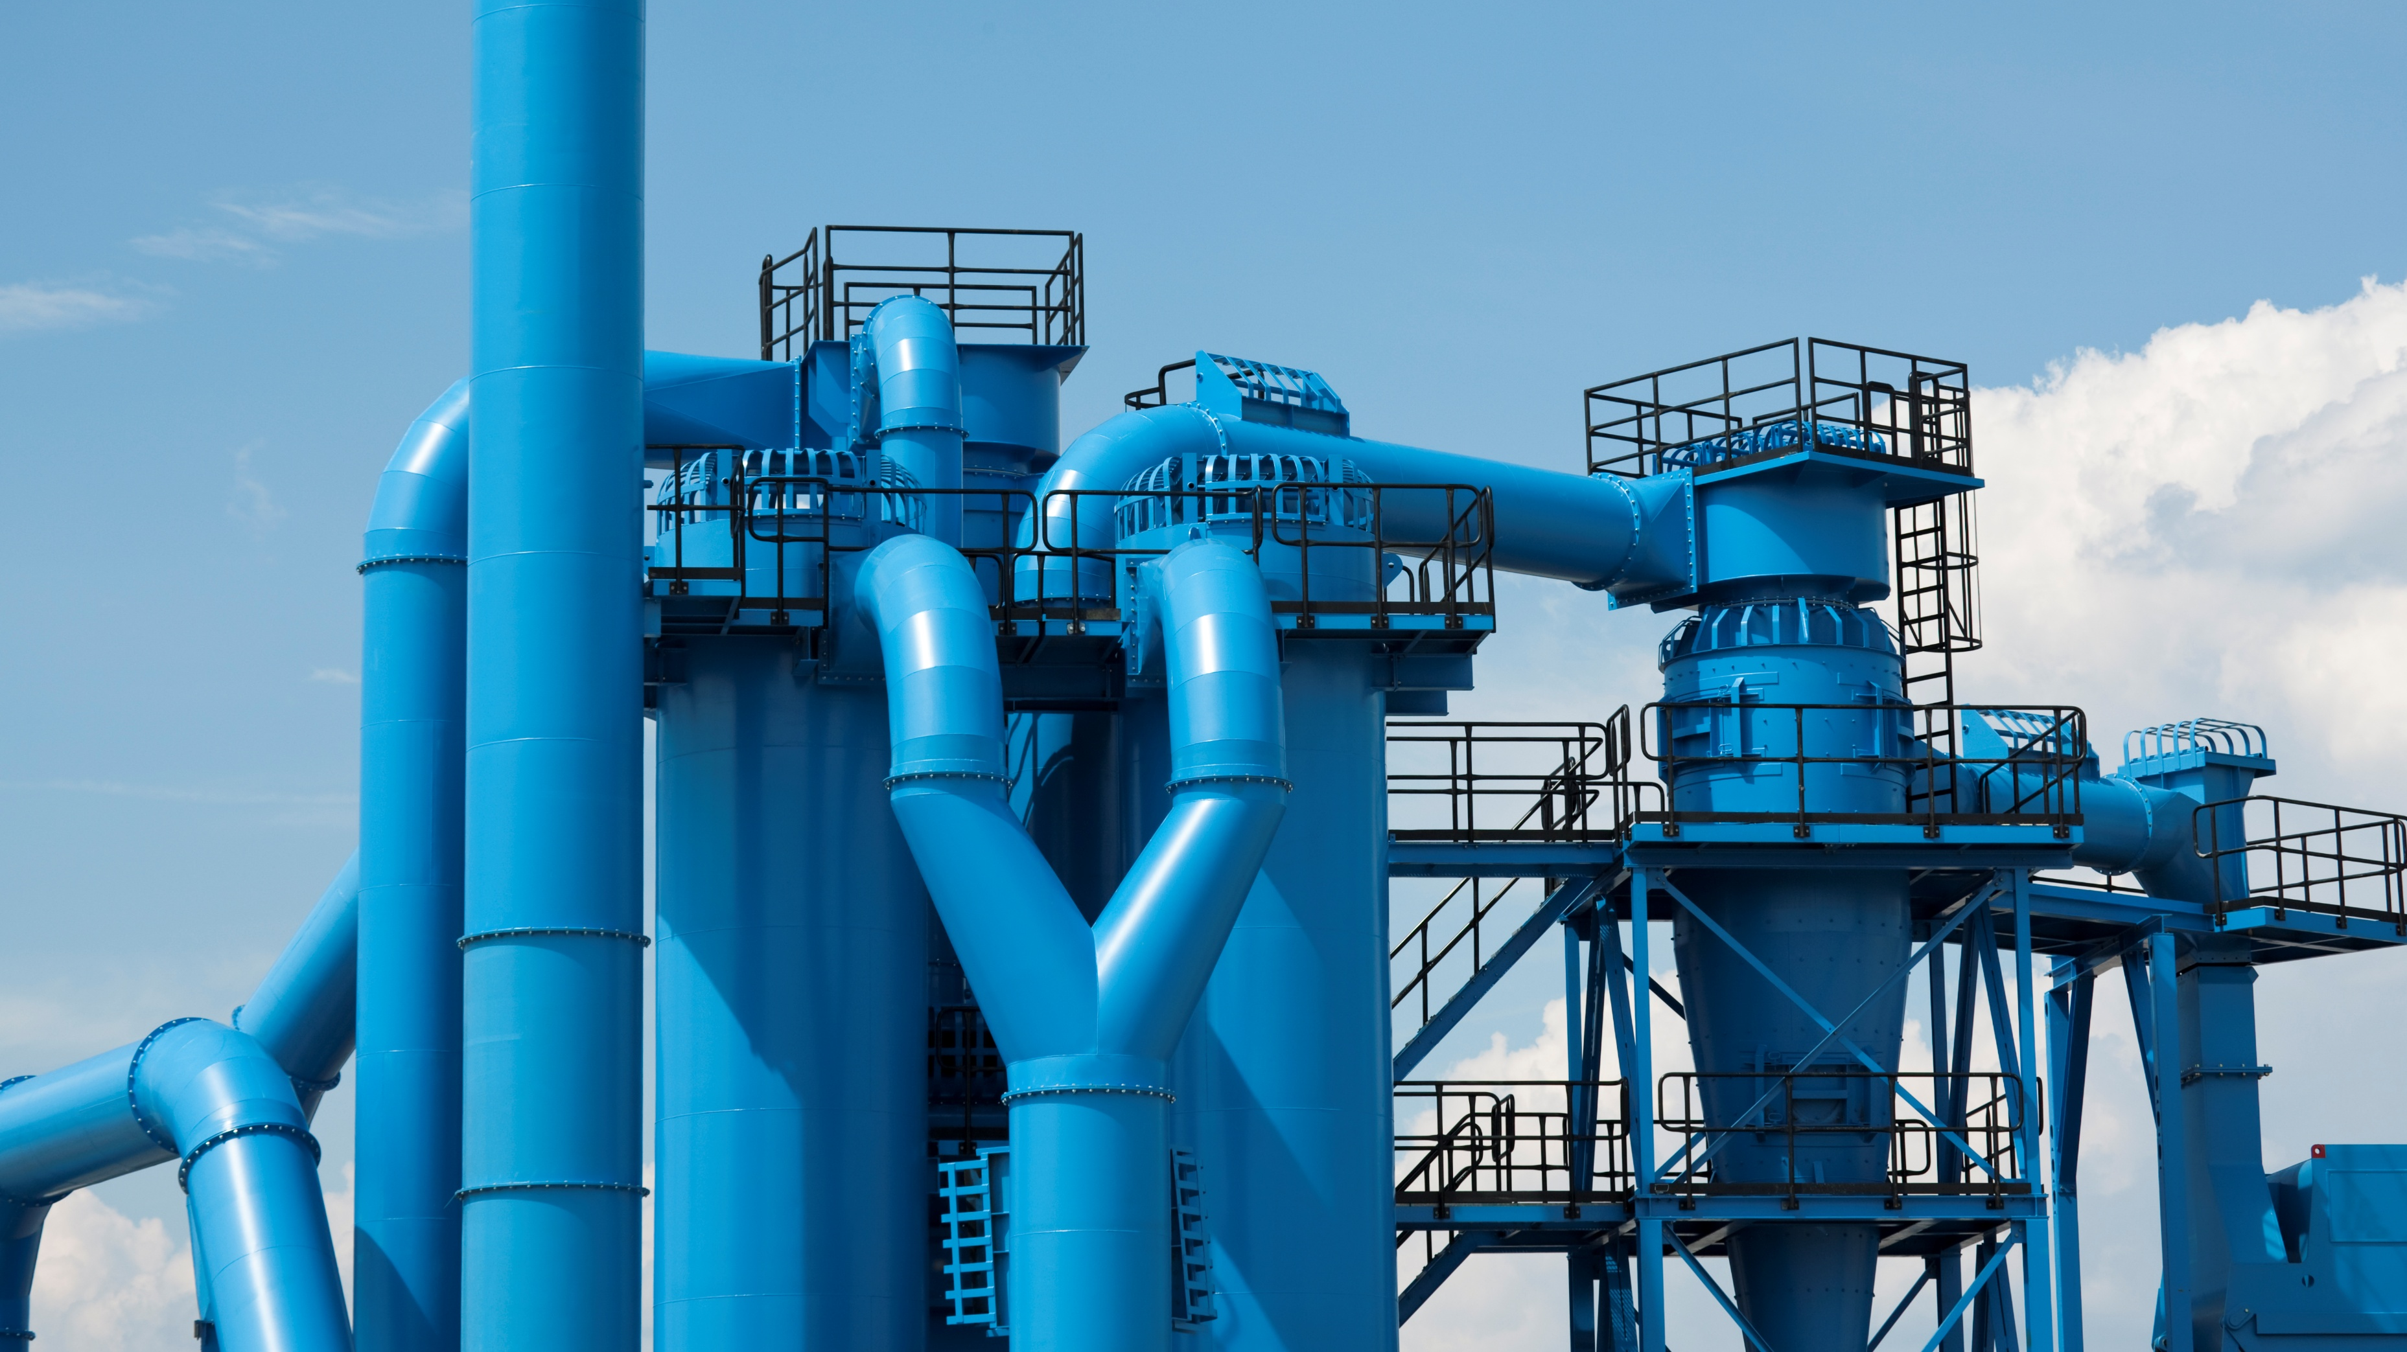
Game of Pipes
Hallsdale-Powell Utility District

Slide 2

What are some ways you used water today?

Slide 3
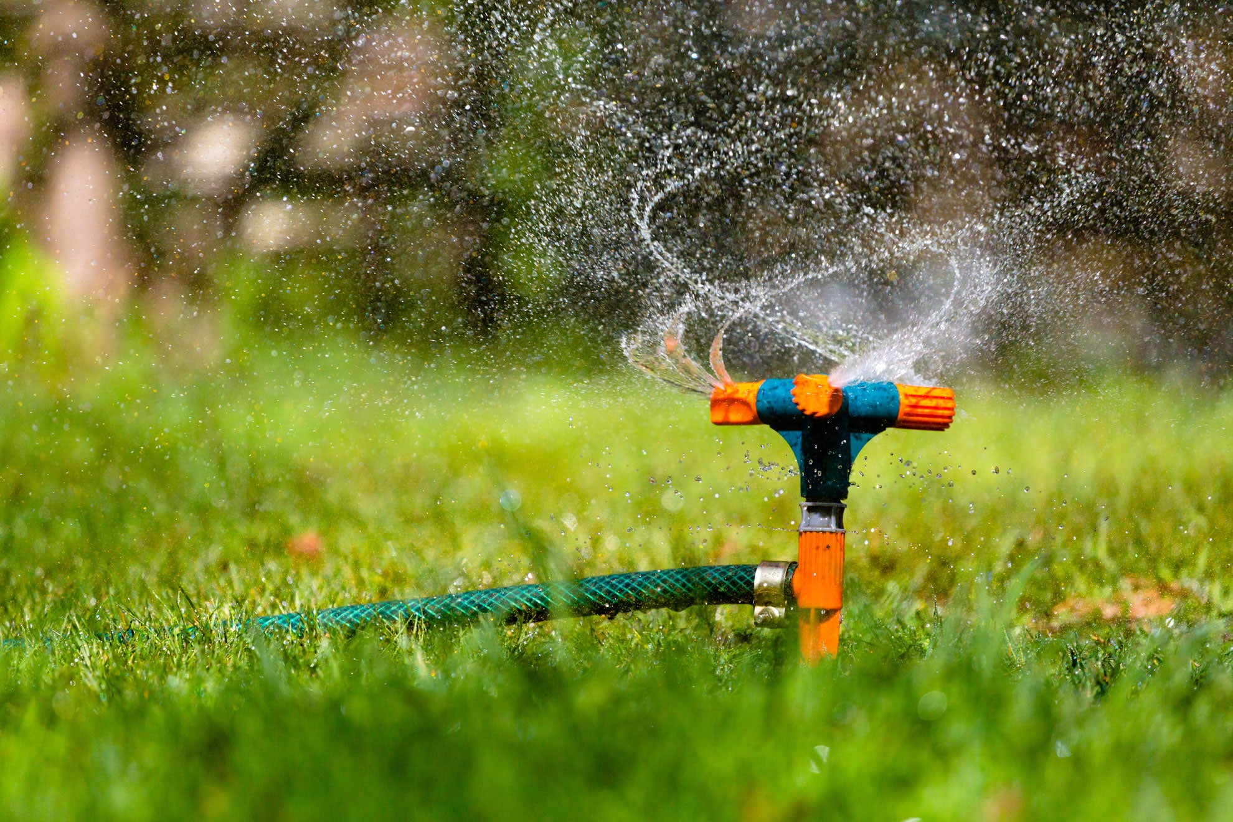
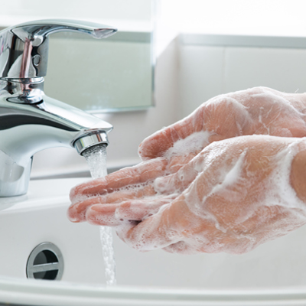
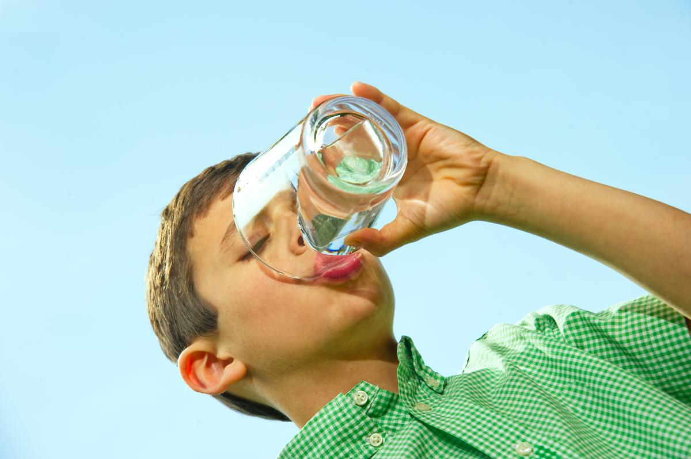
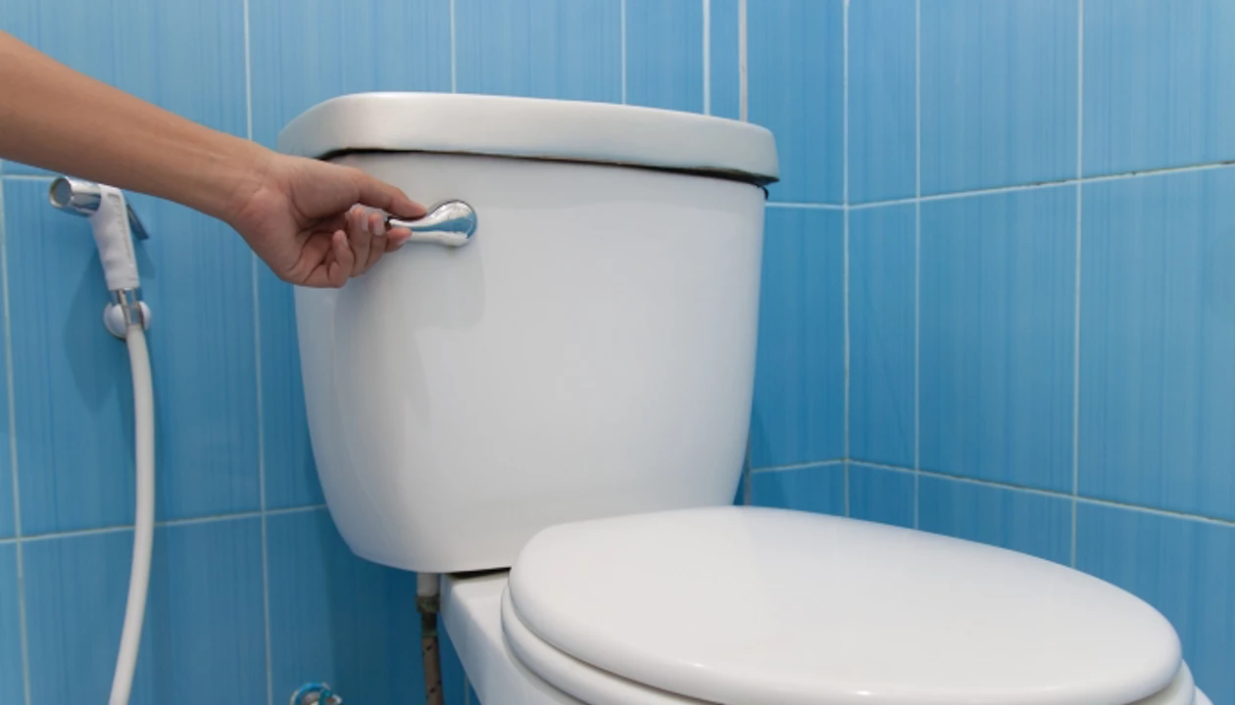
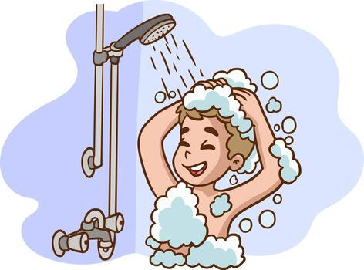
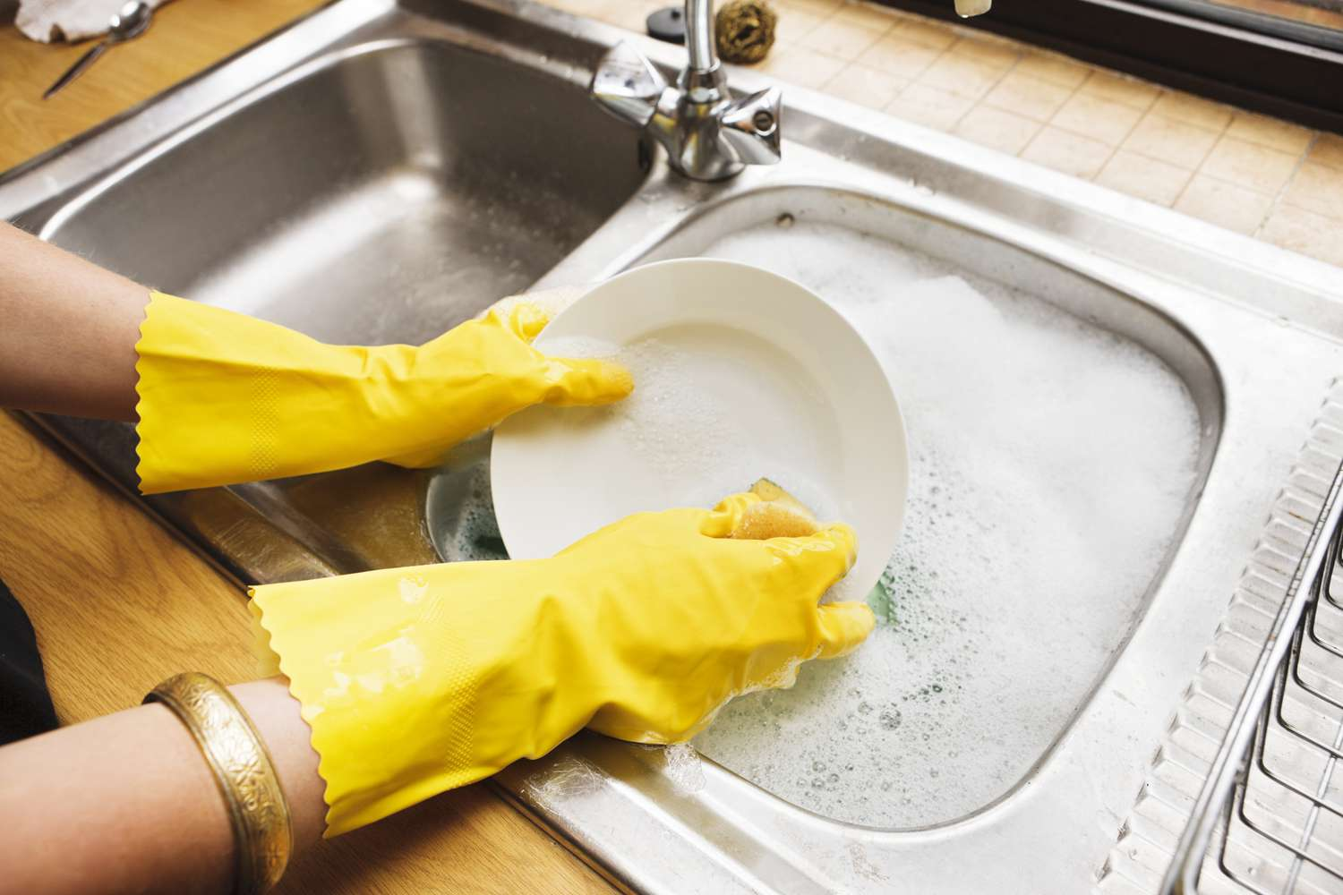
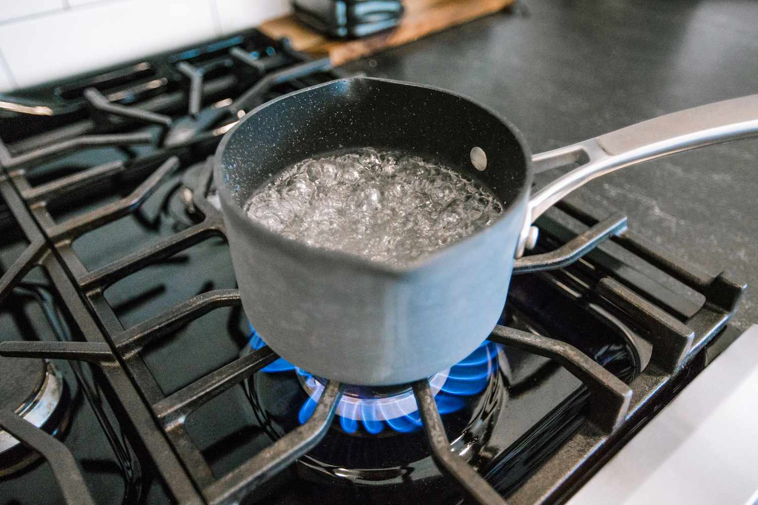

Slide 4
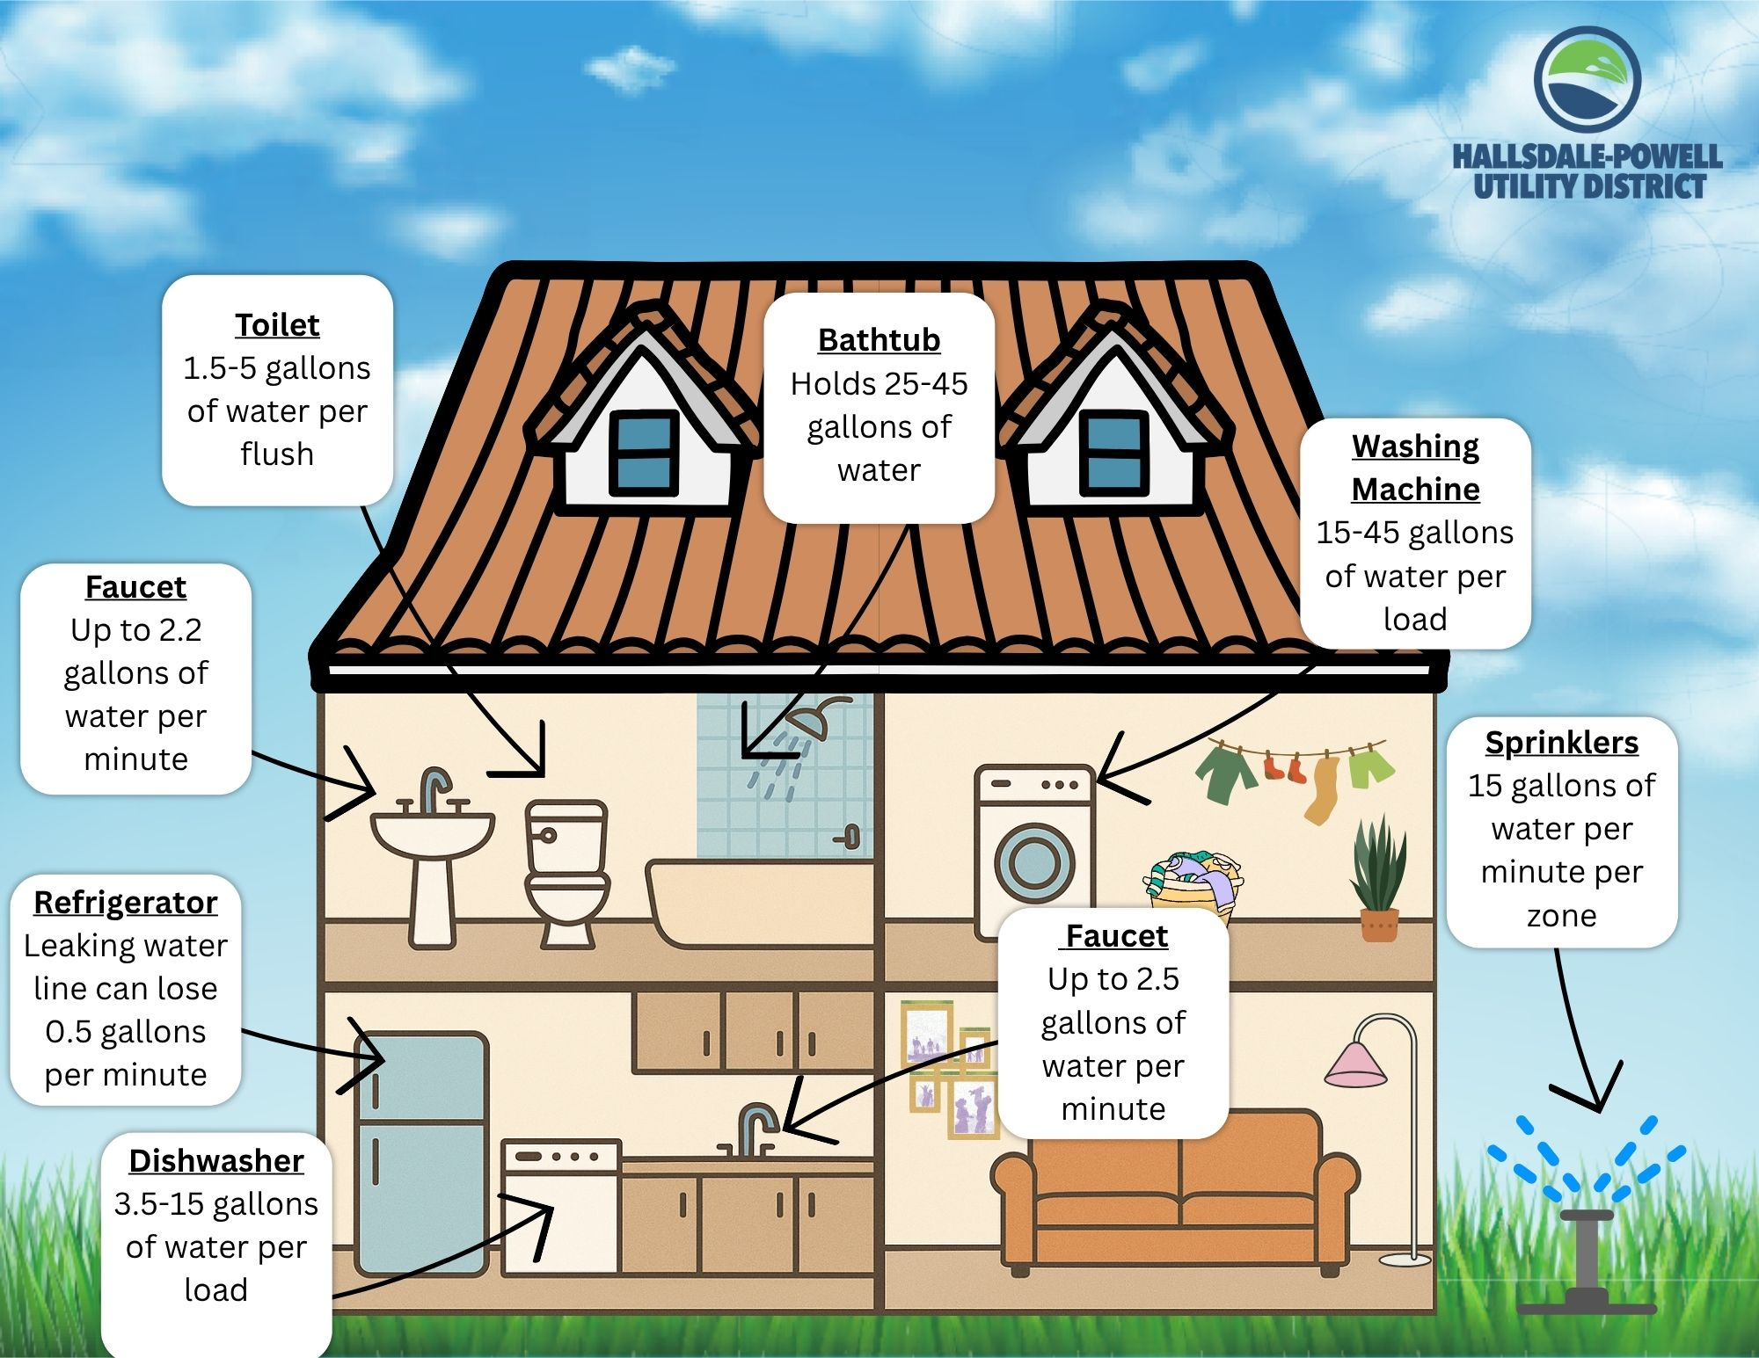

Slide 5
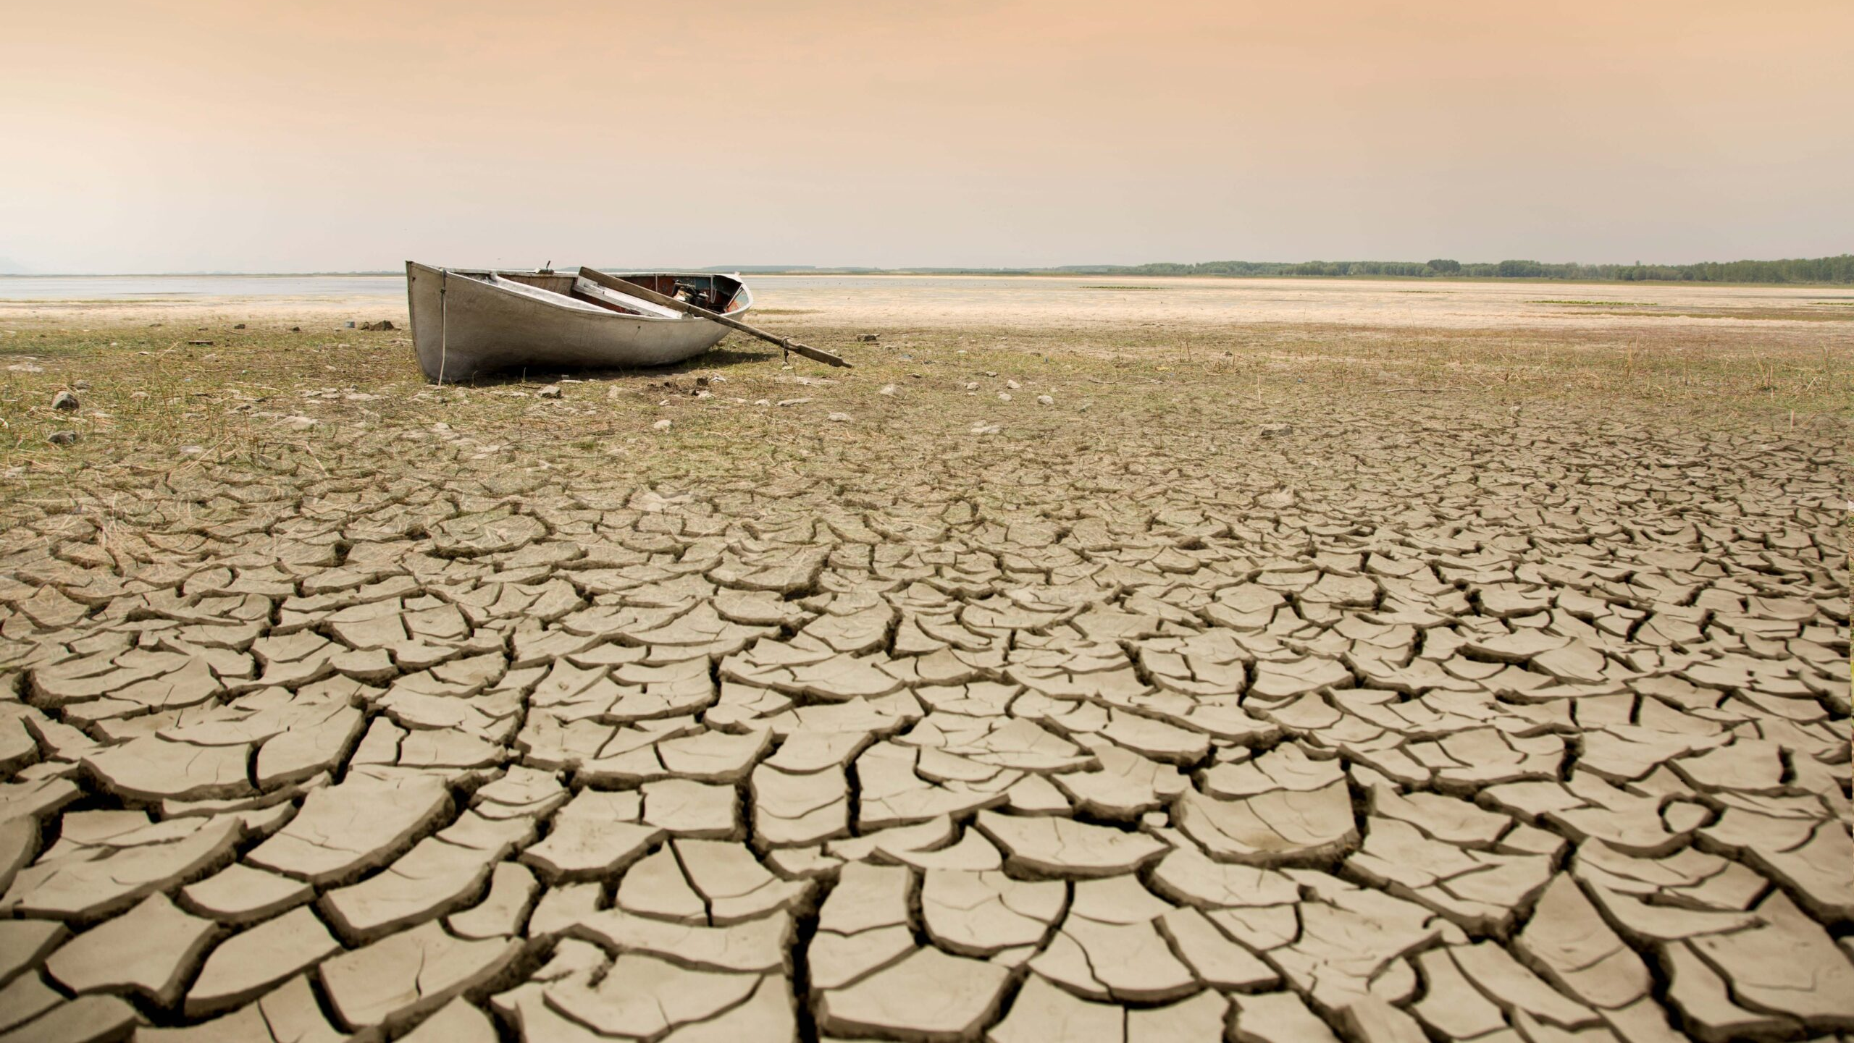
What would life be like without water?

Slide 6
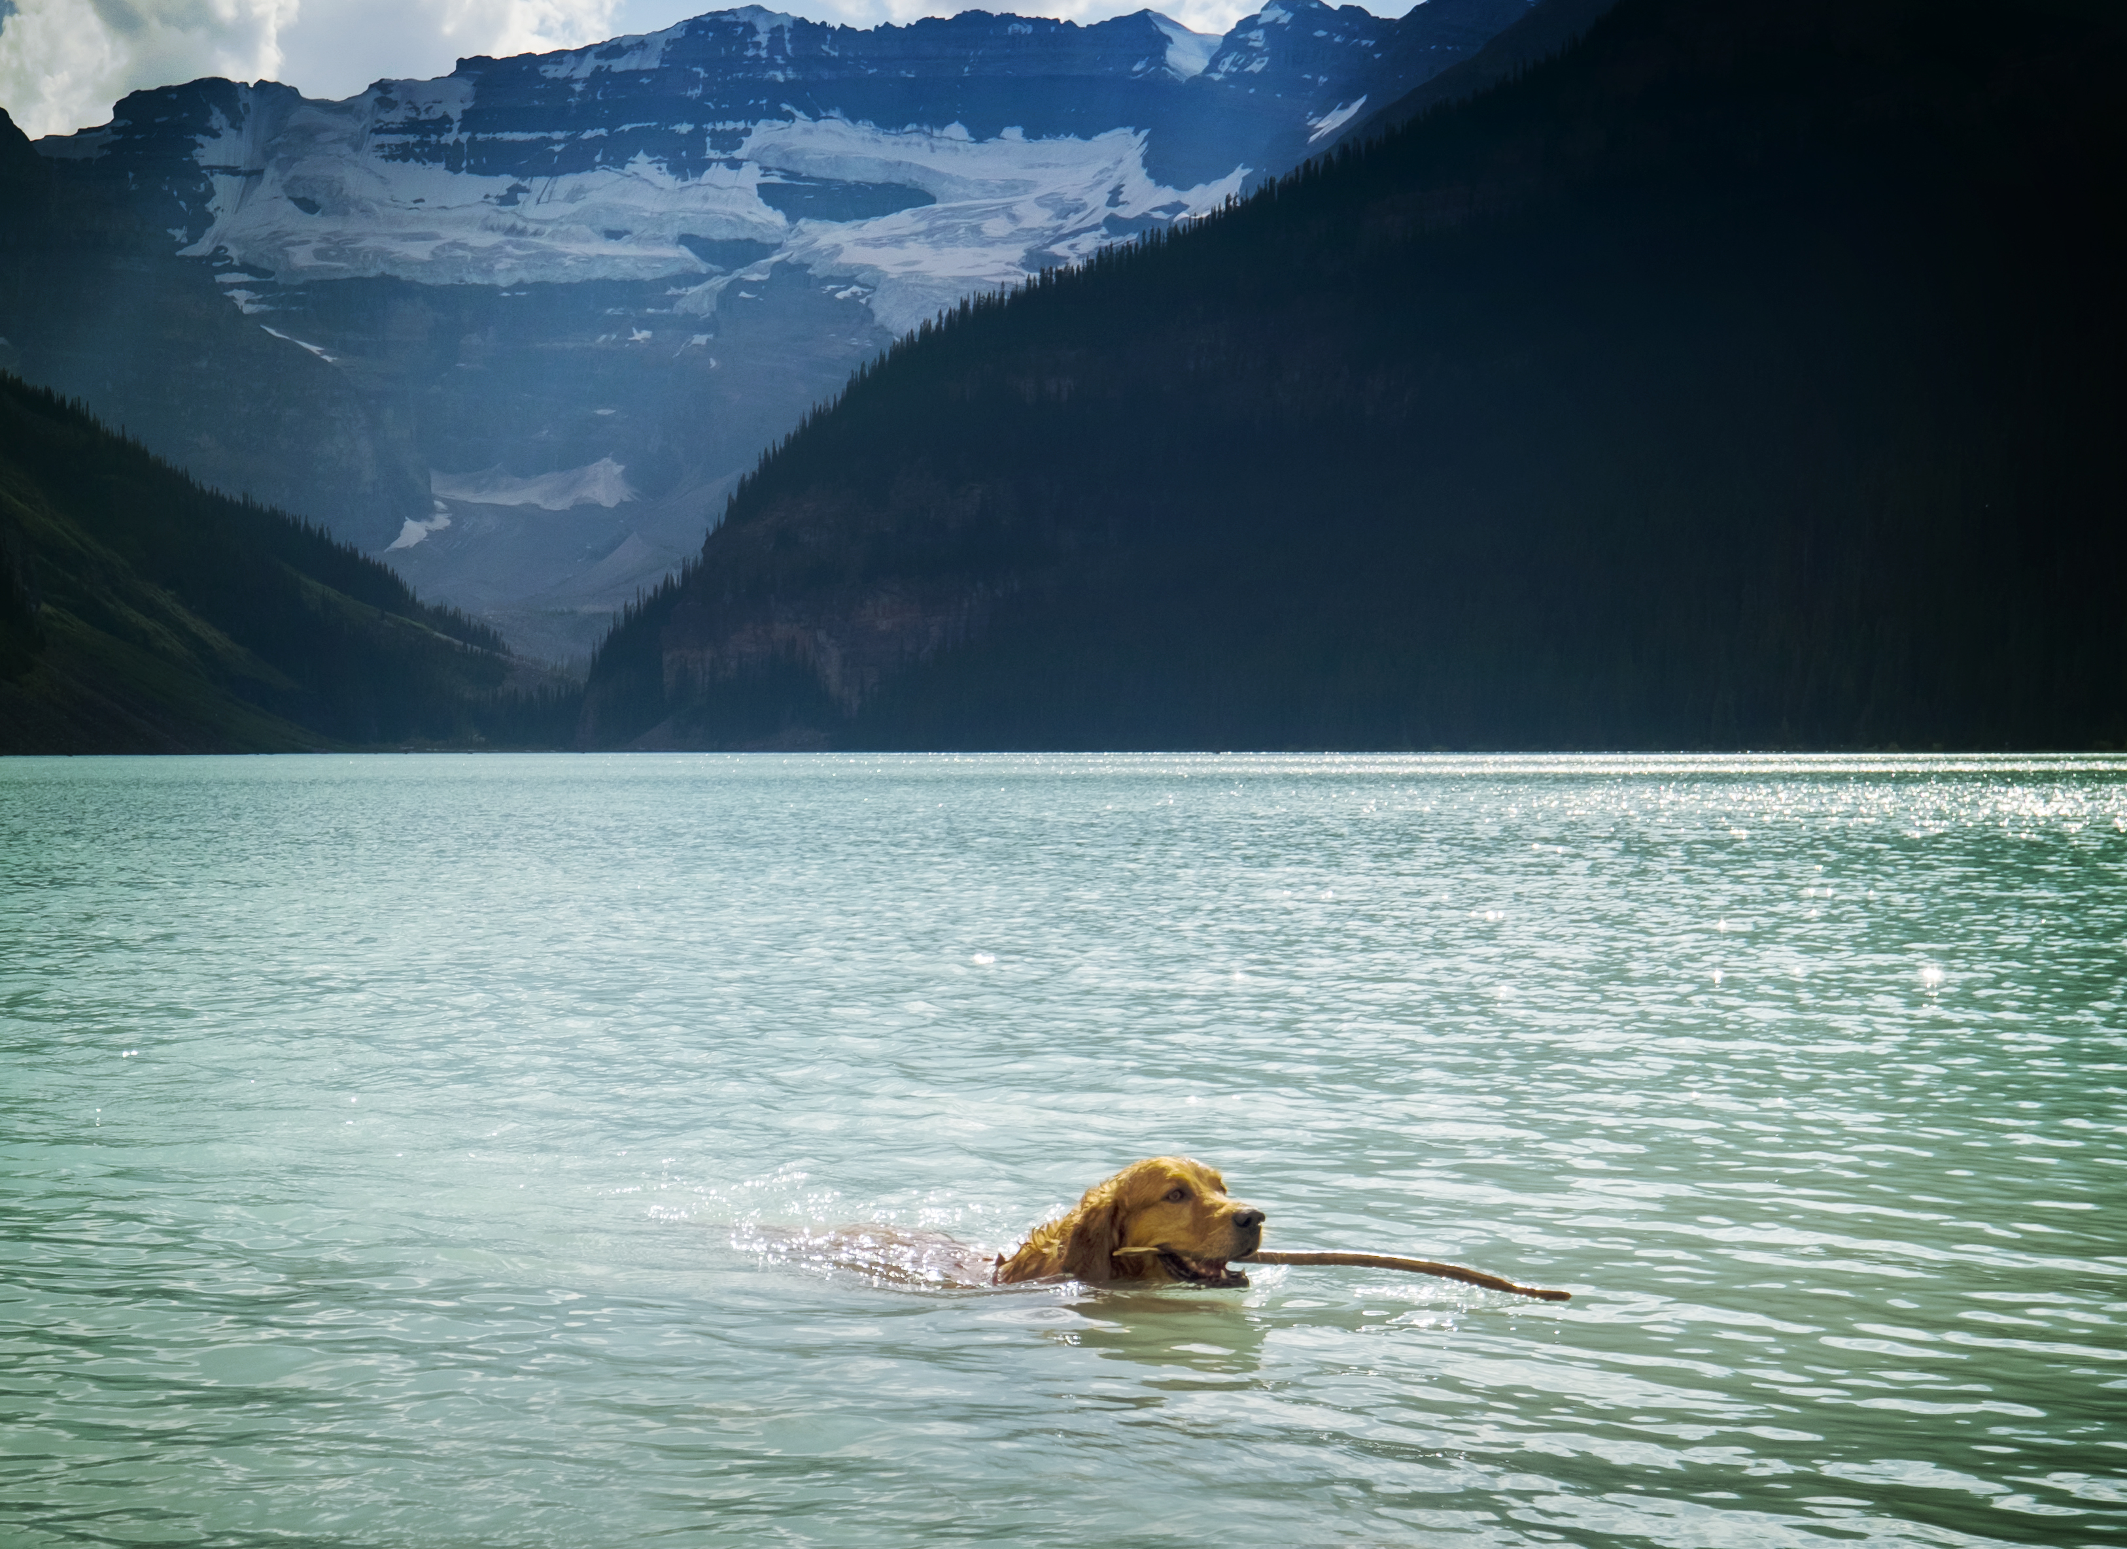
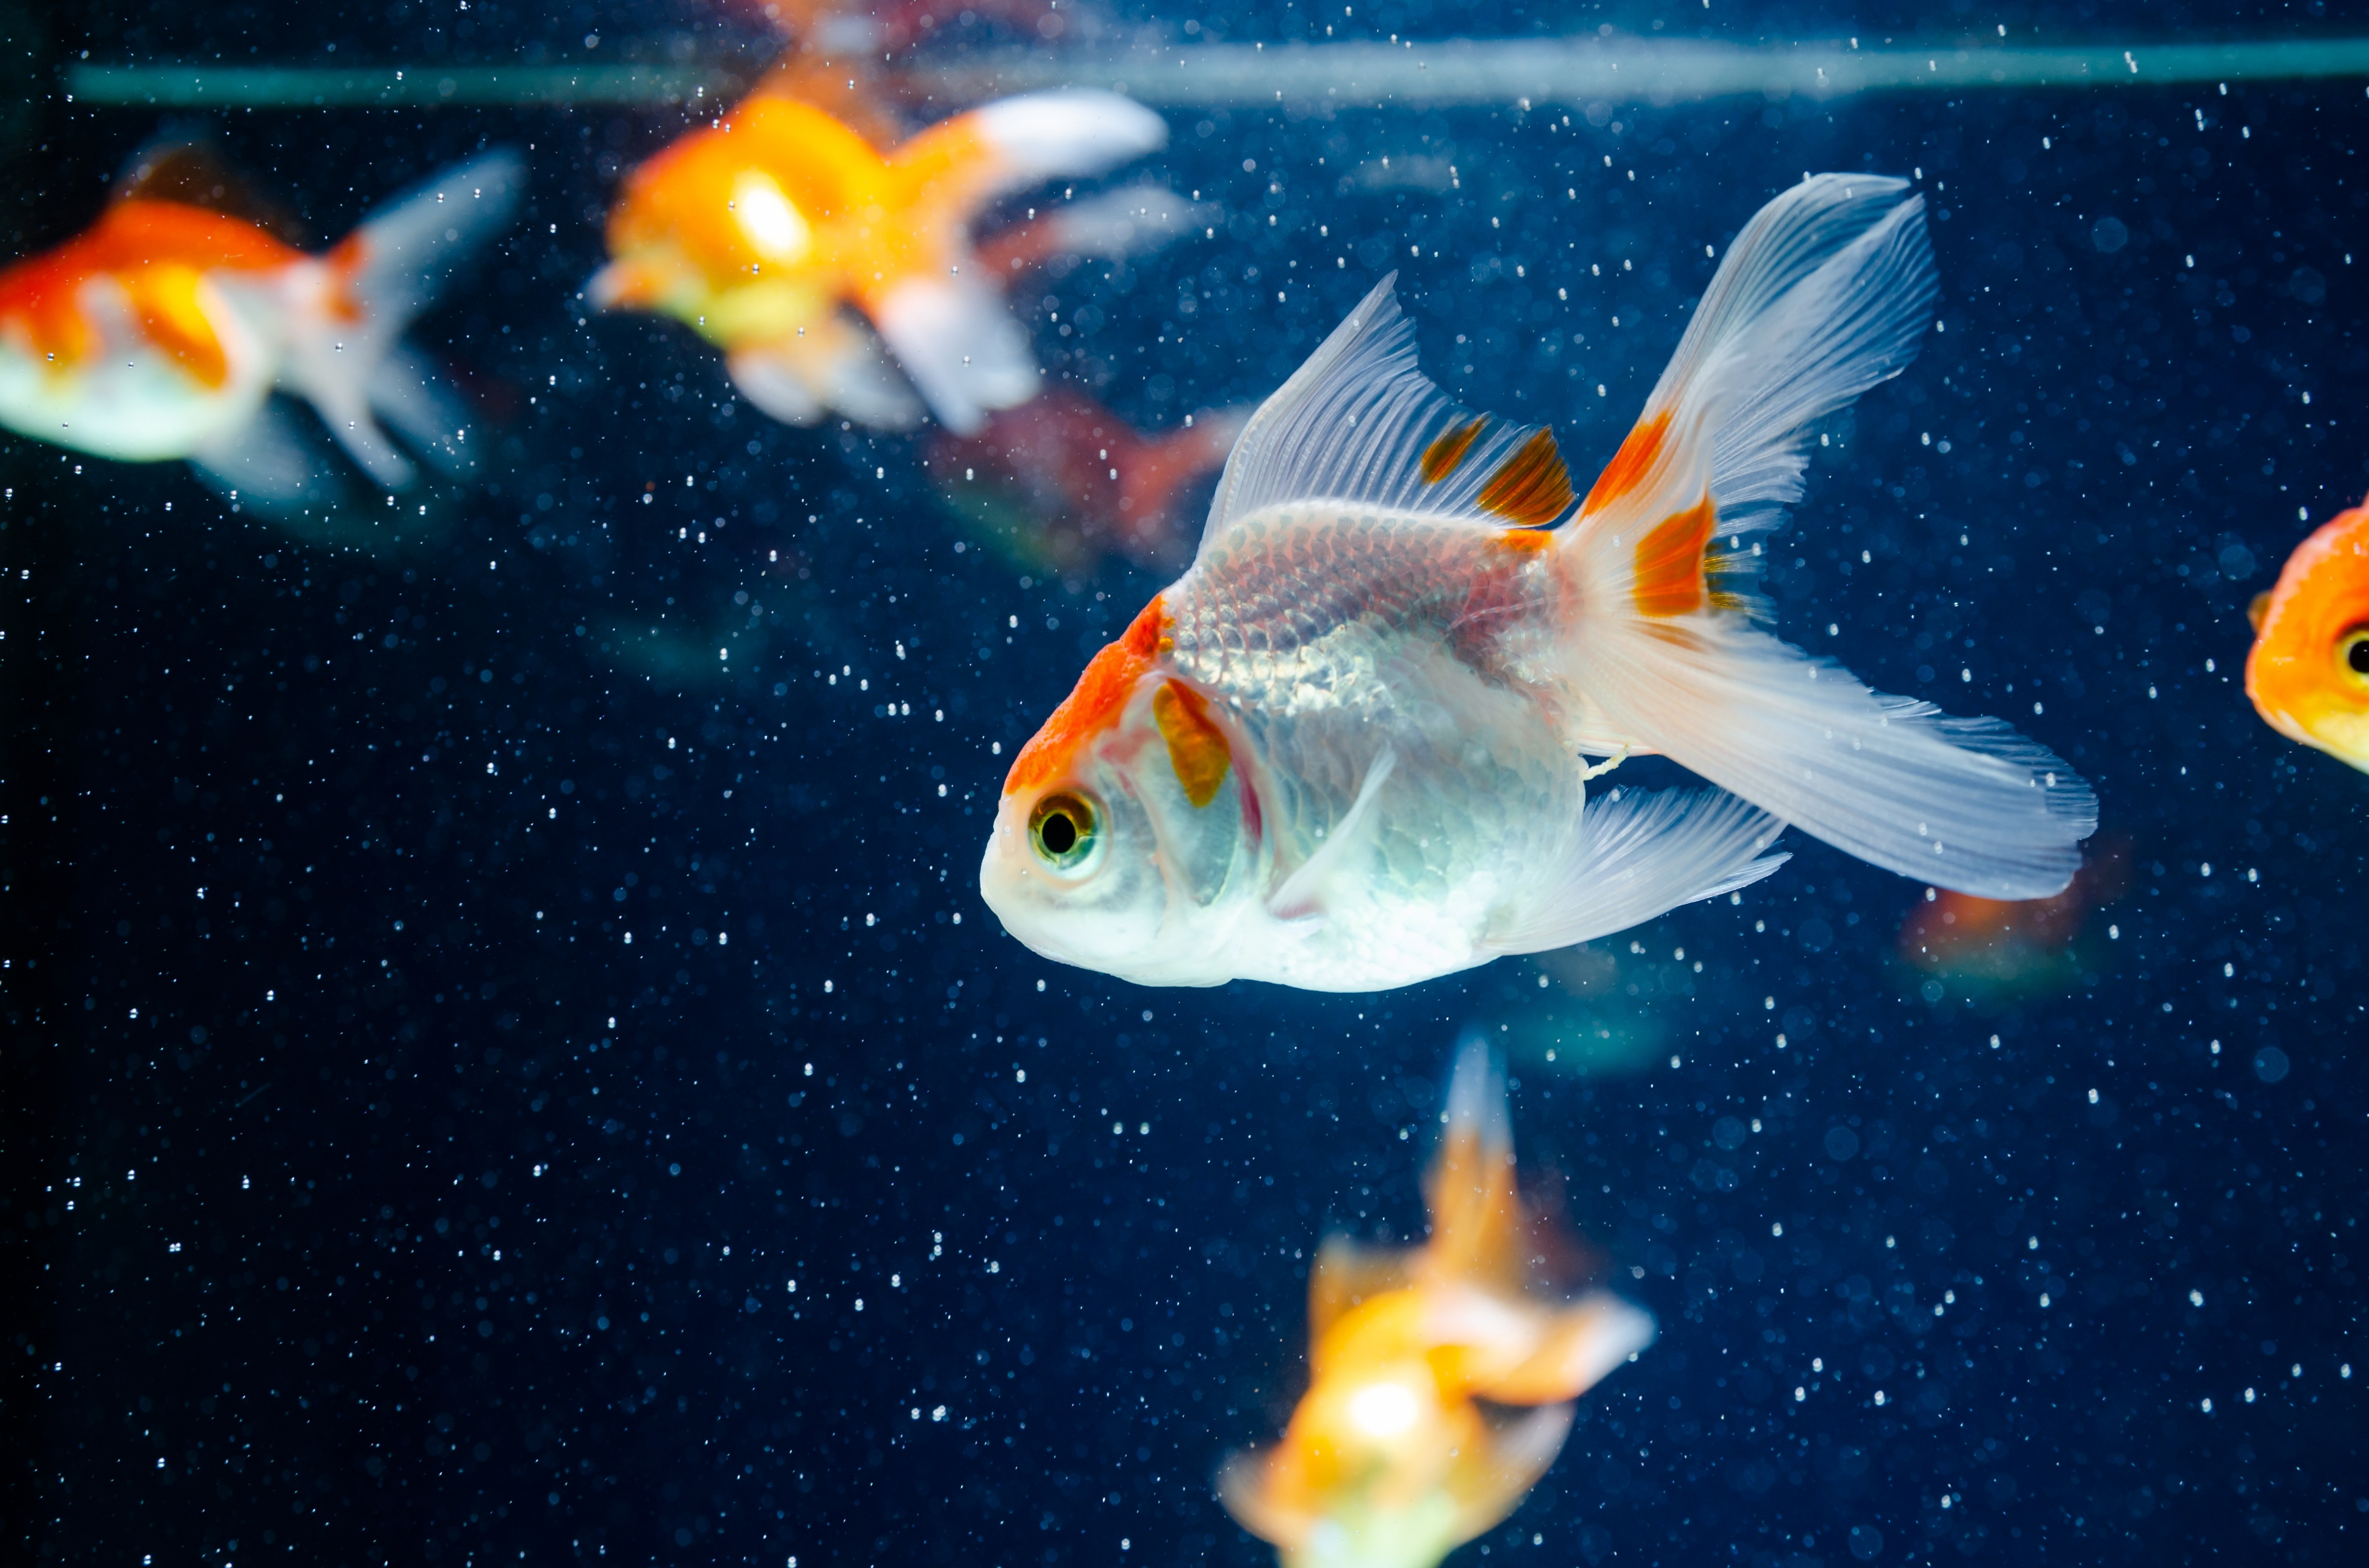
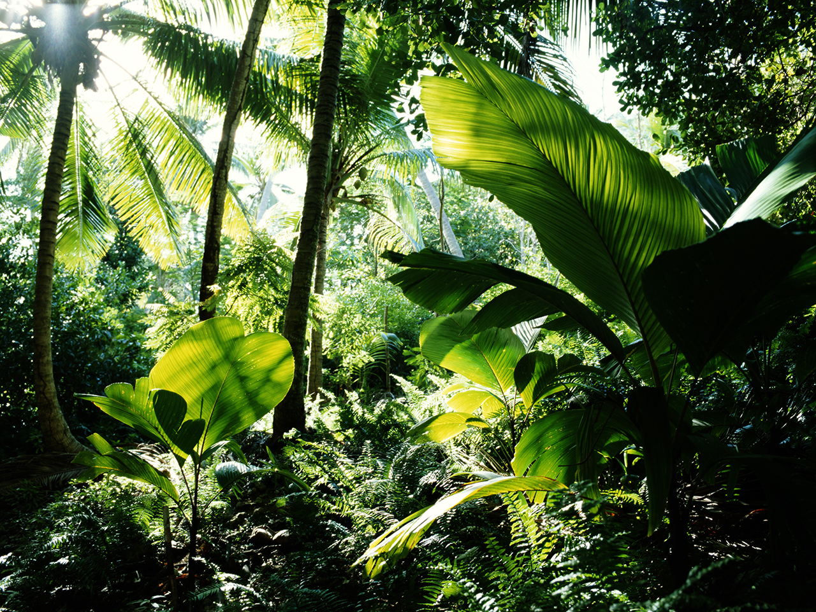
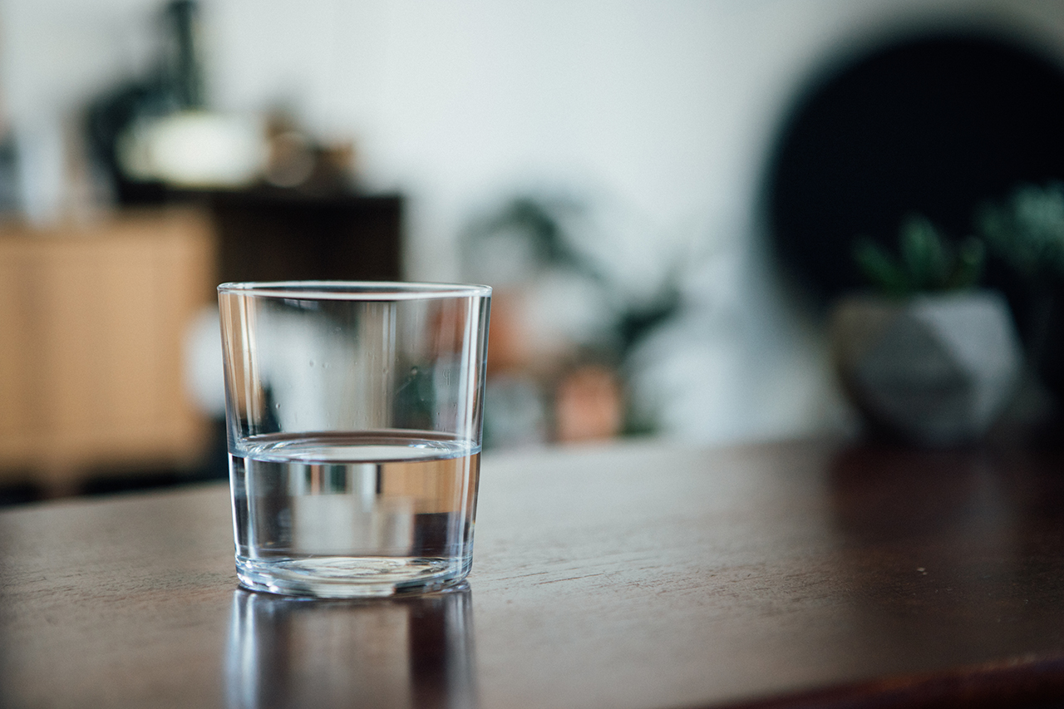

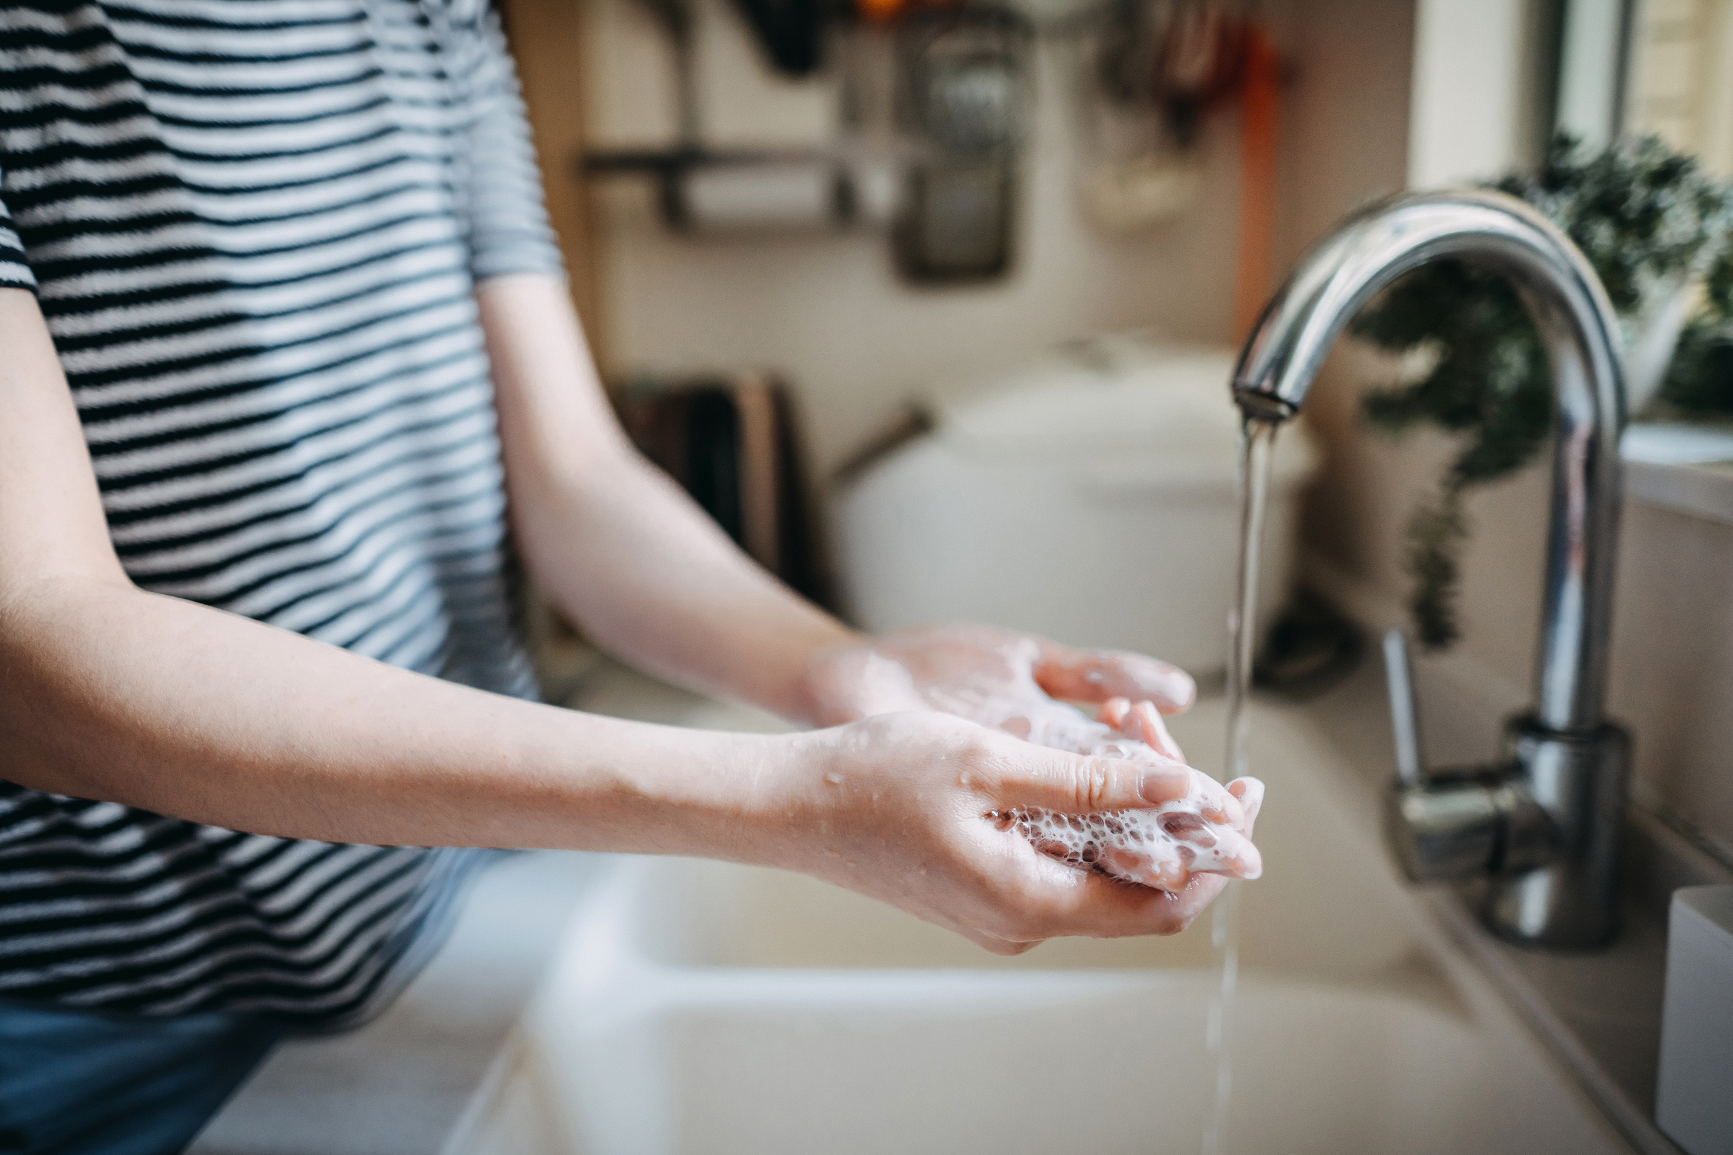
What would life be like without water?
No Trees!
No Swimming!
No Fish!
No Drinking Water!
No Flowers!
No Staying Clean!

Slide 7
Time For a game!
The goal? Use as little water as possible!
Select a game piece and begin at “Start.”
You’ll start with 6 water droplet pieces.
On your turn, roll the dice and move forward.
Pick up a card and follow the directions. If you have a water-saving behavior card, you’ll get to move forward and gain water droplet pieces! If you have a water-wasting behavior card, you’ll move backwards and lose water droplet pieces.
You may share water droplets with your teammates if they run out!
How to Win: Be the first to make it to Beaver Creek Wastewater Treatment Plant. - Or –
Have the most water droplets left at the end of the game.

Slide 8
What can you do to use less water every day?

Slide 9
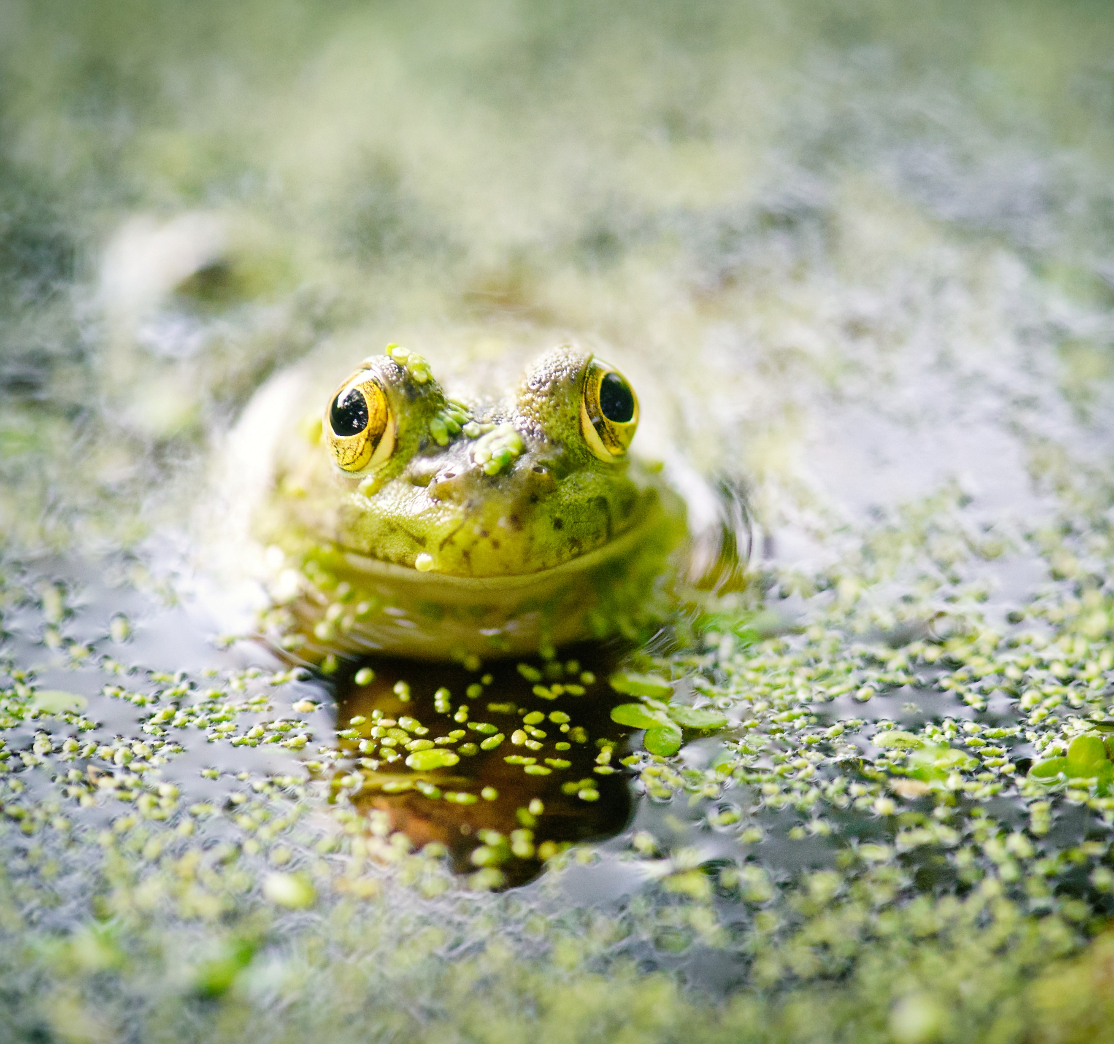
What can you do to use less water every day?
Take shorter showers!
Turn off the faucet while brushing your teeth!
Only flush when necessary (and only flush the 3 P’s – Pee, Poo, and Toilet Paper
Have leftover water? Water your plants!
Use only what you need!

Slide 10
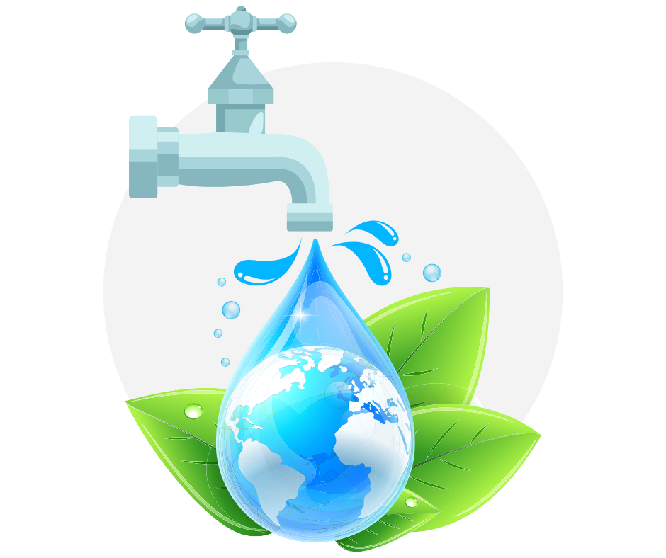
The Important Work of Hallsdale-Powell Utility District
Every day, millions of gallons of used water flow into the wastewater treatment plant. It is crucial that the water is treated before being released back into the nearby Beaver Creek. Water is treated before it enters your home and after it leaves. This ensures that we have safe, clean water and that we protect the environment.

Slide 11
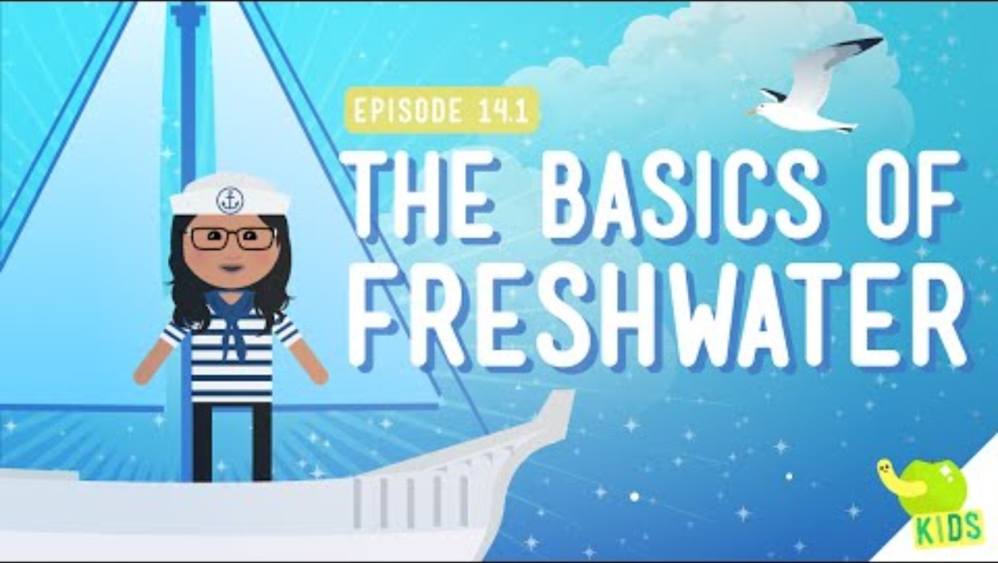
Link: https://www.youtube.com/watch?v=oaQCiwzjnCM
Notes:
https://www.youtube.com/watch?v=zNdbj3PbX6o

